Slide 1

water framework directive
Slovenia

Slide 2

Slovenia adds water to constitution as fundamental right for all (november 2016)
Parliament adopts amendment that declares country’s abundant clean supplies are ‘a public good managed by the state’ and ‘not a market commodity’

Slide 3
First EU country to add water to the constitution
Prime minister Miro Cerar:
We should protect water – the 21st century’s liquid gold – at the highest legal level.
Slovenian water has very good quality and, because of its value, in the future it will certainly be the target of foreign countries and international corporations’ appetites.
As it will gradually become a more valuable commodity in the future, pressure over it will increase and we must not give in.

Slide 4
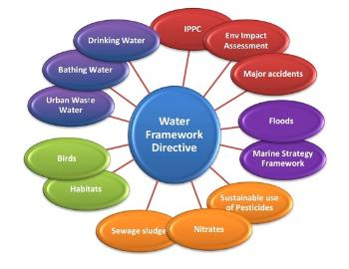
Main objectives of the water framework
To reduce harmful effects on the water
To provide water of appropriate quality for people and natural ecosystems
To preserve biotic diversity

Slide 5
Impementation of wfd into legislation
2002: Waters act
Responsible ministry: Ministry of Agriculture, Forestry and Food
National programe of water management: objectives, priorities
Funding: national water fund; national and municipality funds, EU cohesion and regional fund
Some issues pointed out by EC

Slide 6
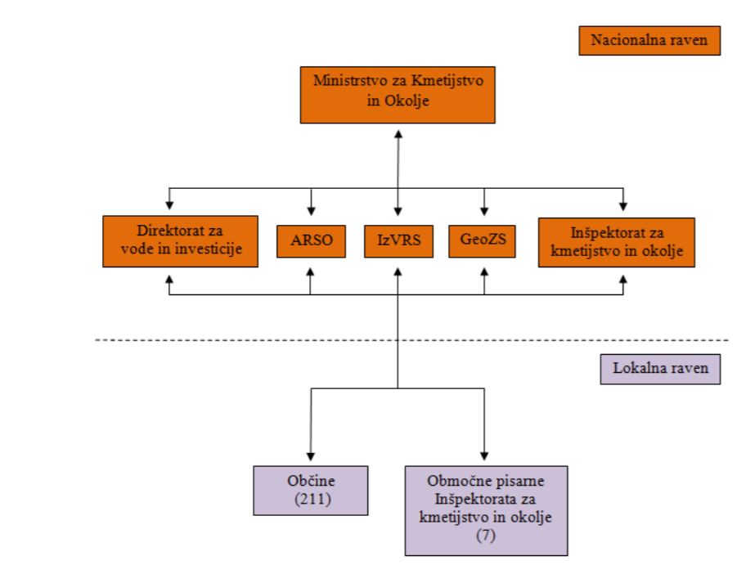

Slide 7
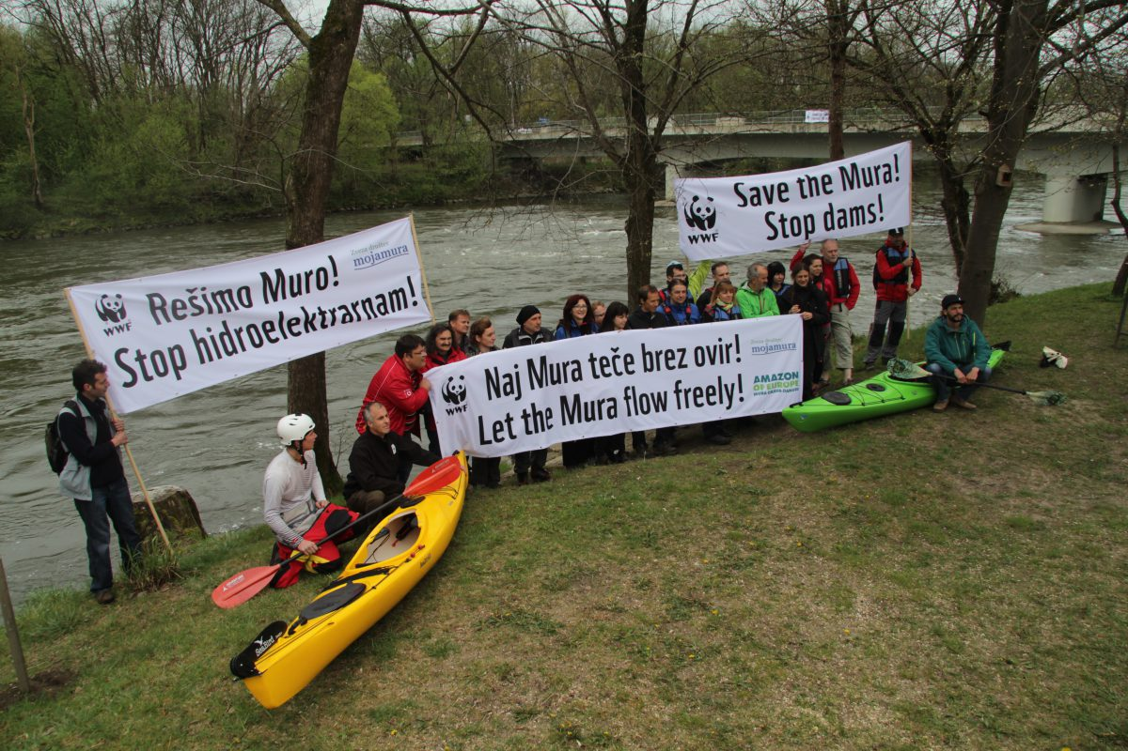
issues
Mura river – hydro power plants – renewable energy vs. Environment
Environmentalist claim the plans are against EU law

Slide 8

Tap water campaign

Slide 9
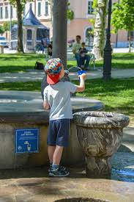
Ljubljana

