Slide 1

Water Framework Directive:
United Kingdom
Bridging to the Future

Slide 2

UK Water Legislation
UK water management is dealt at a regional level:
  The Water Environment (Water Framework Directive) England and Wales Regulations 2003
  The Water Environment (Water Framework Directive) Scotland Act 2003
  The Water Environment (Water Framework Directive) Northern Ireland Regulations 2003
Competent Agencies in the UK
  Environment Agency (England and Wales)
  Scottish Environment Protection Agency (SEPA)
  Northern Ireland Environment Agency (NIEA)

Slide 3
How it works
UK Water companies have been private entities since 1989
→ the extent they implement good environmental practice depends on their revenue (i.e. Prices they set).

Slide 4
Implementation
Step 1: How is the price set
  Water companies submit their financial performance and annual business plan to OFWAT, the government agency that regulates water tariffs, in the June Return(JR)
  Based on the JR, OFWAT release their Price Review, i.e. Setting the prices water companies can charge

Slide 5
Implementation
Step 2: How do water companies implement the WFD and its River Basin Management Plan (RBMP)
  Based on the PR, water companies will create their Asset Management Plan (AMP)
    AMP = plan on how to maintain and renovate their assets through tendered contracts
    AMPs are done in 5 year cycles, we are currently in AMP6 (started in April 2015)
  AMPs should be in line with the RBMP and approved by the Environmental Agency

Slide 6
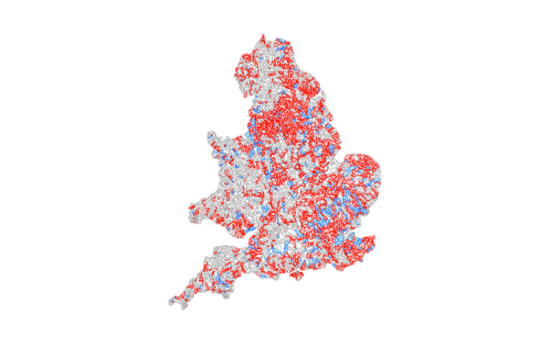
Results
Failures to Implement WFD standards, 2013 (could not verify source of map)

Slide 7
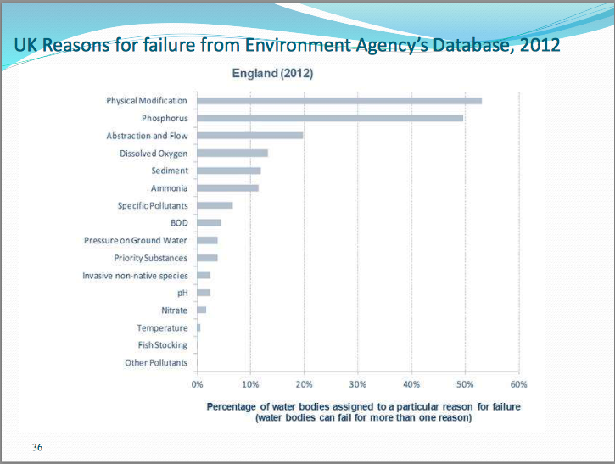
Results
Reasons for negative results according to Environmental Agency (2012):

Slide 8
Results
The RBMP are challenging to the UK
  because the AMPs are out of step with RMBP
    AMP = 5 year plan (last started in April 2015)
    RMBP = 6 year plan (last started in December 2015)
  Therefore, the capital expenditure to meet the RMBP targets will only be met in AMP 7 (Starts April 2020)
Notes:
http://wwtonline.co.uk/features/digging-deeper-the-water-framework-directive-and-brexit#.WbFakq2ZORs
The RMBP are challenging to the UK to achieve the WFD compliance because the UK has a five year investment cycle, known as the Asset Management Programmes (AMPs)
Out of step with six-year cycles of the RBMPs
As a result of this mismatch is that most capital expenditure required to comply will be undertaken the 7th AMP cycle (from april 2020 to March 2025)
So, difficult aims, like removing priority substances (affecting 700 wastewater treatment works in the UK) will have to wait until AMP7
Price review are set by the OFWAT through consultation, that then becomes the basis for the AMPs
UK Government Science and Technology Select Committee determined that implementing the WFD in the UK could cost as much as £30bn + 30m per annum
Criticism is that there is little visibility for the water corporates on Price Reviews
Creation of the WFD – UK collaborative approach for UK companies to share and work together.

Slide 9

Case Study
https://www.gov.uk/government/news/thames-water-ordered-to-pay-record-20-million-for-river-pollution
Strict implementation?
Thames Water Utilities fined record £20 million for a seried of pollution incidents on the River Thames
6 cases between 2012 to 2014
Environmental damage, sewage visible along 14km, death of wildlife, disruptions to farmers and business.

Slide 10
Case Study: Burberry
2020 target of eliminating the use of chemicals witha negative environmental impact
Work in collaboration with the Zero Discharge of Hazardous Chemicals Group
Set standards, guidelines and reporting templates for their supply chain
  80% of their suppliers have published their data on hazardous chemicals
Removed all PFCs
GreenPeace Detox Catwalk: Evolution Stage

