Slide 1
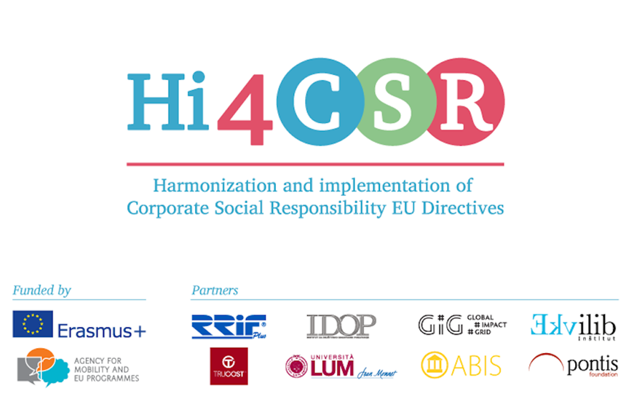
The Water Framework Directive: Directive 2000/60/EC SLOVAKIA
Tatiana Čaplová / Pontis Foundation
tatiana.caplova@pontisfoundation.sk
September 14 / 2017 / Brussels

Slide 2
CONTENT
Statistics
State of Implementation (Directive 2000/60/EC) in Slovakia
Slovak National Legislation
Example of Good Practice
Q &A

Slide 3
STATISTICS
Flash Eurobarometer on Water (2012): Attitudes of Europeans towards water – related Issues

Slide 4
STATISTICS
Flash Eurobarometer on Water (2012): Attitudes of Europeans towards water – related Issues

Slide 5
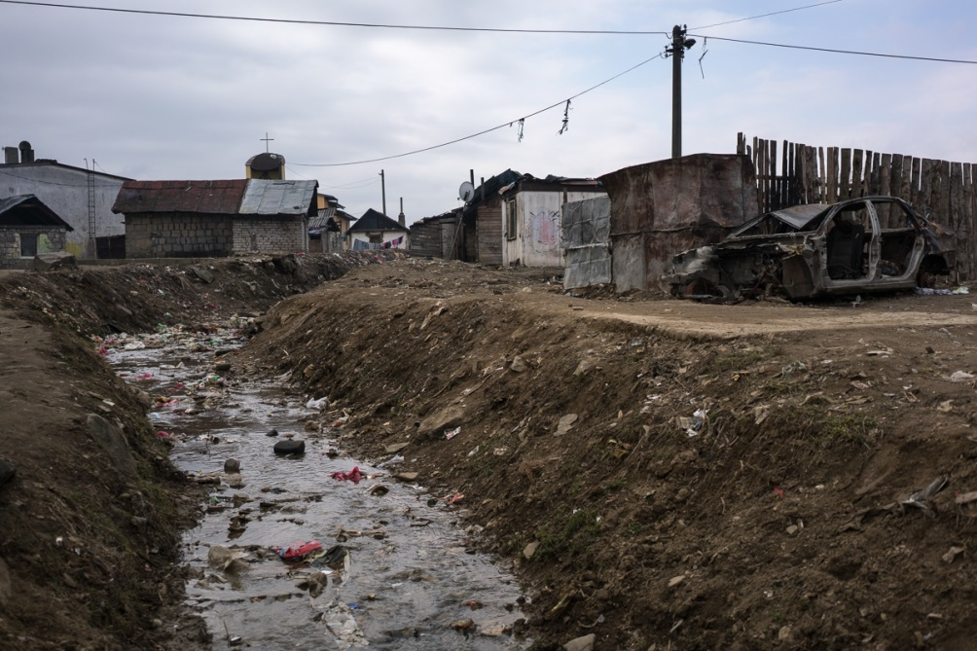
STATISTICS
Flash Eurobarometer on Water (2012): Attitudes of Europeans towards water – related Issues
90% of Slovaks think that the main threat to to the water environment is chemical pollution. This concern has increased in almost all EU countries.
69 % of Slovaks thins that quality of water is a serious problem in our country (EU average - 68 %)

Slide 6
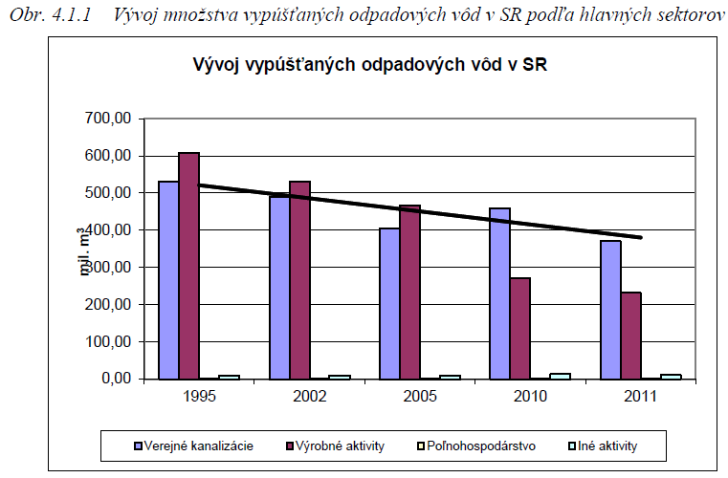
STATISTICS
Trend of discharged waste water volumes in Slovakia
Public swage system Production activities Agriculture Others
Source: Water plan of Slovak republic, 2015

Slide 7
STATE OF IMPLEMENTATION
Water Framework Directive Implementation Strategy in the Slovak Republic
Administrative capacities for the implementation of WFD requirements
WFD requires creation of river basin districts1 and appointment of the competent authority responsible for its implementation in the framework of each river basin district. Pursuant to the Act No. 364/2004 Coll. on waters, amending the Act No. 372/1990 Coll. of the Slovak Parliament on violation, as amended (Water Act), as amended, as amended by the Act No. 384/2009 Coll. (hereinafter as the Act No. 364/2004 Coll. On waters, as amended by the Act No. 384/2009 Coll.), two river basin districts are designated on the national level under conditions of the SR. Namely, the Danube River Basin District (96 % of the SR territory), which belongs to the international Danube River Basin District, and which is determined by sub-basins of rivers Danube, Morava, Váh, Hron, Ipeľ, Slaná, Bodrog, Hornád and Bodva, and the Vistula River Basin District, determined by subbasin of rivers Dunajec and Poprad (4 % of the SR territory).
Source: Water plan of the Slovak republic, 2010

Slide 8
STATE OF IMPLEMENTATION
Water Framework Directive Implementation Strategy in the Slovak Republic
Administrative capacities for the implementation of WFD requirements
River basin management plans are elaborated in compliance with the Water Act in force in the Slovak Republic for the following:
a) sub-basins (Morava, Danube, Váh, Hron, Ipeľ, Slaná, Bodva, Hornád, Bodrog, Dunajec and Poprad),
b) Water Plan of the Slovak Republic – consisting of management plans of the national districts of rivers Danube and Vistula2.
In addition to the national management plans, SR contributes to the development of the international plans coordinated by the International Commission for Protection of the Danube River (ICPDR), namely:
– International Danube river basin district – addressing the issues relevant for Danube,
– International Tisza river basin – addressing the issues relevant for Tisza.
Source: Water plan of the Slovak republic, 2010

Slide 9
STATE OF IMPLEMENTATION
Water Framework Directive Implementation Strategy in the Slovak Republic
Water Framework Directive Implementation Strategy in the Slovak Republic was developed for the national level that was adopted by the resolution of the Government of the Slovak Republic No. 46/2004 of January 21, 2004, and that is annually updated, resulting in more detailed plan of tasks for next two years.
This strategy is in full compliance with the EU strategy and strategy of International Commission for Protection of the Danube River.
The cooperation with EU is in the Ministry of Environment SR coordinated by the Division of Environmental Policy and Foreign Affairs. Water Division that is responsible for the implementation of obligations towards EC coordinates WFD implementation.
Process of development of river basin management plans
Whole WFD implementation process is scheduled for the time period of years 2003 – 2027, with more detailed definition of tasks for fulfilment in the first planning cycle ending up in year 2015 by revision of the achievement of environmental objectives.
Source: Water plan of the Slovak republic, 2010

Slide 10
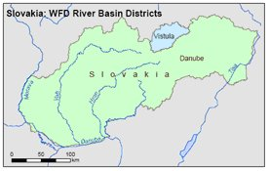
STATE OF IMPLEMENTATION
1st RBMPs (2009-2015)
Slovak Republic has 2 river basin districts, out of which 2 are international sharing water courses with Austria to the west, Poland and Czech Republic to the north and Hungary to the South.
Consultation on the draft River Basin Management Plans took place between 23 January 2009 and 22 July 2009
The Water Management Plan (River Basin Management Plan) of the Slovak Republic was approved by the Government on February 10, 2010, and is available on the web page of the Ministry of Environment of the Slovak Republic. The Water plan of the Slovak Republic was elaborated in the framework of the first WFD planning cycle ending up in year 2015. Further two planning cycles will follow after year 2015, ending up in years 2021 and 2027.
The Commissions assessment of the Slovak River Basin management plans is now available here :
SWD(2012)379 Volume 28/30 - English version
Source: http://ec.europa.eu/environment/water/participation/map_mc/countries/slovakia_en.htm

Slide 11
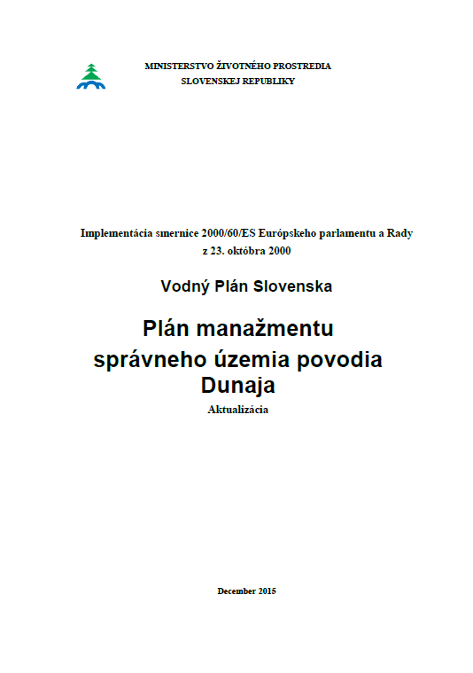
STATE OF IMPLEMENTATION
2nd RBMPs (2016-2021)
The 2nd RBMPs were adopted on 13 January 2016.
A new Water plan of the Slovak republic -> December 2015 (503 pages ☺ )
Source: http://ec.europa.eu/environment/water/participation/map_mc/countries/slovakia_en.htm

Slide 12
NATIONAL LEGISLATION
WFD – National transposition
Zákon č. 364/2004 Z. z. o vodách a o zmene zákona Slovenskej národnej rady č. 372/1990 Zb. o priestupkoch v znení neskorších predpisov (vodný zákon) Official publication: Zbierka zákonov SR; Number: 153; Publication date: 2004-06-24
Vyhláška Ministerstva životného prostredia Slovenskej republiky č. 224/2005 Z. z., ktorou sa ustanovujú podrobnosti o vymedzení oblasti povodí, environmentálnych cieľoch a o vodnom plánovaní Official publication: Zbierka zákonov SR; Number: 98; Publication date: 2005-05-31
Zákon č. 384/2009 Z. z., ktorým sa mení a dopĺňa zákon č. 364/2004 Z. z. o vodách a o zmene zákona Slovenskej národnej rady č. 372/1990 Zb. o priestupkoch v znení neskorších predpisov (vodný zákon) v znení neskorších predpisov a ktorým sa mení a dopĺňa zákon č. 569/2007 Z. z. o geologických prácach (geologický zákon) v znení zákona č. 515/2008 Z. z. Official publication: Zbierka zákonov SR; Number: 139; Publication date: 2009-10-08
Zákon č. 7/2010 Z. z. o ochrane pred povodňami Official publication: Zbierka zákonov SR; Number: 3; Publication date: 2010-01-12
Vyhláška Ministerstva pôdohospodárstva, životného prostredia a regionálneho rozvoja Slovenskej republiky č. 418/2010 Z. z. o vykonaní niektorých ustanovení vodného zákona Official publication: Zbierka zákonov SR; Number: 159; Publication date: 2010-11-10
Zákon č. 409/2014 Z. z., ktorým sa mení a dopĺňa zákon č. 364/2004 Z. z. o vodách a o zmene zákona Slovenskej národnej rady č. 372/1990 Zb. o priestupkoch v znení neskorších predpisov (vodný zákon) v znení neskorších predpisov a ktorým sa dopĺňa zákon č. 401/1998 Z. z. o poplatkoch za znečisťovanie ovzdušia v znení neskorších predpisov Official publication: Zbierka zákonov SR; Number: 116; Publication date: 2014-12-31
Vyhláška Ministerstva životného prostredia Slovenskej republiky č. 212/2016 Z. z., ktorou sa mení a dopĺňa vyhláška Ministerstva pôdohospodárstva, životného prostredia a regionálneho rozvoja Slovenskej republiky č. 418/2010 Z. z. o vykonaní niektorých ustanovení vodného zákona Official publication: Zbierka zákonov SR; Publication date: 2016-07-13
Source: http://eur-lex.europa.eu/legal-content/EN/NIM/?uri=CELEX%3A32000L0060

Slide 13
NATIONAL LEGISLATION
Slovak national strategy in the area of water protection
Stratégia pre implementáciu rámcovej smernice o vode v Slovenskej republike, ktorá bola
schválená uznesením vlády SR č. 46/2004 z 21. januára 2004;
Stratégia, zásady a priority štátnej environmentálnej politiky, schváleného uznesením Národnej
rady SR č. 339/1993 a uzneseniami vlády SR č. 619/1993, č. 894/1993 a č. 531/1994;
Národná stratégia trvalo udržateľného rozvoja (NSTUR), schválenej uznesením Národnej rady
SR č. 1989/2002 a uznesením vlády SR č. 978/2001;
Národná stratégia regionálneho rozvoja SR (NSRR, schválená uznesením vlády SR č.
222/2014);
Stratégia adaptácie SR na zmenu klímy;
Koncepcia územného rozvoja Slovenska 2011 (schválenú uznesením vlády SR č. 513/2011);
Vodný plán Slovenska (VPS, schválený uznesením vlády SR č. 109/2010);
Plány manažmentu povodňového rizika;
Plán rozvoja verejných vodovodov a verejných kanalizácií pre územie Slovenskej republiky;
Aktualizovaná národná stratégia ochrany biodiverzity do roku 2020 (schválená uznesením
vlády SR č. 12/2014).
Source: Water plan of Slovak republic, 2010

Slide 14
ASSESSMENT
Slovakia: Assessment of Member States’ progress in the implementation of Programmes of Measures during the first planning cycle of the Water Framework Directive (March 2015)
Main achievements
Basic measures are being implemented. Most of the other basic measures and supplementary measures are ongoing, some have been completed and some not started. The measures requiring construction are often delayed because the necessary finances exceed the available state budget. The missing financial means will be secured primarily by setting appropriate priorities in the new EU funding policy 2014-2020.
In terms of ecological status in Slovakia, 64.6% of water bodies were reported to be good or better in 2009, which was expected to increase by 0.2% to 64.8% by 2015. In 2009, 95.9% of natural surface water bodies were at good chemical status and this was expected to increase to 100% in 2015. In Slovakia as a whole, 61.4% of groundwater bodies were reported to be at good chemical status in 2009, and this number was not expected to increase any further by 2015. 69.3 % of groundwater bodies were reported to be at good quantitative status in 2009, increasing to 74.3% in 2015.

Slide 15
ASESSMENT
Slovakia: Assessment of Member States’ progress in the implementation of Programmes of Measures during the first planning cycle of the Water Framework Directive (March 2015)
Main obstacles
The measures requiring construction are often delayed because the necessary finances exceed the available state budget. The missing financial means will be secured primarily by setting appropriate priorities in the new EU funding policy 2014-2020. As far as the Urban Waste Water Treatment Directive (91/271/EEC) is concerned, the Slovak government creates good conditions for the construction of measures but the progress in implementation depends mainly on the owners of the infrastructure.
Overall Progress
Basic measures are under implementation. Most of the other basic measures and supplementary measures are ongoing, some have been completed and some not started. The measures requiring construction are often delayed because the necessary finances exceed the available budget. The missing financial means will be secured primarily by setting appropriate priorities

Slide 16
RECOMMENDATIONS
Recommendations for Slovakia (selection):
Ensure good coordination between public administration and other stakeholders to improve the planning and implementation of PoMs and to monitor their effectiveness, i.e. a more detailed implementation plan for the PoMs and information about the control mechanisms should be included in the 2nd RBMPs cycle. Furthermore, Slovakia should ensure effective coordination between WFD and FD.
 Complete the monitoring framework, as an adequate WFD-compliant monitoring and assessment framework is a necessary pre-requisite to design effective PoMs and ultimately to achieve the WFD objectives.
 Ensure in the 2nd RBMPs that measures adopted in the PoMs are based on a reliable status assessment of water bodies and are linked to the relevant pressures. The explanation of the links between pressures and status and respective measures should be included in the update of the RBMPs. In the 2nd RBMP cycle, Slovakia should consider supplementary measures for RBSPs and priority substances that show exceedances.
 Ensure that the quantitative assessment of how much the pressures have to be reduced to achieve the WFD objectives is clearly identified in RBMPs. The gap that needs to be closed for the achievement of WFD objectives by 2015 (or later) has to be clearly quantified in terms of the reductions needed in the pressures causing water bodies to fail, or be at risk of failing, the environmental objectives. The applied Environmental Quality Standards (EQS) should be specified in the 2nd RBMPs. The identified impacts have to be clearly apportioned between the sources and sectors/drivers responsible for the pressures for all significant water management issues.
.......
Source: COMMISSION STAFF WORKING DOCUMENT: Report on the progress in implementation of the Water Framework Directive Programmes of Measures (March 2015)

Slide 17
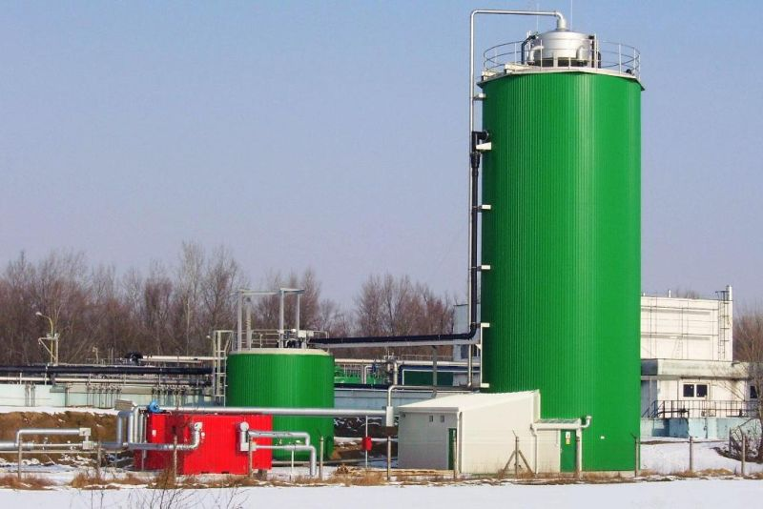
BEST PRACTICE
Best practice – Heineken Slovakia
the company has its own sewage water treatment plant in Hurbanovo and the biogas produced during the treatment process is then used for producing electricity.
„Thanks to our sewage water treatment plant,we can produce nearly 500,000 kilowatt hours of green electricity a year - twice as much as our administrative building consumes a year.“ Hana Šimková, Corporate Relations Manager in Heineken Slovakia
At the same time, thanks to another ecological water project (adjusting water by reverse osmosis), the brewery is able to save more than 35,000 m3 of water a year, which is approximately a yearly water consumption of 250 Slovak households.

Slide 18
Q & A
ANY QUESTIONS ?

Slide 19
THANK YOU
....for your attention.
Tatiana Čaplová
Program Coordinator
Pontis Foundation / Business Leaders Forum
tatiana.caplova@pontisfoundation.sk

