Slide 1

The importance of water

Slide 2
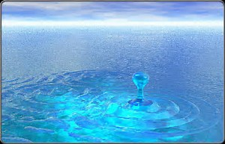
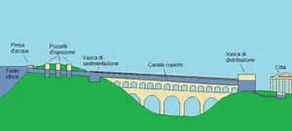
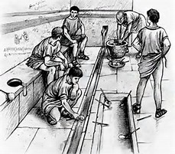

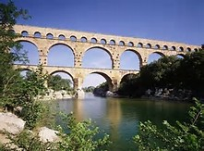
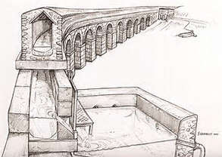
Roman times

Slide 3
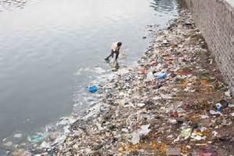
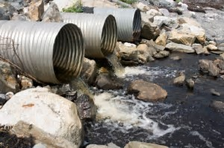
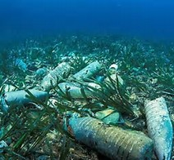
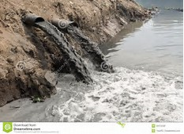
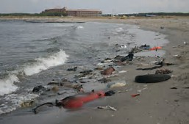
The destruction of the environment: water and our past ignorance

Slide 4
Some news:
Approximately 1,390 million cubic km
of which 97.5% is salt water in the seas and oceans
only 2.5% is "theoretically" potable water

Slide 5
Directive 2000/60/EC of the European Parliament and of the Council of 23 October 2000 establishing a framework for Community action in the field of water policy

Slide 6
Directive 2000/60 / EC (Water Framework Directive - DQA) establishing a framework for Community action in the field of water has introduced an innovative approach to European water legislation both from the environmental and administrative point of view and managerial. The directive pursues ambitious objectives: preventing qualitative and quantitative deterioration, improving water status and ensuring sustainable use, based on the long-term protection of available water resources. Directive 2000/60 / EC seeks to achieve the following general objectives:
• Extend the protection of both surface and underground water
• achieve the status of "good" for all waters by December 31, 2015
• manage water resources based on river basins regardless of administrative structures
• proceed through an action that combines emission limits and quality standards
• recognize all water services the right price that takes into account their real economic cost
make the citizens take part in the choices made in the matter.

Slide 7

WHAT THE DIRECTIVE PROVIDES
The Directive establishes that individual Member States deal with water conservation at the "catchment basin" level, and the territorial reference unit for river basin management is identified in the "river basin district", land and sea area, constituted by one or more adjacent river basins and their respective groundwater and coastal waters.
In each river basin district, Member States must strive to ensure that:
• an analysis of district characteristics
• An examination of the impact of human activities on surface and underground waters
an economic analysis of water use.
Regarding each district, a program of measures that takes into account the analyzes and environmental objectives set by the Directive, with the ultimate aim of achieving a "good state" of all waters by 2015 (unless specifically stated from the Directive).
Measure programs are set out in the Management Plans that Member States have to prepare for each river basin and therefore represents the programming / implementation tool for achieving the objectives set by the Directive.

Slide 8
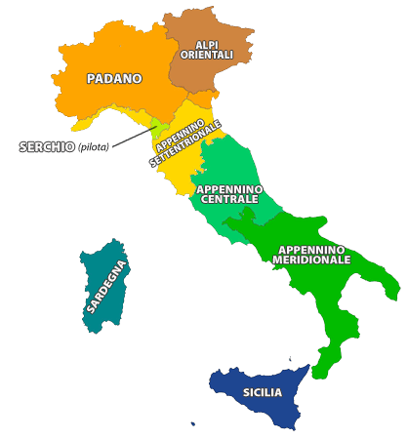
Directive 2000/60 / EC was transposed into Italy by Legislative Decree no. 152 of 3 April 2006. The Legislative Decree, Art. 64 has divided the national territory into eight river basin districts and for each district has been drafting a management plan, assigning it competence to the District Water Authority.

Slide 9
But in Italy …….
Even before the transposition of Directive 2000/60 / EC, however, the national legal order introduced Law No 183/89 on the concept of basin-scale planning, to be implemented through the implementation of the Basin Plans and anticipated an approach integrated with water protection through Legislative Decree 152/1999 which included a tool for planning measures to achieve environmental objectives in water, the elaboration by regions, the protection plans , drainage of basin plans.

Slide 10
The Community obligations regarding the development of management plans have been transposed into national law through the third part of Article 117 of Legislative Decree 152/2006 which, within the wider framework of district planning, provides for the obligation for each river basin district to adopt a Management Plan.
The current regulatory framework identifies several levels of planning, articulated as follows:
• For each of the 8 identified hydrographic districts, Legislative Decree 152/2006 (art.63) provides for the establishment of a district basin authority responsible for drafting the Management Plan (Article 117). The Management Plan is part of the District Basin Plan;
• Legislative Decree 152/2006 also lays down additional planning requirements, requiring the Regions to draw up a Protection Plan for their territory, which is a specific sectoral plan (Article 121). Aspects such as the status of water bodies and measures for the qualitative protection of water fall within the elements of the protection plan.
With respect to the spatial spheres of competence, the contents of the Protection Plans are broadly coincident with those of the management plan.
This implies that in the current regulatory environment, the Protection Plans - made and / or ongoing - represent an indispensable reference to the drafting of the Management Plan.

Slide 11
The management plan
The management plan is the instrument for achieving the objectives of Directive 2000/60 / EC (Article 13 of the DQA) to be set up for each river basin district within the national territory. The management plan can be supplemented by more detailed plans and plans for sub-basins, sectors, problems or water categories in order to address particular aspects of water management.
The contents of the River Basin Management Plans can be summarized as follows:
a general description of the district's characteristics;
the synthesis of pressures and impacts of human activities on surface and underground water bodies;
the list and the representation of protected areas;
the map of monitoring networks;
the list of environmental targets for all water bodies;
the synthesis of economic analysis;
the synthesis of measures programs (including more detailed information on sub-basins, sectors or specific issues, as well as measures taken for public participation);
the list of competent authorities and procedures for obtaining documentation and basic information.

Slide 12
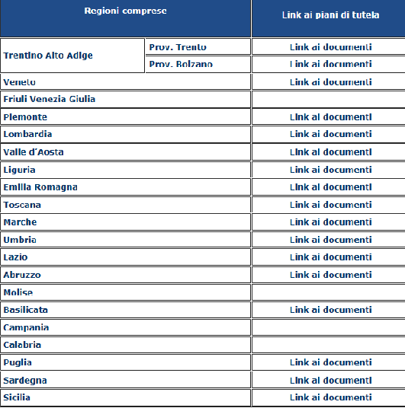
The protection plan
For each region there are different plans of protection, each of them referring to national legislation and therefore it is based on the European directive, but it follows the regional laws.
http://www.direttivaacque.minambiente.it/link_pianificazione_piani.html

Slide 13
What are the good practices in Italy?
I don’t know, I will find, I will research!!!
Unfortunately, at the moment, I do not find a good example of water conservation. my mind thinks of all the disasters that happen in Italy, precisely because of the poor management of rivers, lakes and torrents. In Italy there are territories that suffer from lack of water, while there are other territories that are hit by overturns that lead to destruction.
I'm sorry I can not give you a better vision here, but I have to look for something that can be a good Italian practice with regard to water protection and protection.

