Slide 1

Lecture on Corporate Social Responsibility
EU Water framework
The best practice in Germany
Boris Bulatovic

Slide 2
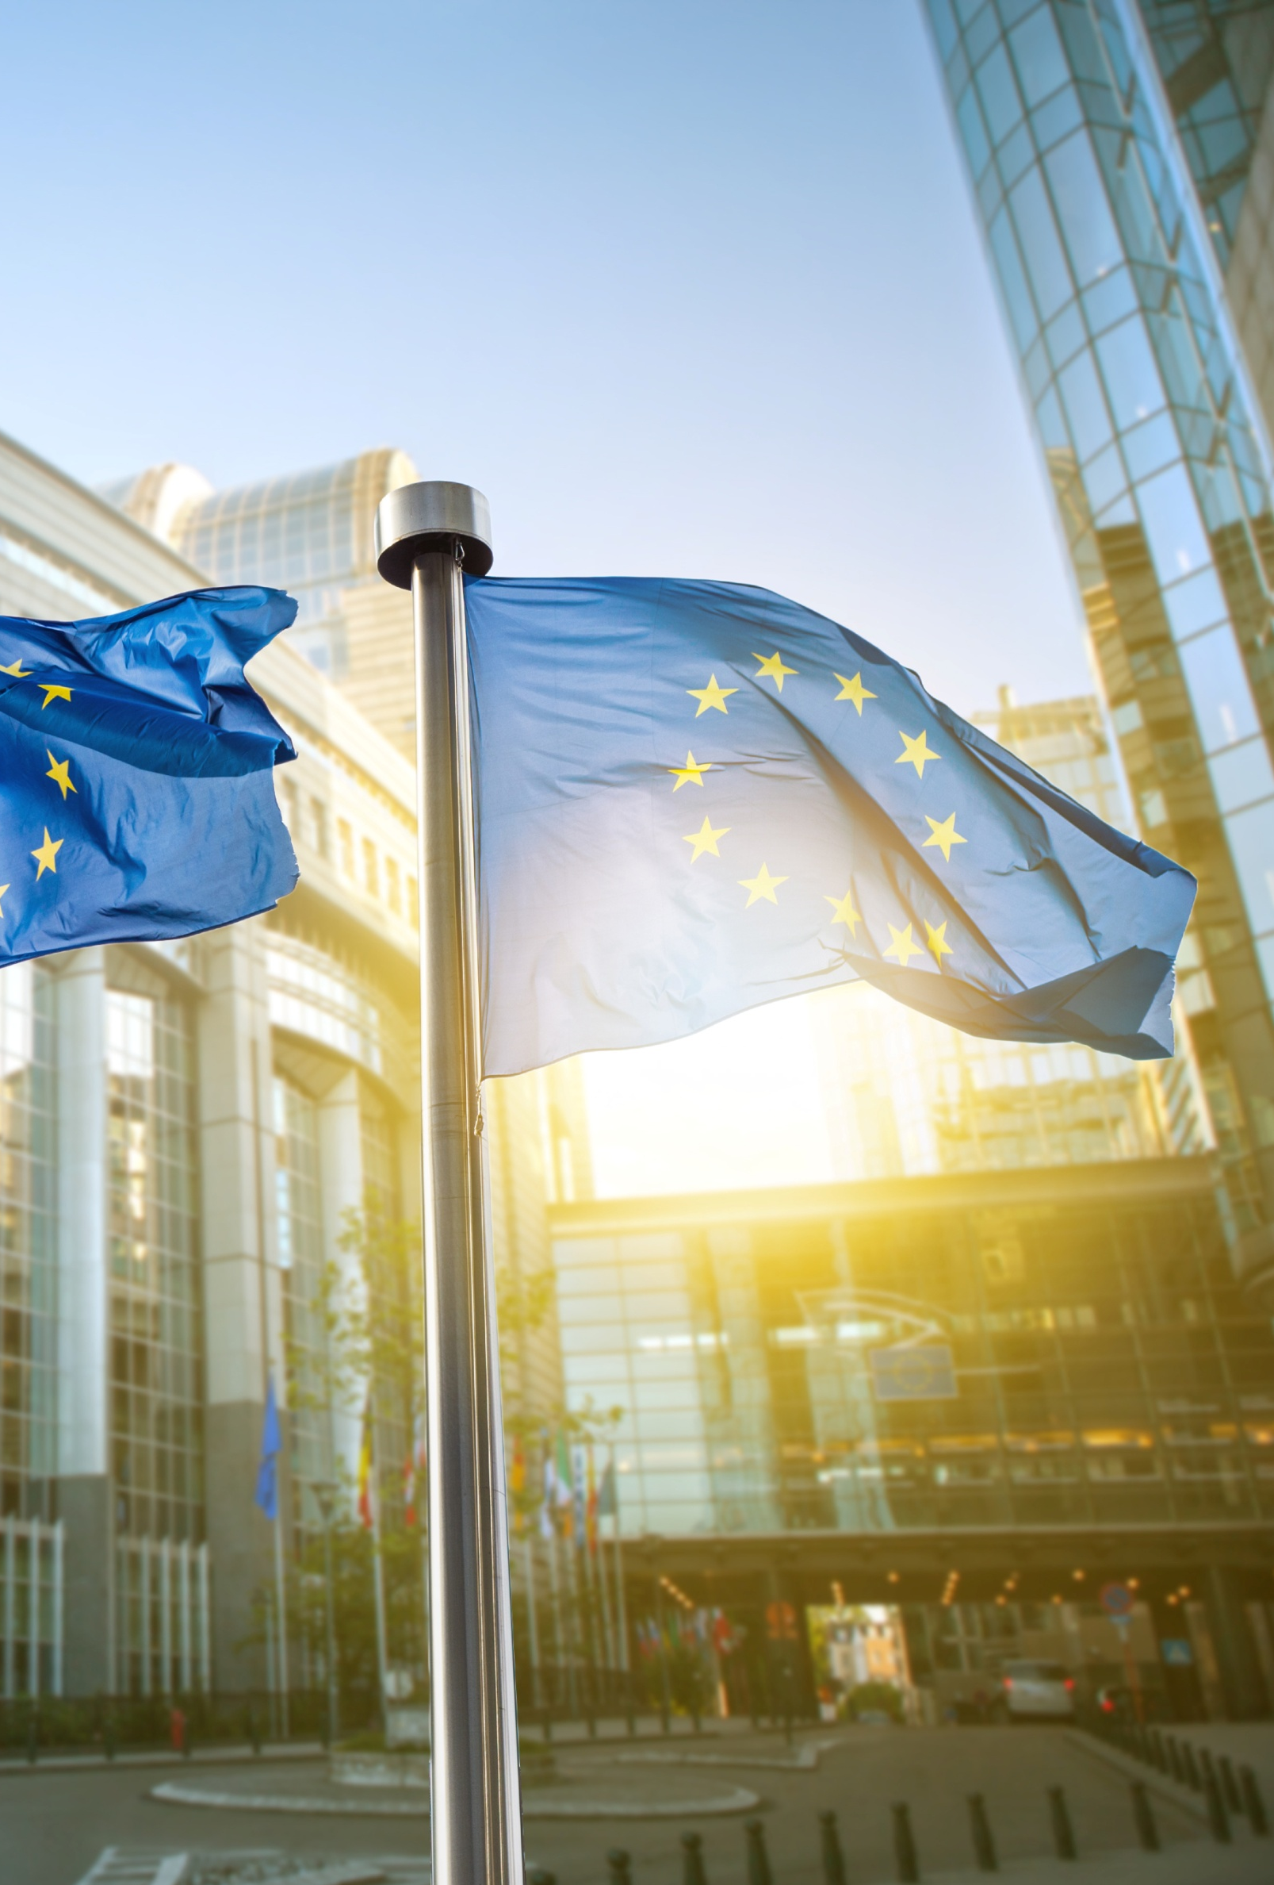
Contents
Legal framework
Statistics
Good examples
Innovation
Conclusion

Slide 3
Legal framework
The most important federal law is the Federal Water Act
(Wasserhaushaltsgesetz, WHG, in German), originally
adopted in 1957.
A substantially revised version entered into force in
March 2010. This amendment completed the transposition of the EU Water Framework Directive (WFD) into German national law and allowed the German Länder to adapt their respective water acts to the European provisions.

Slide 4
Legal framework
Regulatory law stipulates that water bodies in Germany
are subject to state management. Citizens and authorities are obliged to use water responsibly.
The goal is to achieve good status for all water bodies by
2027 at the latest, not just in terms of pollutant levels, but
also with regard to the status of native aquatic animal and plant species.

Slide 5
Federation, Länder and the Local Authorities
To coordinate water management policy, the Länder and the federal government have formed the German Working Group on water issues of the Federal States and the Federal Government (Bund/Länderarbeitsgemeinschaft Wasser, LAWA).
In the working group, the Länder coordinate administrative implementation with one another and coordinate legislation with the federal government.
The most important water management tasks of the local authorities are central water supply and waste water disposal. Waste water disposal is provided as a public service, water supply is sometimes privatised to an extent.

Slide 6
Statistics
The assessments of the ecological and chemical status of water, carried out as part of the national evaluations under the European Water Framework Directive, showed that only 8.2 percent of all surface waters reached a "very good" or "good" ecological status, while the chemical status was rated "good" for 84 percent of water bodies (in 2015).
According to the status of December 2015, 64% of groundwater bodies in Germany have obtained a good chemical status.
Of the total 1,000 groundwater bodies, only 4% have not achieved a "good quantitative status" (Status December 2015).

Slide 7
Statistics
Also counting spring water and bank-filtered water, groundwater accounts for more than 70 percent of drinking water in Germany, which makes it the most important resource for drinking water. The quality of drinking water in Germany is good or very good. It is regularly monitored at short intervals and complies with the stringent quality requirements of the Drinking Water Ordinance.
The latest EU bathing water quality report for the year 2016 found that approximately 2300 German bathing waters are very clean compared to the European average. Approximately 94 percent of coastal bathing waters and 97 percent of bathing waters along rivers and lakes have a good or even excellent status, which means that there is very little pollution with pathogens.

Slide 8
Statistics
Waste water from private households is collected in the public sewage system covering 540,723 km of sewers and discharged into just under 10,000 waste water treatment facilities. 10.07 billion m³ of waste water are annually treated in public sewage treatment facilities - 0.1 per cent receive only mechanical treatment, 1.9 per cent undergo biological treatment without nutrient removal and 98 per cent pass through a biological treatment process with targeted nutrient elimination.

Slide 9
Good examples
I
The implementation of EU WFD in Germany is seen through measures to reduce water pollution (nitrogen) that comes from farming and agriculture.
For 60 % of all riverine water bodies in Germany, agricultural measures are planned for the reduction of nutrient inputs. Measures are also planned for 69 % of groundwater bodies and for 46 % of lakes.
These include the planting of catch crops and converting to organic farming methods. These are exclusively measures to implement good agricultural practice and are thus basic measures or obligations that farmers are obliged to comply with anyway.

Slide 10
Good examples
II
Germany is taking measures towards registration and putting under special protection all areas within river basin districts. (Reference to the Directive Art. 6, Annex IV Article 7 ). For example:
areas designated under Article 7 for the abstraction of water intended for human consumption
areas designated for the protection of economically significant aquatic species (e.g. fish waters).
areas designated for the protection of habitats or species where the maintenance or improvement of the status of waters is an important factor in their protection.

Slide 11
Good examples
III
Along with other European countries through which Danube floats, Germany is taking precautions to decrease flood risks.
A major pillar of the flood protection strategy in the Danube River Basin District in Germany is the new flood storage polder concept in Bavaria. In the last years several locations for new flood storage polders have been identified like Riedensheim/Danube, Öberauer Schleife/Danube, Katzau/Danube, Seifener Becken/IllerDanube, Feldolling/Mangfall-Inn-Danube.

Slide 12
Innovation
Water innovation can apply not only to new sustainable technologies but also to new partnerships extending across public administration, research and industry: new business models and new forms of water governance that are not only innovative themselves but can also stimulate and support technological innovations.

Slide 13
Innovations in technologies
Membrane filtration has been developed and installed in the last decade, providing new and compact designs for wastewater treatment plants. These membranes range in pore size from microfiltration to ultrafiltration and nanofiltration and can be specialised to rid the water of pathogens, toxic metals, salinity or selectively allow nutrients through, depending on the pore size.
Many require considerable further testing, development and standardization to be of wider scale use.

Slide 14
Conclusion
Status of water in Germany is generally good, but needs further preservation, improvement and management.
There is space and need for innovation in order to achieve better quality of all forms of water
Steps are being carried to implement EC WFD and there is significant engagement of public and private sector.
Good examples show that it is possible to go towards sustainability and need to be more widespread.

Slide 15
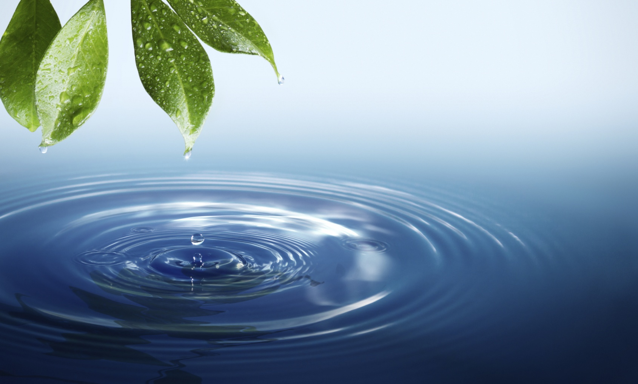
Thank you for your attention!
Do you have any questions?

Slide 16
Sources
http://www.bmub.bund.de/en/topics/water-waste-soil/water-management/
http://www.umweltrat.de/SharedDocs/Downloads/EN/02_Special_Reports/2012_2016/2015_06_part_translation_implementation_water_framework_Directive.pdf?__blob=publicationFile
http://www.lawa.de/documents/Arbeitshilfe_englisch_d34.pdf
http://ec.europa.eu/environment/integration/research/newsalert/pdf/innovation_european_water_sector_FB10_en.pdf

