Slide 1
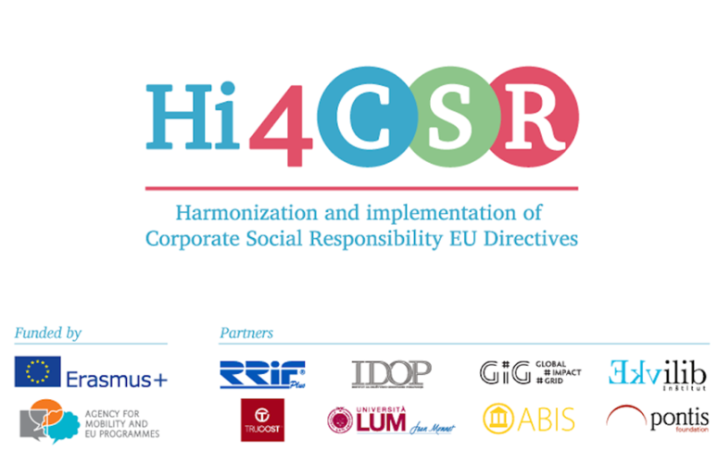
Ecolabels: information or confusion?
Slovenia

Slide 2
LABELING IN SLOVENIA*
FOCUS ON AGRICULTURAL PRODUCTS
Agricultural products food marketed in Slovenia should be marked with a single designation „ecological“only if it was produced/processed in accordance with the national and EU laws. In addition to the use od a word „organic“, abbreviations such as "bio" and "eco„ can also be used.
In the labeling of agricultural products it is also mandatory to use the European logo.

Slide 3


national trademark
Official trademark for labeling organic food in Slovenia:
EU logo:

Slide 4
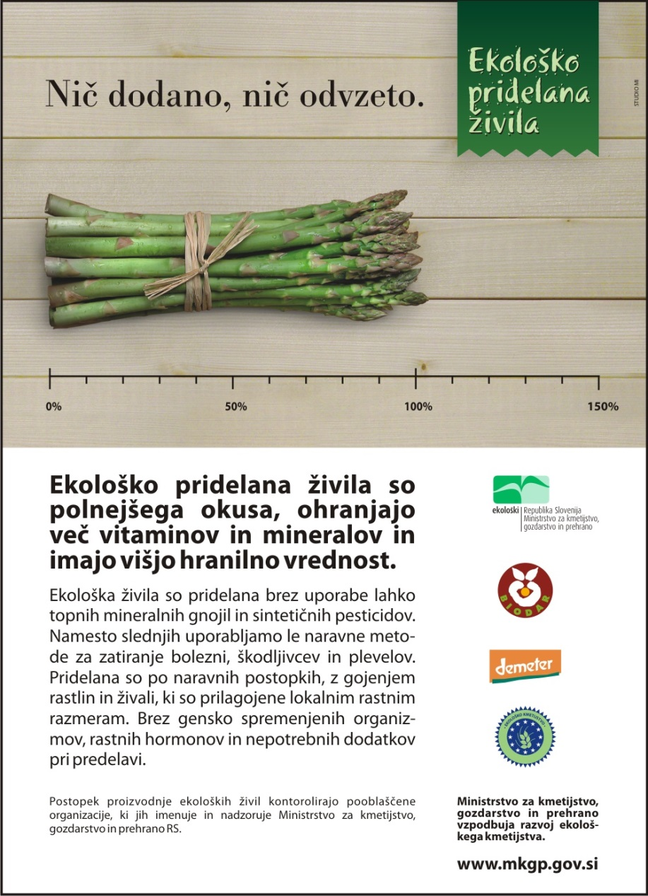
Example of a national add campaign promoting organically grown food

Slide 5

Private trademarks
Biodar: The most widespread collective mark for organic foods of Slovenian origin. Biodar Association has its own standards, which are in certain requirements even more stringent than Slovenian and EU legislation.

Slide 6

Demeter: International symbol for food that meets the standards of biologically - dynamic production and processing.

Slide 7

Bio Slovenija: Certified by Institute Concert to those foods that are produced in nature-friendly way (with integrated production)

Slide 8
can we trust the eco signs?
Independent tests show high reliability of these signs. In Europe, depending on the country, the reliability varies between 90 and 97%.
Even in cases where the foods found to contain pesticide residues, it was ten times smaller quantities as the average for the standard products. At the same time they also found that the cause of contamination is often inadequate transport, storage conditions in the store, inadequate processing (grinding in a conventional mill) or inadequate packaging. In 80% of reviewed cases of contamination with pesticides there was no use on the side of producers.

Slide 9
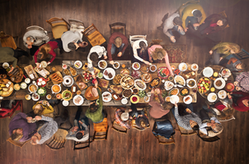
NEW CAMPAIGN – PREMIUM QUALITY
https://youtu.be/3pKn-krSHnY

Slide 10

PREMIUM QUALITY
WHY?
In order for Slovenian consumers to easily recognize local quality products, Slovenia established a new quality scheme.
This ensures that the labeled agricultural and food product is:
Of higher quality,
In addition to supervision by the official institutions also regularly checked by the certification body,
From the basic products of known origin,
Fully produced and processed in Slovenia

