Slide 1


Donations of Dairy Products to Humanitarian Institutions
Zagreb, January 2017 Kristina Klarić Rubčić

Slide 2
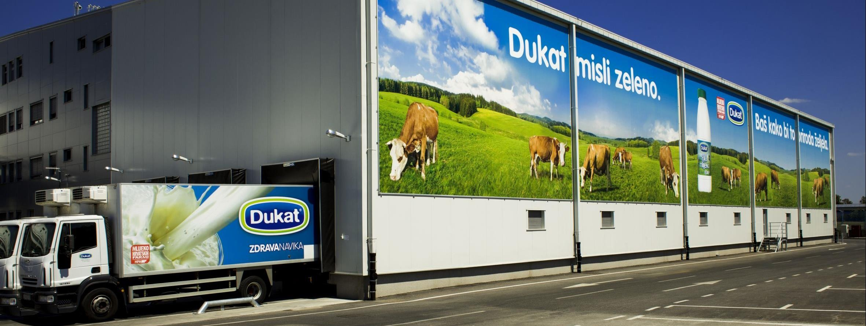
DUKAT Inc.
Leading dairy industry in Croatia with a century-old tradition
Leading regional dairy industry
Since 2007, part of Lactalis Group, the leading global dairy group and the leading global cheese manufacturer
Bases its operations on the processing of top quality raw milk produced by Croatian dairy farms – No. 1 milk collector in Croatia

Slide 3
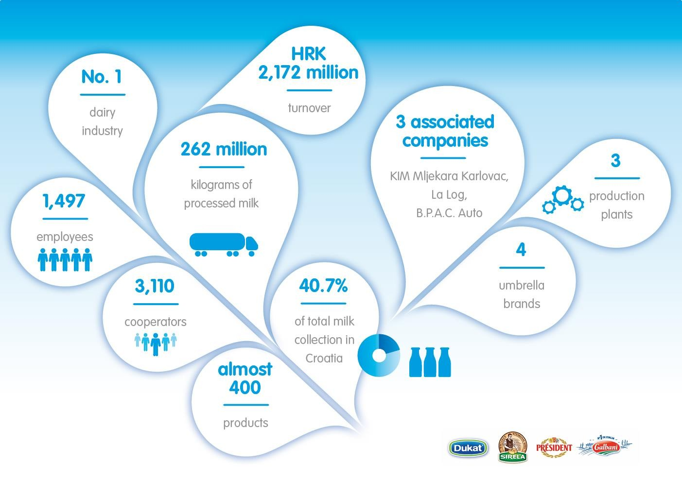

KEY FIGURES

Slide 4




To bring the best of dairy products
to the greatest number of consumers
VISION AND VALUES
VOCATION = cover all dairy categories (milk, yogurt and chilled dairy, butter & cream)
Ambition
Dedication
Simplicity

Slide 5

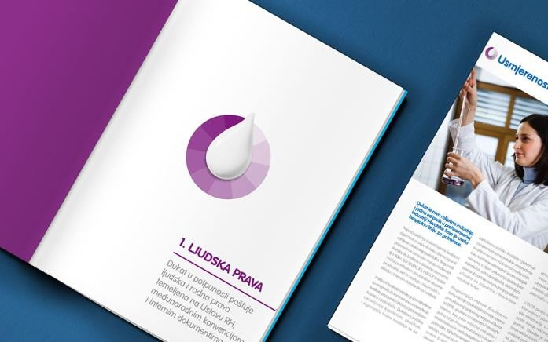

A SOCIALLY RESPONSIBLE COMPANY
Member of UN Global Compact since 2012 – Communication on Progress reports
Reports on Environmental Protection since 2000
Involved in donation activities for many years
  Donations of milk and dairy products in the cases of natural disasters (floods in Karlovac, Gunja, etc.)
  Donations of dairy products to humanitarian institutions
  Participation in humanitarian campaigns

Slide 6
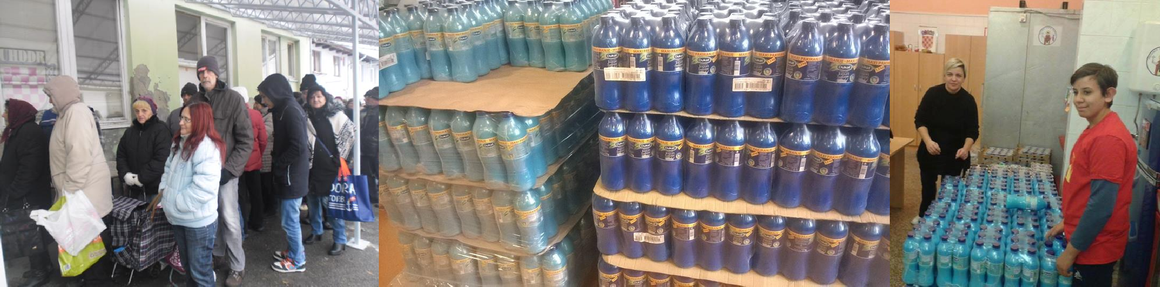
DONATIONS IN 2015
Decision on regular donations of dairy products (in a systematic manner) to soup kitchens, charity food shops and humanitarian associations
Donation process & internal procedure defined
3 departments included (Central Planning and Forecasting, Corporate Communications and Logistics)
Regular, twice a week

Slide 7
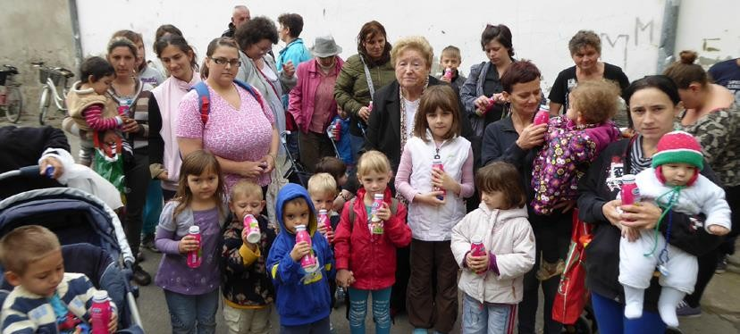
DONATIONS IN 2015
219 t of dairy products = 571 donations
(Feb – Dec 2015)
To 40 soup kitchens, charity food shops and humanitarian associations all over Croatia
Dukat provided dairy products for over 20 000 socially disadvantaged citizens and children in need

Slide 8

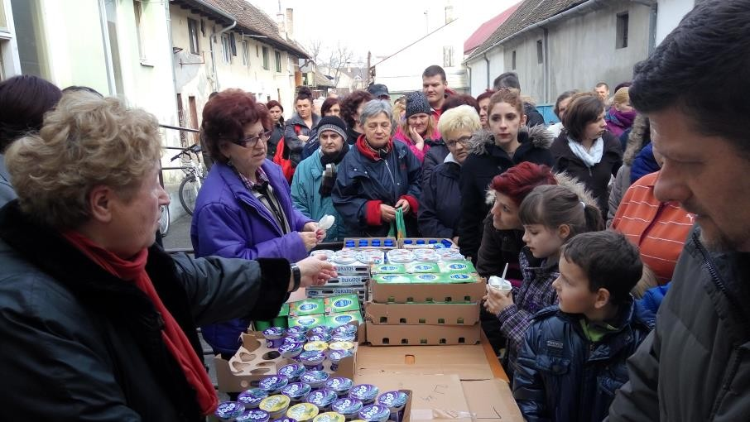
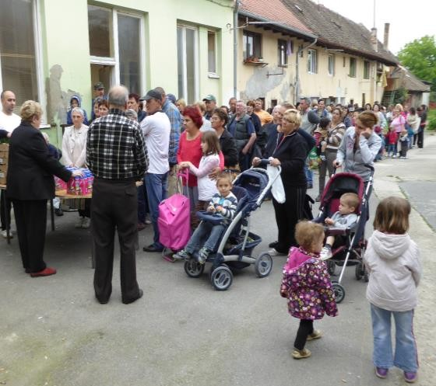
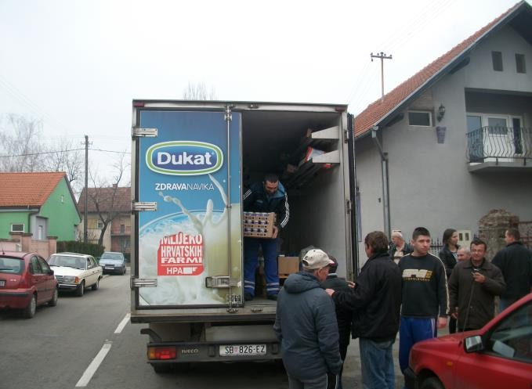
DONATIONS IN 2016
244 t of dairy products = 657 donations
To 36 social supermarket, soup kitchens and humanitarian organizations - registered intermediaries in donation process -> 26 000 citizens and children in need
28 delivery locations
Ongoing project with

Slide 9
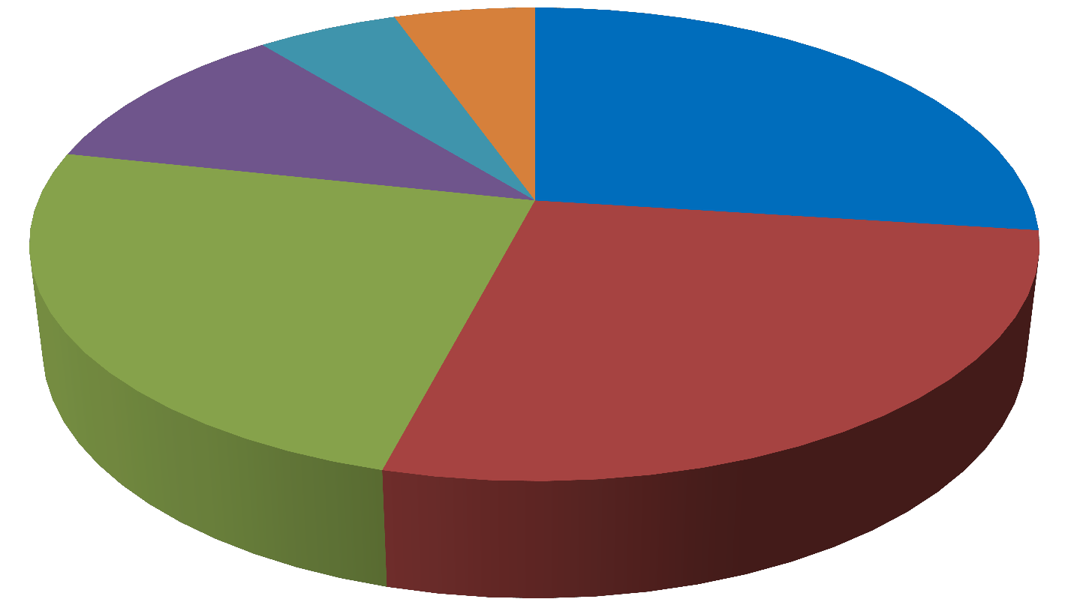
DONATIONS 2016 BY RECIPIENTS
Caritas 5%
Red Cross
6%
orphanages 11%
humanitarian associations 27%
soup kitchens 24%
charity food shops 27%

Slide 10
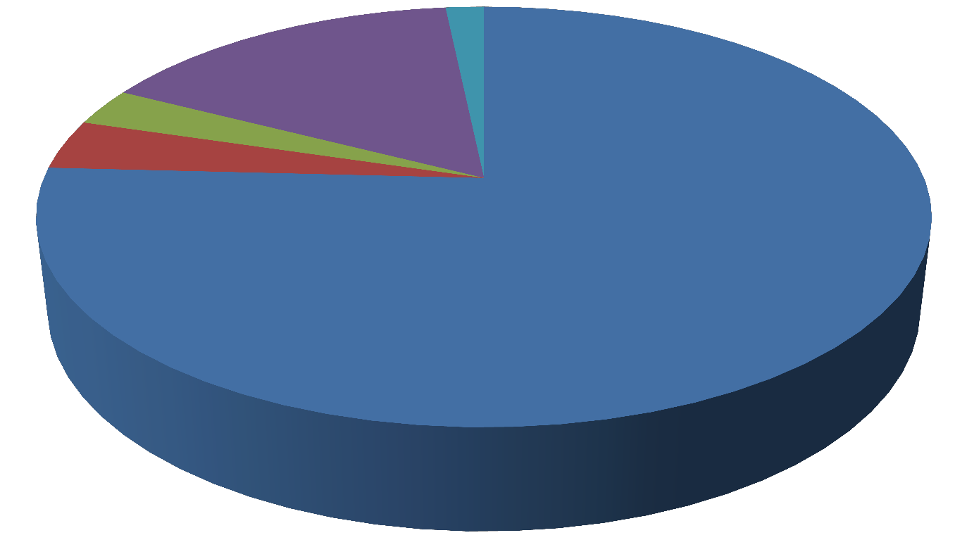
DONATIONS IN 2016 - BY CATEGORY
other 1%
cheese 3%
spreads 4%
milk
16%
yogurt & chilled dairy 76%

Slide 11


WHAT HAS CHANGED?
Necessary framework for greater involvement of companies created
463 t of dairy products donated in two years
Amount of products that are thrown away reduced by 12%
More active involvement in the fight against poverty
Increased scope of (administrative) work
A slight drop in the number of “registered” donation recipients
A large drop in food donations to non- humanitarian institutions (dealing with education, rehabilitation, culture, sports, environmental protection, etc.)
Insufficient response of
retail chains

Slide 12
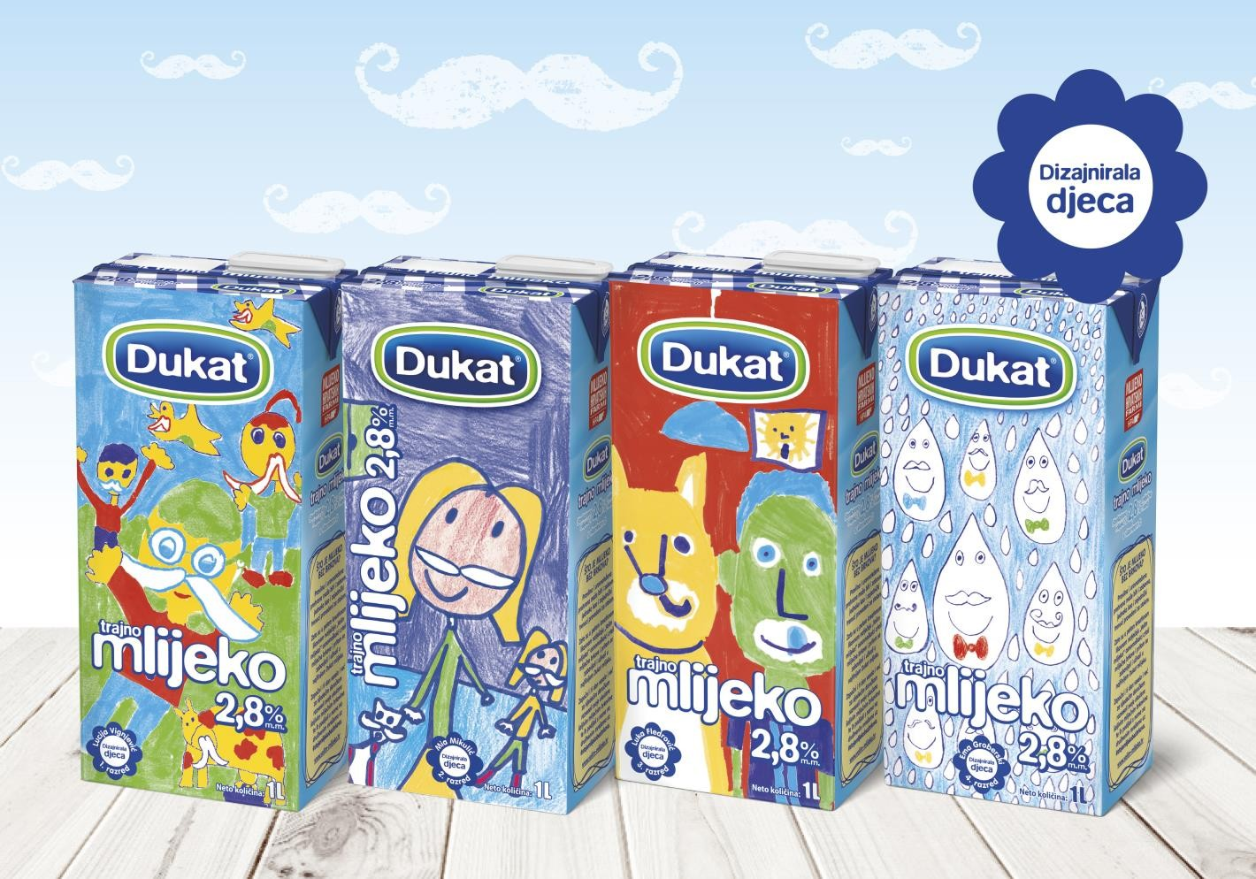


www.dukat.hr Dukat Hrvatska
@dukat_hrvatska
kristina.klaric-rubcic@hr.lactalis.com

