Slide 1
FOOD WASTE IN THE UK
Prepared Hi4CSR learning activity
Zagreb, 2nd February 2017

Slide 2
OVERVIEW
https://www.youtube.com/watch?v=ZYlQGs0fbr4
Local Authorities are responsible for the collection of municipal waste and operate contracts
Household Waste Recycling Act 2003 required local authorities in England to provide every household with a separate collection of at least two types of recyclable materials by 2010
Recycling policy is devolved to the administrations of Scotland, Northern Ireland and Wales who set their own targets, but all statistics are reported to Eurostat
Local Authorities are given incentives towards meeting recycling targets set by European, national and regional Government by the imposition of financial penalties for failing to recycle e.g. landfill tax of £82.60 per tonne.
UK domestic recycling policy is geared towards, and over the last decade a number of new regulatiencouraging more people to take control of recycling in their own homesons have been introduced to encourage greater amounts of recycling. These include fines for people who don’t cut their household waste and a greater emphasis on separating waste into different recyclable materials, with each council applying different rules.
There was a 235% increase in household recycling in England between 2000/01 and 2009/10.

Slide 3
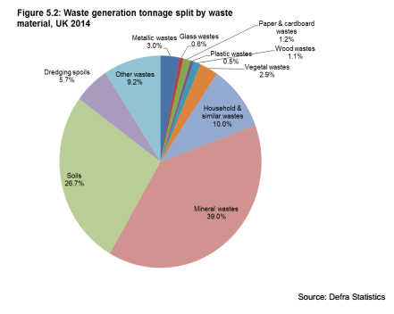
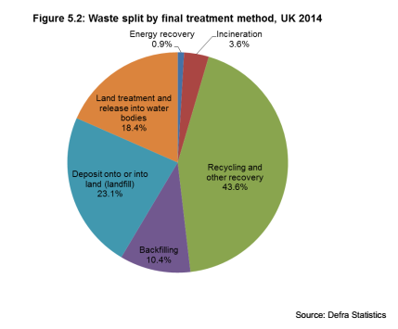
OVERVIEW
UK on track to meet its 2020 landfill diversion target 2020 (35% on 1995 levels)
EU Waste Framework Directive states that the UK must recycle 50% of household waste by 2020 (includes composting and reusing waste).EU also demands a 70% minimum recycling target for construction and demolition waste by 2020. The British government is highly confident in meeting the 2020 recycling target.

Slide 4


WASTE RESOURCE ACTION PLAN (WRAP)
The establishment of the government body Waste & Resources Action Programme has increased the country's recycling capacity. It is a registered charity. It works with businesses, individuals and communities to achieve a circular economy through helping them reduce waste, develop sustainable products and use resources in an efficient way. WRAP was established in 2000 as a company limited by guarantee.[6] and receives funding from the Department for Environment, Food and Rural Affairs, the Northern Ireland Executive, Zero Waste Scotland, the Welsh Government and the European Union.
https://vimeo.com/87663657

Slide 5
Q&A

