Slide 1

Zagreb,
2nd February 2017
Hi4CSR Learning Activity
Food donations:
Current developments at EU level

Slide 2
Overview
The Context
Legislative framework
  General Food Law Regulation
  Food Hygiene legislation
  VAT Directive
Recent developments

Slide 3
1. The Context
Estimates show that 88 million tonnes of food wasted in the EU each year
  representing 20% of food produced
  with an economic cost valued at EUR 143 billion
  at the same time 55 million people can’t afford a quality meal every second day
…leading to the emission of 170 million tonnes of CO2 and consumes 261 million tonnes of resources
The sectors contributing the most to food waste in the EU are
  households (53%)
  processing (19%)
  food service sector contributes with 12%, primary production with 10% and wholesale-retail with 5%
Notes:
Estimates show that 88 million tonnes of food wasted in the EU each year
representing 20% of food produced in the EU
with an economic cost amounting to an estimated EUR 143 billion
The production and disposal of EU food waste leads to the emission of 170 million tonnes of CO2 and consumes 261 million tonnes of resources
The sectors contributing the most to food waste in the EU are households (53%) and processing (19%). Food service sector contributes with 12%, primary production with 10% and wholesale-retail with 5%
SDG 12.3 aims at halving per capita global food waste by 2030 and reducing food losses along production and supply chains

Slide 4
2. Legislative Framework
General Food Law Regulation (Regulation (EC) 178/2002)
  lays down general principles, requirements and procedures of food and feed law
  sets up European Food Safety Authority (EFSA)
  ensures a high level of protection of human life and consumers' interests as well as the effective functioning of the internal market
Food Hygiene legislation
  Regulation (EC) 852/2004 on the hygiene of foodstuffs
  Regulation (EC) 853/2004 laying down hygiene rules for food of animal origin
  Regulation (EC) 854/2004 laying down specific rules for the organisation of official controls on products of animal origin intended for human consumption
  Directive 2004/41/EC - repealing certain Directives concerning food hygiene and health conditions for the production and placing on the market of certain products of animal origin intended for human consumption
  → Food donors = food business operators and hence have to comply with all food EU legislation concerning responsibility, liability, traceability and food safety rules under the Food Hygiene Package
Notes:
The General Food Law Regulation is the foundation of food and feed law. It sets outs an overarching and coherent framework for the development of food and feed legislation both at Union and national levels. To this end, it lays down general principles, requirements and procedures that underpin decision making in matters of food and feed safety, covering all stages of food and feed production and distribution.
It also sets up an independent agency responsible for scientific advice and support, the European Food Safety Authority (EFSA).
Moreover, it creates the main procedures and tools for the management of emergencies and crises as well as the Rapid Alert System for Food and Feed (RASFF).
The General Food Law Regulation ensures a high level of protection of human life and consumers' interests in relation to food, while ensuring the effective functioning of the internal market.

Slide 5
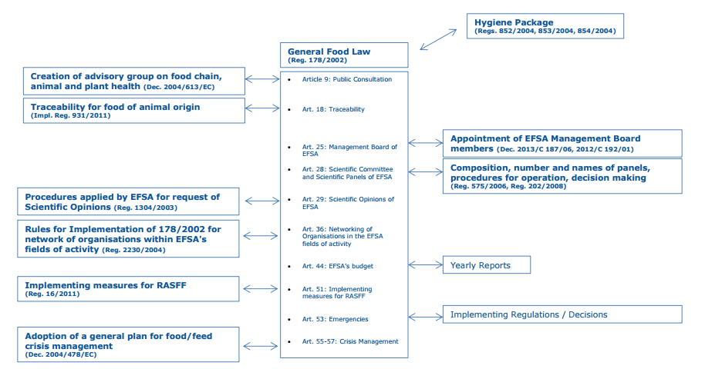
2. Legislative Framework
* JRC Science Hub, 2016
Notes:
The General Food Law Regulation is the foundation of food and feed law. It sets outs an overarching and coherent framework for the development of food and feed legislation both at Union and national levels. To this end, it lays down general principles, requirements and procedures that underpin decision making in matters of food and feed safety, covering all stages of food and feed production and distribution.
It also sets up an independent agency responsible for scientific advice and support, the European Food Safety Authority (EFSA).
Moreover, it creates the main procedures and tools for the management of emergencies and crises as well as the Rapid Alert System for Food and Feed (RASFF).
The General Food Law Regulation ensures a high level of protection of human life and consumers' interests in relation to food, while ensuring the effective functioning of the internal market.

Slide 6
2. Legislative Framework
VAT Directive (Directive 2006/112/EC)
  rules applicable to goods handed out for free - Articles 16 and 74
  Art. 16 “The application by a taxable person of goods forming part of his business assets for […] their disposal free of charge […] shall be treated as a supply of goods for consideration, where the VAT on those goods […] was wholly or partly deductible […]”
  Art. 74 “Where a taxable person applies or disposes of goods forming part of his business assets, or where goods are retained by a taxable person, or by his successors, when his taxable economic activity ceases […] the taxable amount shall be the purchase price of the goods or of similar goods or […] the cost price, determined at the time when the application, disposal or retention takes place”
  → Food donations are taxable + no tax exemptions are allowed
Notes:
16. The application by a taxable person of goods forming part of his business assets for his private use or for that of his staff, or their disposal free of charge or, more generally, their application for purposes other than those of his business, shall be treated as a supply of goods for consideration, where the VAT on those goods or the component parts thereof was wholly or partly deductible. However, the application of goods for business use as samples or as gifts of small value shall not be treated as a supply of goods for consideration.
74. Where a taxable person applies or disposes of goods forming part of his business assets, or where goods are retained by a taxable person, or by his successors, when his taxable economic activity ceases, as referred to in Articles 16 and 18, the taxable amount shall be the purchase price of the goods or of similar goods or, in the absence of a purchase price, the cost price, determined at the time when the application, disposal or retention takes place.

Slide 7
3. Recent developments
2011
  Resource efficiency in Europe - Flagship Initiative of the Europe 2020 strategy towards a resource efficient, low-carbon economy to achieve sustainable growth
March 2014
  Fitness check of General Food Law Regulation Regulation (EC) no 178/2002 (currently being finalized)
25 September 2015
  SDG 12.3: “By 2030, halve per capita global food waste at the retail and consumer levels and reduce food losses along production and supply chains, including post-harvest losses”

Slide 8
3. Recent developments
December 2015
  Adoption of Circulary Economy Package to stimulate Europe's transition towards a circular economy which will boost global competitiveness, foster sustainable economic growth and generate new job
  EC’s legislative proposal to revise the Waste Framework Directive (Directive 2008/98/EC)
  → EC’s 5 key Action Areas
    To elaborate a common EU methodology to measure food waste consistently in cooperation with MS and stakeholders
    To develop EU Guidelines on food donations
    To take measures to clarify and lift barriers which prevent safe use of food resources in food and feed chains
    To improve the use of date marking by actor in the food chains and also its understanding by consumers
    to establish a new EU Platform on Food Losses and Food Waste

Slide 9
3. Recent developments
August 2016
  EU Platform on Food Losses and Food Waste established
  key forum at EU level to support all players in identifying and taking actions needed to achieve the SDG commitment
  gathering 70 members representing public authorities and all actors along the food value chain
  first meeting on 29 November 2016, and discussed EC key action area 1
December 2016
  EU Parliament Committee on the Environment, Public Health and Food Safety published a draft report with a series of recommendations including change in the VAT Directive to authorise tax exemptions on food donations
Notes:
gathering 70 members representing public authorities (Member States, EFTA countries, EU bodies and international organisations) and all actors along the food value chain, including food banks and other NGOs. The platform met for the first time on 29 November 2016, and discussed key deliverables of the circular economy Action Plan on food waste, including the main elements to be considered in developing a methodology to measure food waste consistently across the EU

Slide 10
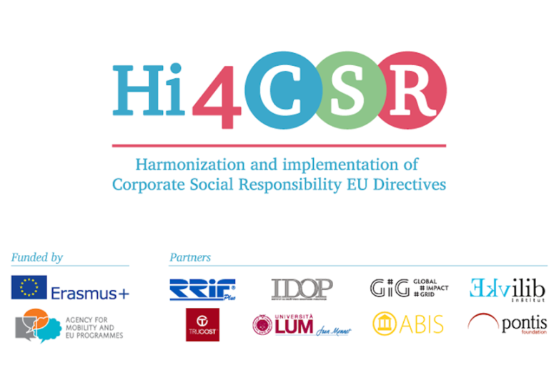
Thank you for your attention!
Karolina Sobczak
Projects Coordinator

