Slide 1

Stimulating the processing of used materials
Ivan Petarčić

Slide 2

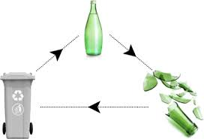

Content
Facts
Why process?
How to process?
Processing in numbers in Croatia
What more can be done for stimulating the processing of used materials?

Slide 3

Processing of used materials & recycling
practice of reusing items that would otherwise be discarded as waste
Variations of recycling:
          Upcycling – involves adding value to an item for reuse
          Downcycling – involves breaking down an item or substance into its component elements to reuse anything that can be salvaged
          Precycling – involves avoiding acquisition of unnecessary items that would eventually have to be recycled or dealt with as waste
          E-cycling – practice of reusing, or distributing for reuse, electronic equipment and components rather than discarding them at the end of their life cycle

Slide 4



#1 Fact
Why people invest in companies?

Slide 5
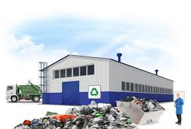
#2 Fact
People will take care of environment only because of:
          Law
          Profit
          Cost
good for cash flow

Slide 6
Why give used materials to a processing company?
taxation problem:
            VAT
            Profit tax (Income tax)
        Evidence:
          if someone from Tax office is controlling disposing of these used materials they* will keep a record
          confirmation from the authorized waste collector
demand evidence
NO EVIDENCE
Pay VAT on estimated value
Pay Income tax (40%)
Not acceptable cost for Profit tax
Notes:
* https://en.wikipedia.org/wiki/Singular_they

Slide 7
VAT Directive 2006/112/EC
Article 199.
1. Member States may provide that the person liable for payment of VAT is the taxable person to whom any of the following supplies are made:
…
(d) the supply of used material, used material which cannot be
re-used in the same state, scrap, industrial and non
industrial waste, recyclable waste, part processed waste
and certain goods and services, as listed in Annex VI

Slide 8
LIST OF SUPPLIES OF GOODS AND SERVICES AS REFERRED TO IN POINT (D) OF ARTICLE 199(1) – ANNEX VI
(1) Supply of ferrous and non ferrous waste, scrap, and used materials including that of semi-finished products resulting from the processing, manufacturing or melting down of ferrous and non-ferrous metals and their alloys;
(2) supply of ferrous and non-ferrous semi-processed products and certain associated processing services;
(3) supply of residues and other recyclable materials consisting of ferrous and non-ferrous metals, their alloys, slag, ash, scale and industrial residues containing metals or their alloys and supply of selection, cutting, fragmenting and pressing services of these products;
(4) supply of, and certain processing services relating to, ferrous and non-ferrous waste as well as parings, scrap, waste and used and recyclable material consisting of cullet, glass, paper, paperboard and board, rags, bone, leather, imitation leather, parchment, raw hides and skins, tendons and sinews, twine, cordage, rope, cables, rubber and plastic;
(5) supply of the materials referred to in this annex after processing in the form of cleaning, polishing, selection, cutting, fragmenting, pressing or casting into ingots;
(6) supply of scrap and waste from the working of base materials.

Slide 9
EXAMPLE
Company “A” has a machine that was used for production. This machine cannot be used anymore and cannot be fixed.
Company “A” can give this machine to a licensed waste collector* and receive money in return because the machine is made out of steel.
When a licensed waste collector offers company “A” a set amount of money (they could get), company “A” will issue them an invoice for that supply and won’t need to pay VAT on said supply, which makes that amount of money company’s revenue.
Notes:
Ako je na hrvatskom bilo “ovlašteni sakupljač otpada”, onda je na engleskom “licenced waste collector”
http://mzoip.hr/doc/waste_management_plan_og_85-207.pdf

Slide 10
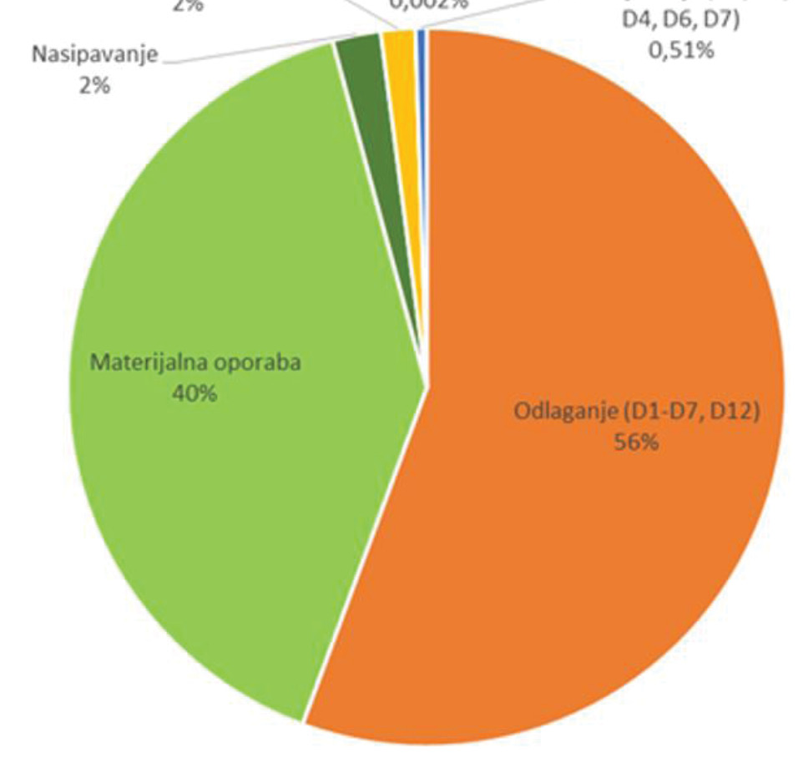
Collected waste in Croatia in 2015.
Material recovery
Disposal

Slide 11
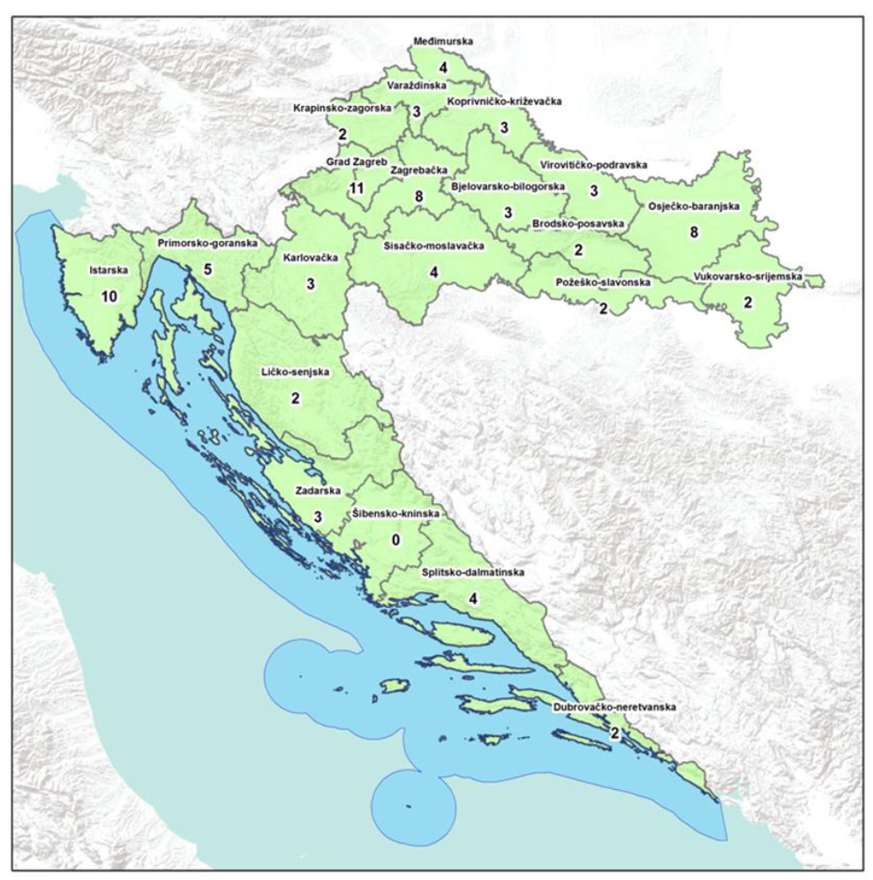
Problems
Ignorance
Administrative difficulties
Expensive transport
Not enough processing companies
Not enough recycling yards (84)

Slide 12
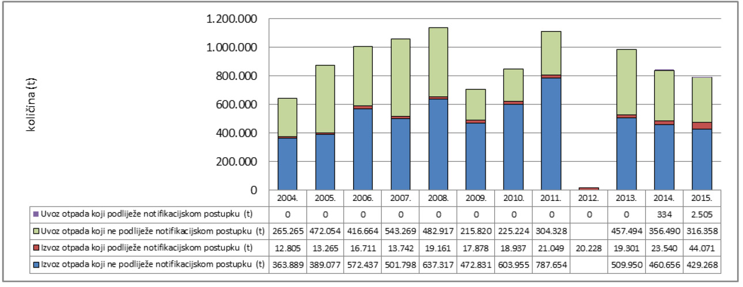
Import & export of waste
Notes:
Import of waste which is subject to the notification procedure
Import of waste which is not subject to the notification procedure
Export of waste which is subject to the notification procedure
Export of waste which is not subject to the notification procedure

Slide 13

What more can be done?
Stimulate companies:
          More benefits (revenue will not be taxable…)
Stimulate the setting up of new companies which will process used materials:
          Easier registration (less legislation, simplified procedures)
          Providing financial support
          Providing support for buying equipment

Slide 14

Any suggestions?

Slide 15

Thank you for your attention!

