Slide 1


Diversity meets csr
Zagreb
February 1st 2017

Slide 2
„Where all think alike, no one thinks very much“
Video
All male panel
Notes:
It's easy to miss something you're not looking for

Slide 3
4 + 4 = ?
5 + 3 = ?

Slide 4
WHAT WE MEAN WHEN WE TALK ABOUR EQUALITY AND DIVERSITY
Equality
Equality does not mean „we are all the same“.
It‘s about recognition, that we are all different, but treated with the same respect and ensuring that everyone has the same access to employment, education, goods and services, buying and renting of real estates,…
Diversity
Diversity goes one step further.
It is about recognizing, respecting, appreciating and looking for positive aspects of our differences. Diversity fosters an environment that recognises input of each individual that he/she can make for an organisation. It encourages dignity and respect.
Equality and Diversity UK Ltd , 2012

Slide 5

Equality
Equality is associated broadly with the legislative framework. Its thrust is focused on rights and responsibilities and anti-discrimination.
Equality involves the development of practices to ensure that groups which continue to be disadvantaged gain access to opportunities for full participation in society, with legal sanctions directed against those who violate this principle.

Slide 6
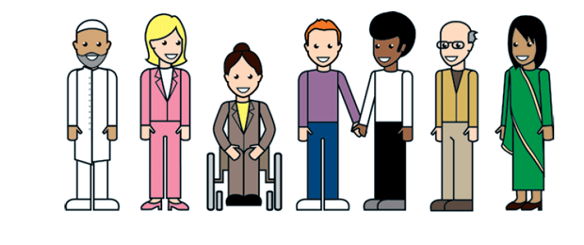
Diversity
Diversity adds an extra dimension to equality of opportunity. It encompasses all types of differences beyond those covered by the legislation, and focuses principally on the individual.
Diversity includes every kind of difference that makes each person unique and distinct.
Diversity seeks to increase people’s awareness, celebration and positive acceptance of individuals and their differences.
Valuing diversity involves the demonstrable inclusion of diverse employees and service users by having policies, procedures and practices that take their diverse needs and preferences into account.

Slide 7
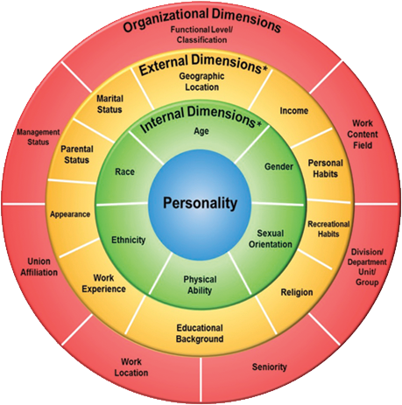
LAYERS OF DIVERSITY
Notes:
Gardenswartz and Rowe specially developped the 4 layers of diversity which differentiate people through:
1. Personality
2. Internal dimensions
➢Race
➢Gender
➢Age
➢Ethnicity
➢Physical ability
➢Sexual orientation
3. External dimensions:
➢Appearance
➢Parental status
➢Marital status
➢Geographic location
➢Income
➢Personal habits
➢Recreational habits
➢Religion
➢Educational background
➢Work experience
4. Organisational dimensions
➢Management status
➢Work content/field
➢Division/department/unit/group
➢Seniority
➢Work location
➢Union affiliation
➢Functional level / classification

Slide 8

GOLDEN vs. PLATINUM rule
Equality and Diversity UK Ltd , 2012
Notes:
We used to assume the „golden rule“ for succesful interaction is „to treat others the way you want other people to treat you“. This rule asumes that everyone is the same – like you.
With diversity we assume the „platinum rule“, that says „treat others the way they want to be treated“.

Slide 9
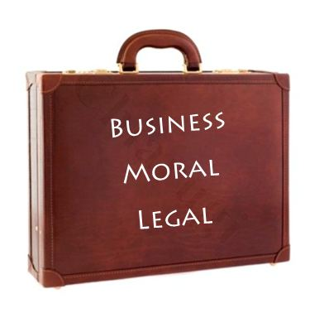
The Business Case
Treating people fairly in
recruitment, training and
development and promotion helps organisations to build a reputation for being a good place to work.
This is an important motivator for staff and volunteers choosing to work for you.

Slide 10
BUSINESS CASE
Wider talent pool
Work environment
Decision making
Innovation
New markets
New costumers
Notes:
Being able to tap into a greater talent pool will make for a more interesting and engaging work environment, which will improve decision-making (avoiding “group-think”) and will lead to greater innovation, which in turn will lead to penetrating new markets and new customer base – all of which has a positive impact on the bottom line.

Slide 11
The Moral Case
Whatever the aims of your organisation, there
will be a moral case for ensuring equality of
opportunity for staff and equality of access for service users.
Equality of opportunity and equality of access to services is one of the fundamental building blocks for organisations. Not only is it the right thing to do but it is also underpinned by the values and objectives of an organisation.

Slide 12
The Legal Case
Legislation provides the basis for
ideas and practices of equal opportunities.
Despite general acceptance of the principles
of equality as a norm within our society,
discrimination persists.
Laws exist because discrimination has occurred and continues to occur.
The elimination and prevention of discrimination is a necessary precursor to achieving equality.

Slide 13
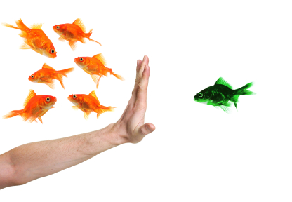
Types of Discrimination

Slide 14
Types of discrimination
Direct discrimination
This applies to all protected characteristics. It is treating someone less favorably than another person because of a protected characteristic that they have. For example, it is refusing to employ an individual because they are a Muslim.

Slide 15

Direct discrimination
A social care organisation does not accept someone as a client because they are a disabled person with a particular mental health condition.

Slide 16
Indirect discrimination
Indirect discrimination occurs when:
a provision, criterion or practice is applied to all, and:
it puts a group with a protected characteristic at a disadvantage when compared with another group
an individual is put at a disadvantage
the employer cannot show it to be a proportionate means of achieving a legitimate aim.

Slide 17
Indirect discrimination
The owner of a restaurant asks the job candidates to provide a document on finished education in Slovenia and a certificate on excelent verbal and written use of Slovenian language.
Both conditions (seemingly neutral to candidate‘s ethnicity) are used the same for everyone, but can have an effect for excluding foreigners and citizens of non-Slovenian origin. The condition of language is dissproportionate to the everyday tasks of a waiter.

Slide 18
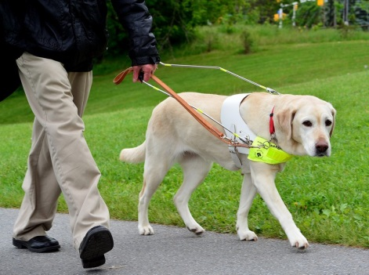
Failure to provide reasonable accommodation
A blind person is prevented from entering a cafe with his/her guide dog, because animals are prohibited.
an obligation that, in certain instances, rules, practices, criteria are adapted to the needs of persons with certain personal circumstances. This is necessary so that these persons do not only formally have equal conditions for the exercise of their rights, but can actually enjoy them equally effective.

Slide 19
Associative Discrimination
This is treating someone less favourably because they associate with an individual who has a protected characteristic.

Slide 20
Discrimination by association
A small privately run homecare provider refuses to assist an older client at home because they discover that the older person’s partner is HIV positive.
This is almost certainly direct discrimination because of disability based on the client’s association with a disabled person.

Slide 21
Perceptive discrimination
This is treating someone less favourably because it is perceived that they have a protected characteristic, whether or not they do.

Slide 22

Discrimination by perception
A member of staff mistakenly thinks a man is gay. Because of this they tell him a service is not open to him.
It is likely the man has been unlawfully discriminated against because of sexual orientation, even though he is not gay.

Slide 23
Harassment
Harassment is ‘unwanted conduct related to a relevant protected characteristic, which has the purpose or effect of violating an individual’s dignity or creating an intimidating, hostile, degrading, humiliating or offensive environment for that individual’.
The employer is also liable for harassment that comes from a third party (for example, a customer) if that harassment has occurred on at least two occasions, the employer knew about the harassment and did nothing to prevent it re-occurring.

Slide 24
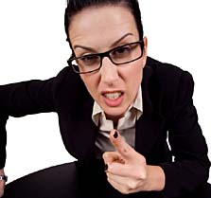
Harassment
A service user is verbally abusive to member of staff in relation to his/her protected characteristic.

Slide 25
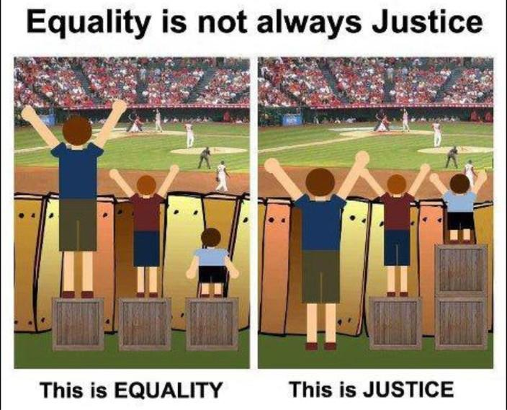
Is positive discrimination still discrimination?
Notes:
Gre za začasne ukrepe, s katerimi ranljive družbene skupine postavimo v ugodnejši položaj v primerjavi s preostalimi, da bi jim tako zagotovili enake možnosti oziroma izenačitev izhodiščnega položaja. Tak primer je politika aktivnega zaposlovanja, v katero so vključene težko zaposljive osebe, kot so Romi, starejše ženske, hendikepirani in podobno.

Slide 26
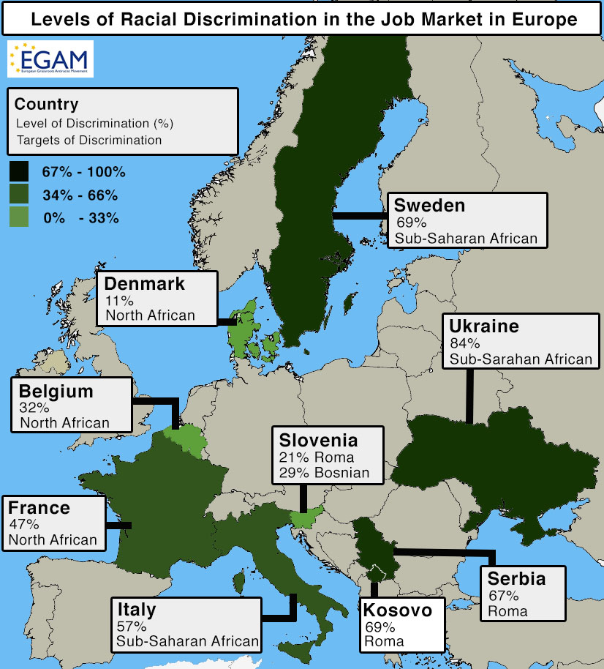
DISCRIMINATION IN THE WORK FORCE
Notes:
The labour market is an important area of society. Discrimination in the labour market has serious consequences for job seekers. For most people, work is the only way to generate revenue and economic independence. Exclusion from employment or employment in jobs below their qualifications as a result of discrimination impedes social and economic integration.

Slide 27
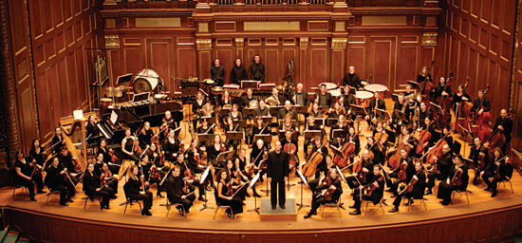
Unconscious bias – can we change opinions?
Notes:
Ker pristranskosti ne moremo izločiti, je potrebno prilagoditi organizacije – primer orkestri v 70ih, ki so imeli samo 10% žensk, dokler niso začeli avdicij izvajati za zaveso. Delež žensk se je povečal od 25-40%. To torej ni bila posledica spremenjenih mnenj, saj so bili najbolj znani vodje orkestrov prepričani, da ne potrebujejo zaves ker so osredotočeni na kakovost glasbe, ne osebne lastnosti glasbenikov.

Slide 28
DIVERSITY MANAGEMENT IN ORGANISATION

Slide 29
DIVERSITY MANAGEMENT
Strategic management approach designed to target treatment and deliberate use of the diversity of people and appropriate organizational environments or stakeholders in order to create the structural and social conditions under which all employees can develop their competences and achieve their full potential in the benefit of all stakeholders involved and to increase performance organizations.
ECQA Certified Diversity Manager, 2015

Slide 30
DIVERSITY MANAGEMENT
Economic paradigm
Management approach
Economic benefit of diversity of human resources
Notes:
Diversity Management - with its focus on the economic value and benefits from human diversity –supports and “promotes” the implementation of the respective anti-discrimination legislations, and, on the other hand, communicates additional needs, or problems and feasibility of the compliance with legislation and regulations in the “real world”, i.e. in the organizational and managerial context. In an ideal world, the legal paradigm reacts to this feedback in order to insure the proper implementation of the laws and regulations.
The information campaign of the European Commission also promotes the value of diversity, and the economic value is not excluded: “Through its activities, the campaign works to convey the message to as many people as possible that a diverse Europe is something to be valued, and that a life free from discrimination is a fundamental right in the EU.”

Slide 31
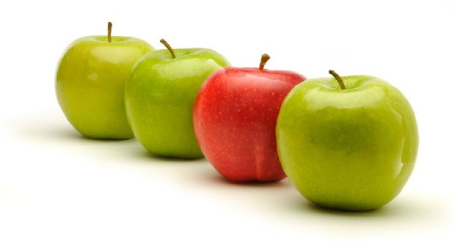
Diversity in the language of management?
Managing an aging workforce, declining access to skilled talent, and taking into account the challenges of managing multigenerational workforce.

Slide 32
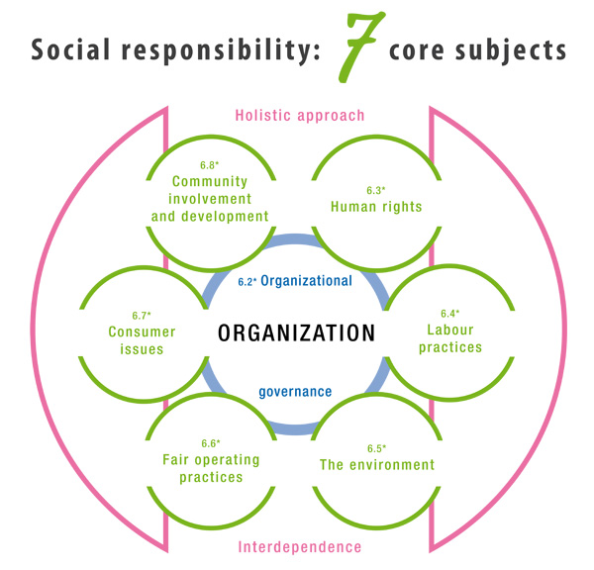
ISO 26000

Slide 33
Labor Practices
hiring, promotion, lay off and relocation of workers
training and skill development
health and safety
any policy for working conditions like working hours and salary

Slide 34
What companies are doing

Slide 35
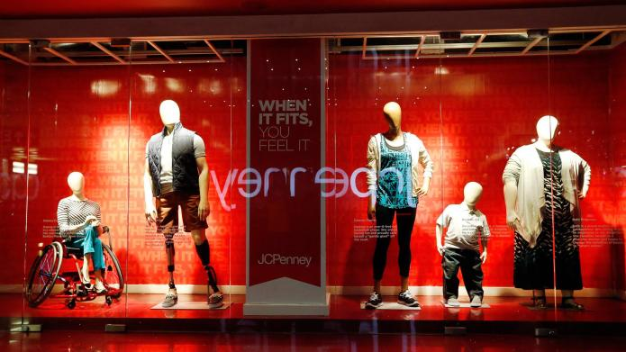
JC Penney debute mannequins with body diversity

Slide 36
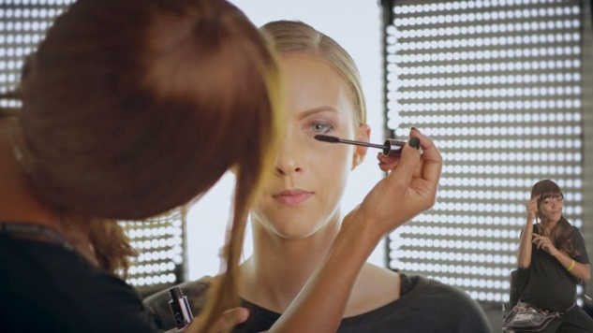
L'OREAL SWITZERLAND AND URBAN DECAY BRAND STEP UP RECRUITMENT OF PERSONS WITH DISABILITIES
L’Oréal is one of the world’s top 20 companies in proactively addressing diversity and inclusion, according to the new Diversity & Inclusion index
In Switzerland, L’Oréal has adopted an unprecedented approach to disability inclusion: the company is not only recruiting persons with disabilities for public-contact positions, it has also created a product-use tutorial for consumers who are deaf or hard of hearing.
Notes:
http://www.loreal.com/media/news/2016/dec/urban-decay

Slide 37


