Slide 1

DIVERSITY: VIEW FROM THE UK
Prepared Hi4CSR learning activity
Zagreb, 1st February 2017

Slide 2

NON-FINANCIAL REPORTING: PRE-EXISTING UK CONTEXT
Pre-existing context:
Non financial reporting requirements in the UK have developed substantially over recent years – recognised as a world leader in reporting & governance
UK Government Department for Business, Energy and Industrial Strategy (BEIS): “Annual reports are an important communication channel for businesses to show the company’s strategy for ensuring long-term growth, how the company will respond to future customer demands and new market risks and opportunities, and deliver strong returns to investors over the long-term.
Recognising the importance of high-quality, comparable nonfinancial information, the UK introduced a new narrative reporting framework in October 2013.
The European Union (EU) has also recognised the importance of nonfinancial information for a range of users of company reports and in April 2014 it agreed a Directive to harmonise non-financial reporting regulations across Member States.
The EU’s disclosure requirements broadly reflect the UK’s framework. However, there are some differences which require changes to the UK regulations
ICAEW: 'This approach requires only minimal amendments to the existing, well-understood and highly-regarded UK narrative reporting regime. Unnecessary or overly-frequent change is unhelpful for users and preparers, who prefer a strong degree of continuity and consistency in reporting.'

Slide 3
HOW DOES DIRECTIVE DIFFER FROM EXISTING UK REQUIREMENTS?
 | Existing requirements | EU Directive
Scope of companies | All quoted UK companies | All PIEs with over 500 employees on average over financial year (including all large unquoted credit institutions & insurance undertakings)
Matters to report on | Environmental; social & community; employee; human rights | As existing plus anti-corruption and anti-bribery matters (must report policy and policy outcomes in respect of these matters)
Risks related to those matters | Describe principal risks and uncertainties facing the business with respect to matters above | As existing but disclosures must be relevant and proportionate
Diversity information disclosures | Provide numerical disclosures on gender diversity. Describe diversity policy and any measurable objectives that have been set for implementing the policy plus outcomes. UK companies often incorporate statement into director’s report. | Describe diversity policy including aspects such as age, gender, educational & professional backgrounds. Must also explain policy objectives, how it has been implemented and results of the policy. Must include disclosure on corporate governance statement.
Location of information | Must be published at same time as the annual report. | Companies can publish information in a separate report within six months of publication of annual report.

Slide 4
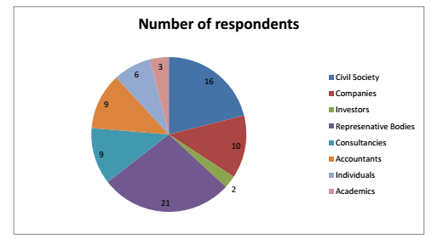
NON-FINANCIAL REPORTING: UK GOVERNMENT CONSULTATION ON Directive 2014/95/EU
February 2016 consultation on best way to transpose the directive including how best to address the differences between the EU and existing UK frameworks and how to use the flexibilities that the Directive offered.
Consultation also offered the opportunity to consider other aspects of the current UK framework and sought views on, and suggestions for improving, the regulatory framework more widely, particularly deregulation.
Consultation posed 16 questions seeking input on the following themes:
  Placement & timing of information
  Scope of the directive
  Third-party verification
  Electronic reporting
  Gender reporting
  Other regulatory reforms
76 respondents:

Slide 5
NON-FINANCIAL REPORTING: OUTCOME OF CONSULTATION
Reporting cycle/placement of report: There will be no delay between the publication of the accounts and non-financial information since this will not be helpful in giving shareholders a holistic picture of the business. Relevant information must remain within the annual report.
Integration with scope of existing UK requirements: Companies that fall within the scope of the Directive must report using the requirements laid out in the Directive. However companies outside the scope of the Directive will continue to be required to comply with the current UK requirements (an option was given to remove reporting requirements altogether from companies outside directive’s scope). Companies at the margin can voluntarily use the EU framework.
Third-party verification: Government will not make verification a mandatory requirement but companies may voluntarily seek independent verification if they wish.
Gender reporting: UK Government continuing to explore these options with business and other stakeholders to consider how best the definition of senior manager in the gender reporting requirement could be improved.
Other regulatory reforms: UK Government will not at this time repeal any additional reporting requirements that fall out of scope of the EU Directive.
Legislation went live as of 1st January 2017.

Slide 6
Q&A

