Slide 1

Diversity meets CSR:
Employment of persons with disabilities
SLOVAKIA
Tatiana Čaplová / Pontis Foundation
tatiana.caplova@pontisfoundation.sk
FEBRUARY 1 / 2017 / Zagreb

Slide 2



CONTENT
Context
Slovak Statistics on Employment of PWDs
Slovak Legislative on Employment of PWDs
Examples of Good Practice
Conclusion

Slide 3
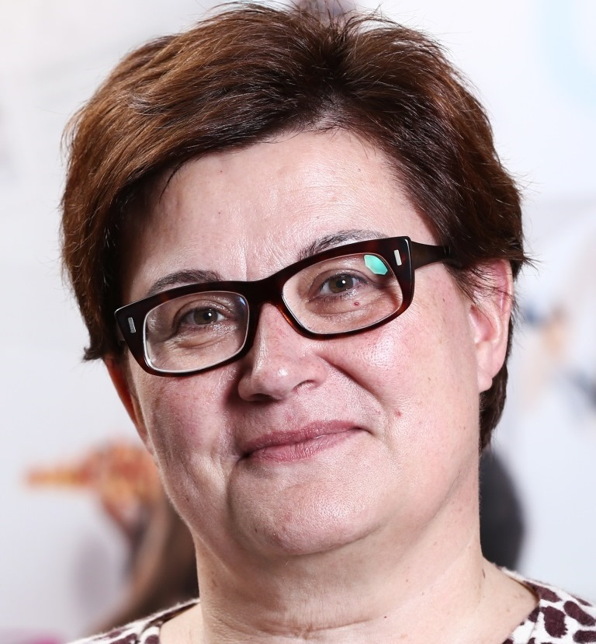
„The best way toward social integration is to provide work that gives status and dignity to a man, work that enables a person with disabilities to live a full and independent live with an adequate income.“
Wallis Goelen
DG Employment and Social Affairs European Commission

Slide 4


CONTEXT
Summary of the overall situation (PWDs)
1 billion people, or 15% of the world’s population, experience some form of disability, and disability prevalence is higher for developing countries.
1/5 of the estimated global total, or between 110 million and 190 million people, experience significant disabilities
2015: 18,4 % of people in Slovakia (963 000 persons) are at risk of poverty and social exclusion
2012: 557 000 persons with disability (14,3 % of overall population)
Source: The World Bank, 2017
Source: Eurostat

Slide 5
SLOVAK STATISTICS - PWDs
Europe 2020 targets vs Slovak targets
In relation to the Europa 2020 strategic targets, Slovakia will also have to address high rate of economic inactivity of PWD. Contrary to that, the investments to support employment of PWD have decreased dramatically over last two years.
Europe 2020 and agreed national targets for the general population:
 | Europe 2020 targets | National targets
Employment | 75% of the 20-64 year-olds to be employed | 72%
Education | Reducing the rates of early school leaving below 10% | 6%
 | At least 40% of 30-34–year-olds completing third level education | 40%
Fighting poverty and social exclusion | At least 20 million fewer people in or at risk of poverty and social exclusion | 170,000
Source: ANED/ European Semester 2015/2016 country fiche on disability

Slide 6
SLOVAK STATISTICS - PWDs
Relevant disability targets from national strategies or sources:
There are disability related targets in the National Program on Improvement of Living Conditions for Persons with Disabilities for years 2014-2020 although they are not quantifiable:
To ensure within the ALMP the inclusion of people with disabilities in the labour market especially by increasing the accessibility and availability of public employment services and counselling, as well as pay more attention to the employment of people with disabilities in an open labour market. (!!!)
To ensure for persons with disabilities the right on education without discrimination and on the basis of equal opportunities to set inclusive education system at all levels including lifelong learning.
To ensure appropriate living standards and social protection of persons with disabilities (e.g. accessible and barrier-free housing.
.
Source: ANED/ European Semester 2015/2016 country fiche on disability

Slide 7
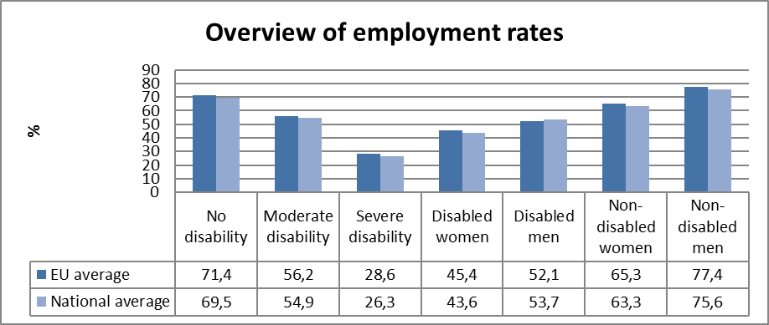
SLOVAK STATISTICS - PWDs
Most recent employment data, aged 20-64:
Data: EUSILC UDB 2013 – version 2 of August 2015
Source: ANED/ European Semester 2015/2016 country fiche on disability

Slide 8
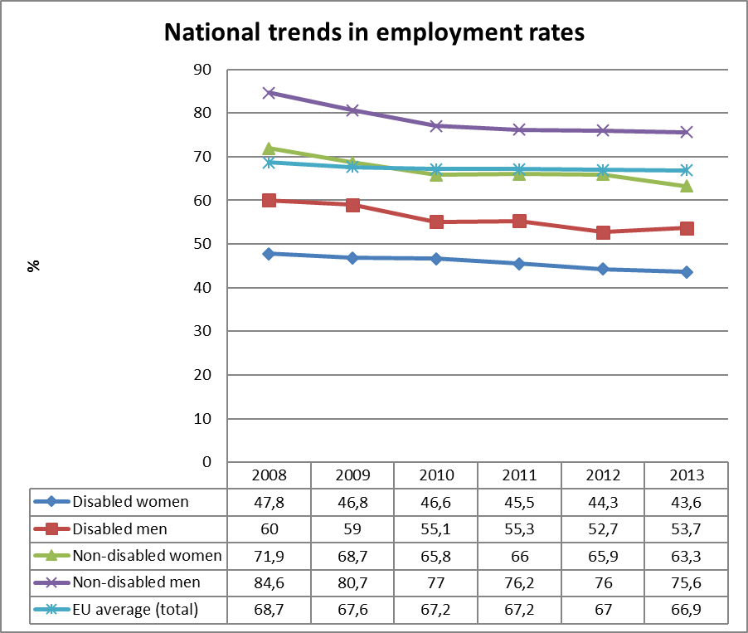
SLOVAK STATISTICS - PWDs
Data: EUSILC UDB 2013 – version 2 of August 2015
Source: ANED/ European Semester 2015/2016 country fiche on disability

Slide 9
SLOVAK STATISTICS - PWD
Economic status of persons with disabilities:
 | 2013 |  | 2014 |  | 2015
 | SIA | LFS | SIA | LFS | SIA
Persons receiving disability pension | 237,073 | n/a | 240,455 | n/a | 244,958
Of which Employed | 70,514 | 38,700 | 75,445 | 57,100 | 78,838
Unemployed | n/a | 9,500 | n/a | 12,500
Economically inactive | n/a | 239,100 | n/a | 257,500
Only marginal increase from 31.38% on 32.18% of employed persons receiving disability pension.
Data: LFS, SIA/ March 2015
Source: ANED/ European Semester 2015/2016 country fiche on disability

Slide 10
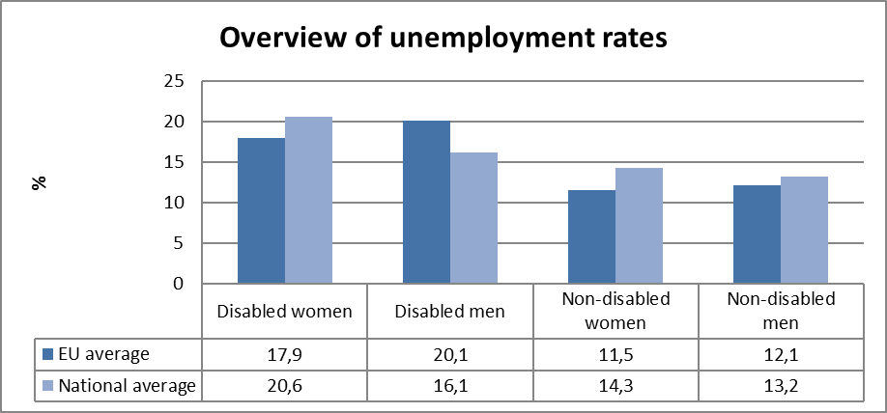
SLOVAK STATISTICS - PWD
Most recent unemployment data, aged 20-64:
Data: EUSILC UDB 2013 – version 2 of August 2015
Source: ANED/ European Semester 2015/2016 country fiche on disability

Slide 11
SLOVAK STATISTICS - PWDs
Table 3: Most recent employment data, aged 20-64
Average number of registered job-seekers in Slovakia:
 | 2013 | 2014 | Change in %
All job-seekers | 415 006 | 385 661 | -7,07 %
Disabled job-seekers | 11 659 | 12 800 | +9,78 %
Data: 2014 Annual Report on the Social Situation of Citizens
Source: ANED/ European Semester 2015/2016 country fiche on disability

Slide 12
SLOVAK STATISTICS - PWD
In a nutshell:
Based on these data it is unrealistic to expect that with the current employment rate of PWD (at about 32%) the national 2020 target (72% according to the SIA) could be achieved for the population as a whole.
It is also to be highlighted that the number of persons receiving disability pension, as well as the number of registered disabled job-seekers, has risen in 2014. In fact, whereas number of non-disabled job-seekers has fallen by 7.07% in 2014, it has risen by 9.78 % in case of disabled job-seekers. One of the explanations for the increased number of registered disabled job-seekers is reduced funding of active labour market measures for persons with disabilities as a consequence of legislation change in 2013, as well as reduced funding for ALMPs to support employment of people with disabilities.
Data: 2014 Annual Report on the Social Situation of Citizens
Source: ANED/ European Semester 2015/2016 country fiche on disability

Slide 13
SLOVAK LEGISLATIVE - PWDs
Disability quota in employment of PWD (Slovakia)
§ 63 Act No. 5/2004 on Employment Services
Disability quota is set at 3.2% of employees for employers employing more than 20 people
The positive development is seen in relative terms rather than absolute numbers. In particular, whereas in 2012, 57.3% of employers has met the quota by employing PWD, in 2014, the proportion has increased up to 63.74%. However, since the total number of employers employing more than 20 people has decreased (from 11,946 in 2012 to 10,545 in 2014), there has also been decrease in total number of employers meeting the quota (from 6,850 in 2012 to 6,721 in 2014).
Data: 2014 Annual Report on the Social Situation of Citizens
Source: ANED/ European Semester 2015/2016 country fiche on disability

Slide 14
SLOVAK LEGISLATIVE - PWD
Disability quota in employment of PWD (Slovakia)
Disability quota in employment of PWD (Slovakia)
According to the Act No. 5 of 2004 on Employment Services and its later amendments and additions to certain acts (only “the Act”), an employer giving work to a person with disabilities is bound to:
ensure adequate working conditions to perform the job,
provide initial training and preparation needed for a satisfactory job performance and make the effort to increase qualification of the employee with disabilities while performing their job,
keep a record of persons with disabilities,
employ persons with disabilities in a set quota of 3.2% of the total workforce if this exceeds 20 employees, and if the local Labour Office keeps a record of persons with disabilities in the job seekers register.
The Act authorizes employers to compensate for the compulsory share of employed disabled workers in any of the following ways:
providing a job that falls within the limits of persons with disabilities,
providing payment of social contributions,
a combination of the above stated ways of employment in accordance with the § 63 art. 1 letter d) of the Act.
Data: 2014 Annual Report on the Social Situation of Citizens
Source: ANED/ European Semester 2015/2016 country fiche on disability

Slide 15

EXAMPLES OF GOOD PRACTICE
ACCENTURE
Global program: Persons with disabilities
“At Accenture, we believe each person has unique skills, talent and strengths to contribute. Our focus is to attract, retain, develop and advance the best talent in the world. We are committed to ensuring an inclusive environment that supports our people with disabilities and provides reasonable accommodations and accessibility so they can each perform at their full potential.”
Nellie Borrero
Managing Director,
Global Inclusion & Diversity Center of Expertise
Source: https://www.accenture.com/t20161211T202534__w__/us-en/_acnmedia/PDF-1/Accenture-Persons-with-Disabilities-Fact-Sheet.pdf#zoom=50

Slide 16
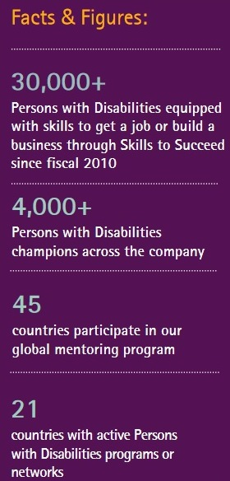

EXAMPLES OF GOOD PRACTICE
ACCENTURE
Global program: Persons with disabilities
Reasonable accomodation
Assistive technologies
Training
Source: https://www.accenture.com/t20161211T202534__w__/us-en/_acnmedia/PDF-1/Accenture-Persons-with-Disabilities-Fact-Sheet.pdf#zoom=50

Slide 17
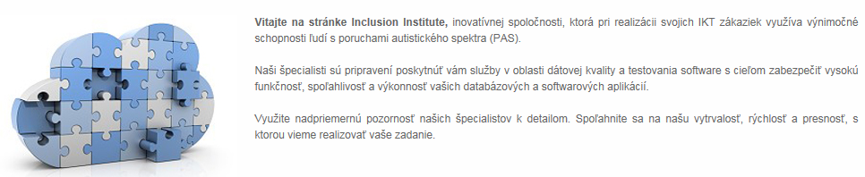
EXAMPLES OF GOOD PRACTICE
ACCENTURE SLOVAKIA
Strategic project “Work integration of people with Autism”
Aim: to involve people with autism in the work process
22 persons with Autism employed during 7 months
3,407 hours worked
Tasks performed: classification of registry entries, control of scanned registry entries
Setting up good practice for preparation of autistic people for professional life
Creating a database of applicants with autistic for potential future orders
In partnership with 3Lobit, http://inclusion.sk/
Budget: 20,000 €
Source: Accenture Slovakia

Slide 18
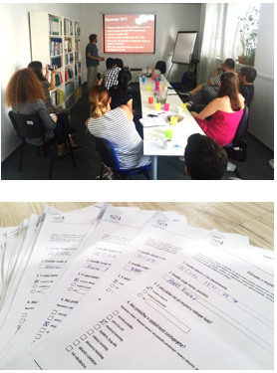
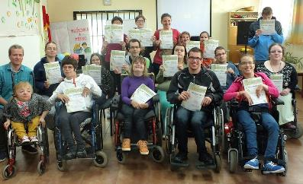
EXAMPLES OF GOOD PRACTICE
ACCENTURE SLOVAKIA
Examples of Projects through Employees’ Grant Program:
EDUMA, NGO
From emotions to knowledge
This project is based on the idea that a disability can be used as an advantage in access to employment in a position of a mystery shopper. Thirteen people with various disabilities were employed as a result of the project.
OZ Barlička
Work makes noble
Work internships for 18 young people with health disabilities in Prešov region (Eastern Slovakia). Participants worked and gained important new skills in three groups (food preparation, ironing and laundry processing).
Source: Accenture Slovakia

Slide 19
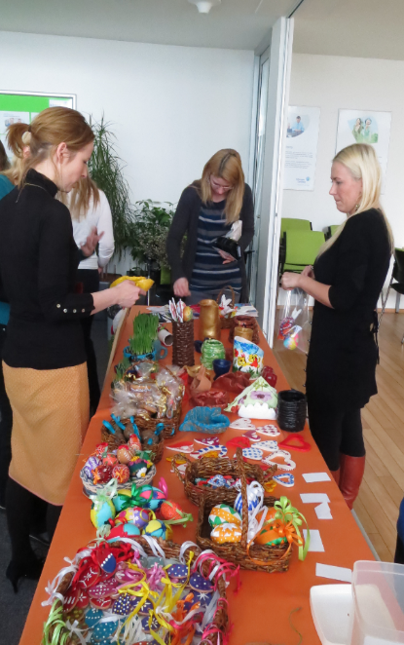
EXAMPLES OF GOOD PRACTICE
ADIENT SLOVAKIA
Sheltered workshops
      They host since beginning sheltered workshops in their premises (sheltered workshops = employed disabled persons)
      Christmas and Eastern markets in offices

Slide 20



Q & A
ANY QUESTIONS ?

Slide 21

THANK YOU
....for your attention.
Tatiana Čaplová
Program Coordinator
Pontis Foundation / Business Leaders Forum
tatiana.caplova@pontisfoundation.sk

