Slide 1

Zagreb,
30th January 2017
Hi4CSR Learning Activity
Non Financial Reporting:
Current Developments at EU level

Slide 2
Overview
The Context: European Commission Strategy on CSR
Non-Financial Reporting: Legislative Framework
Non-Financial Reporting Directive
What’s new?

Slide 3
1. European Commission Strategy on CSR
EU Commission definition of CSR
“…the responsibility of enterprises for their impact on society…”
Why is CSR important?
  In the interest of enterprises
  In the interest of the EU economy
  In the interests of society
European Commission Strategy on CSR
  Enhancing visibility and disseminating good practices
  Improving and tracking levels of trust in business
  Improving self and co-regulation processes
  Enhancing market rewards for CSR
  Improving company disclosure of social and environmental information
  Further integrating CSR into education, training, and research
  Emphasizing the importance of national and sub-national policies
  Better aligning European and global approaches to CSR

Slide 4
2. Non-Financial Reporting:
Legislative Framework
Directive 2014/95/EU on disclosure of non-financial and diversity information by large companies and groups (Non-Financial Reporting Directive)
  published in the Official Journal of the EU on 15 November 2014
  EU Member States to transpose the rules into national legislation by 6 December 2016
…amending Directive 2013/34/EU on the annual financial statements, consolidated financial statements and related reports of certain types of undertakings (Accounting Directive)
…amending Directive 2006/43/EC on statutory audits of annual accounts and consolidated accounts

Slide 5
3. Non-Financial Reporting Directive
Who? Large company with more than 500 employees and that
  issues transferable securities admitted to trading on a regulated market in the EU;
  is a credit institution
  is an insurance undertaking
  is designated by a Member State as a public interest entity
  has a balance sheet total of at least EUR20 mln or a net turnover of at least EUR40 mln
What? Information covering at least
  environmental, social and employee matters,
  respect for human rights,
  anticorruption and bribery issues
  diversity in the company’s board of directors
Why?
  To improve the quality of non-financial reporting across the EU
  To allow greater comparability
  To attract inward investment

Slide 6
4. What’s new?
Public consultation on the non-binding guidelines for reporting on non-financial information by companies
  Public consultation from 15 January to 15 April 2016
  16 bilateral expert interviews, and two workshops with more than 80 stakeholders in September 2016
  results and feedback statement published on 20 September 2016:
    355 responses
    Plurality of views
    Companies and business organisations consider that the guidelines should be oriented towards general principles, providing flexibility to companies to exercise judgement, and making reference to other frameworks
Notes:
(Global Reporting Initiative, UN Global Compact, International Integrated Reporting Council and CDP)

Slide 7
4. What’s new?
EU Commission working on non-binding guidelines on methodology for reporting non-financial information
  the Directive required the Commission to prepare the guidelines by 6 December 2016
  Planning adjusted to include the work of industry-led Task Force on climate-related financial disclosures by the Financial Stability Board
  “Non-binding guidelines” will be published in Spring 2017
  Transposition workshops to assist national authorities
It’s live! ☺
  The Directive applies to all Member States from 1 January 2017
  First reports are to be published in 2018
Notes:
(on financial year 2017)

Slide 8
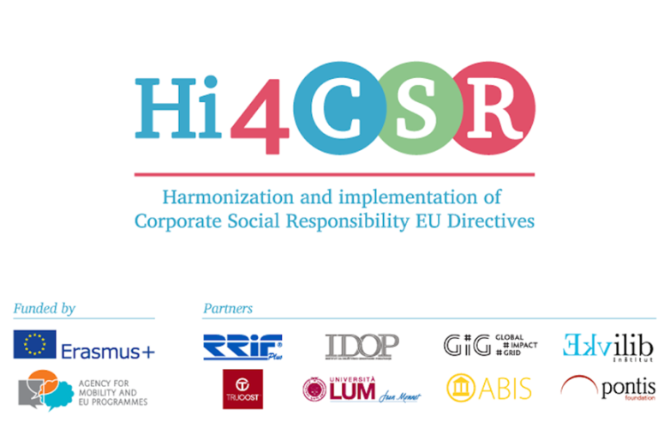
Thank you for your attention!
Karolina Sobczak
Projects Coordinator

