Slide 1
Eco-labels in Croatia
Zvonimir Vukić
IDOP

Slide 2
Introduction
Every product has a negative impact on the environment in one way or another, which is reflected in all stages of the so-called life-cycle of the product: from manufacturing, packaging, distribution to consumption, use and disposal after use.
Ecolabelling award scheme in Croatia was established in 1993.
It was modelled after the German system which has existed since 1977 and is the forerunner of all ecolabeling schemes which are in existence today.

Slide 3

"Organic Product of Croatia”
According to the 2010 Act on Organic Production and Labelling of Organic Products this eco-label can be used for labelling, advertising and presentation of products
The products having this label are either described or marked with terms "organic", “natural” or with abbreviations "bio" or "eco"
Eco certificate in Croatia is awarded by the Ministry of Environment and Energy.

Slide 4

“Environmentally Friendly”
The label "Environmentally Friendly" on products indicates to the consumer that the product is in fact less harmful to the environment
This type of label is awarded on the basis of pre-established criteria, with the participation of experts and general public, following a precisely defined procedure.
The award of the label is not therefore intended as a prize or a reward in terms of competition, but is instead directed to the development of a recognizable product quality from the standpoint of environmental protection

Slide 5

“Croatian Creation”
Label “Croatian Creation”is awarded to the products and services of outstanding quality, if they are manufactured in the Republic of Croatia and are the result of Croatian tradition.
It is awarded by the Croatian Chamber of Economy.
Rigorous testing of goods and services is required, since only the best Croatian products and services can carry the label.

Slide 6

“Croatian quality”
The right to use the “Croatian Quality” mark is awarded to goods of above-average quality which are made within the Croatian territory.
For the right to use the mark, the Croatian Chamber of Commerce and the user will sign a three-year contract for use of the mark, based on the branding protocol.

Slide 7

Recycling
This symbol indicates that the packaging is recyclable or has already been recycled during the reproduction. It generally refers to paper and cardboard.
Recycling symbol, which is internationally standardized as ISO symbol 7000-1135, is used in the EU, the US, Canada, Australia and other countries.

Slide 8

EU Ecolabel
EU Ecolabel is the official voluntary eco-label scheme of the European Union established by the European Commission, for the products and services with fewer adverse environmental impacts throughout the life cycle, compared to the same or similar products and services from the same group of products.
The EU Ecolabel on one hand gives companies confirmation that their products and services meet high environmental standards and on another hand, provides information to consumers and retailers how to chose those products and services wich have less of an impact on the environment and are the more green choice.

Slide 9
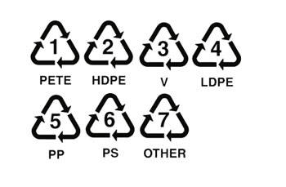
Plastics
At the bottom of every plastic package, look for the triangle with three "chasing arrows" and a number in the middle. That number indicates how dangerous your plastic really is.
As for disposable plastic bottles, there is considerable evidence that some toxic chemicals will leach out of the plastic, such as heavy metals and compounds which interfere with hormone functions and are suspected human carcinogens.

Slide 10
Which Plastics Are Safe?
2 – HDPE ’good’ plastic
3 – PVC ( or 3V ) – this plastic is known to leach two dangerous compounds, both of which interefere with hormone functions
4 – LDPE – type of plastic which is not known to leach chemicals in the water

Slide 11
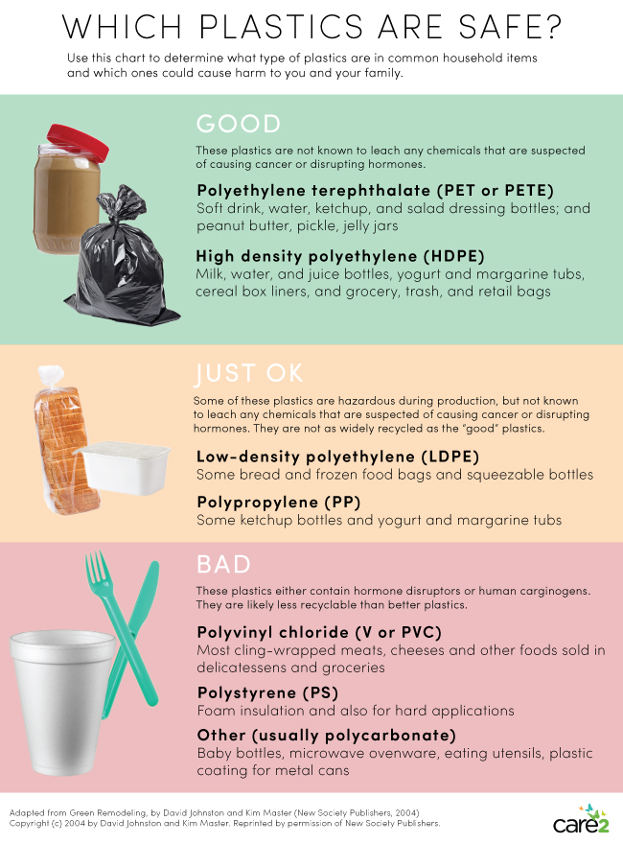

Slide 12
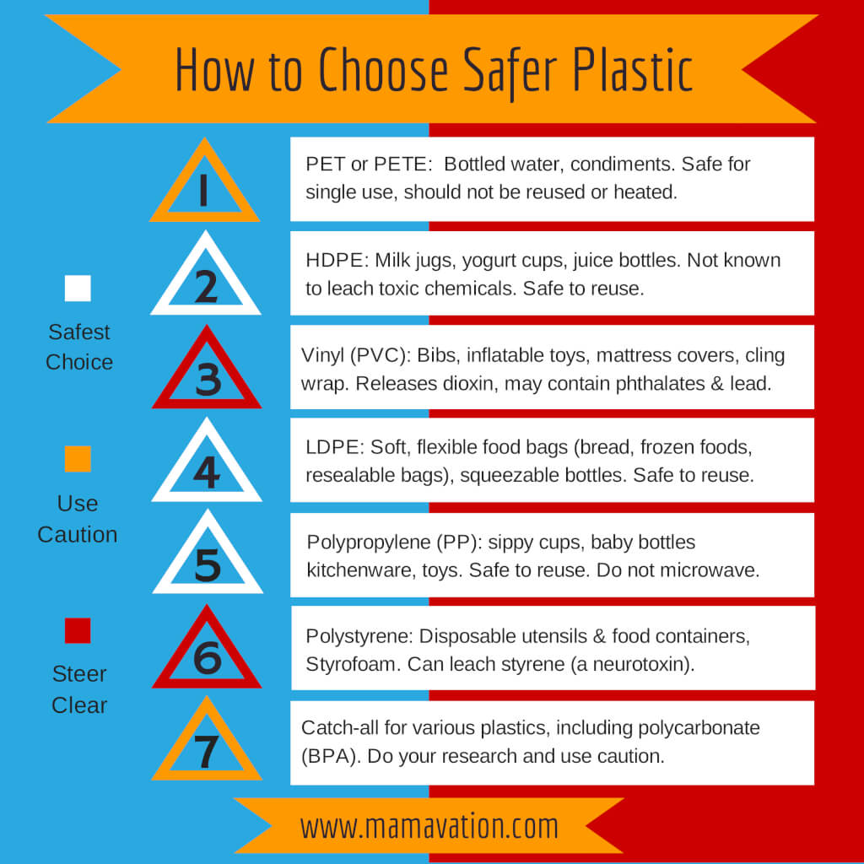

Slide 13
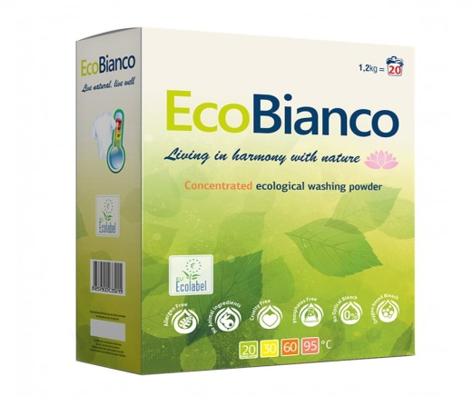
Example of good practice
Company Ecology 108 Ltd. obtained the European Ecolabel certificate in September of 2016
Ecolabel was awarded to laundry detergent EcoBianco
Detergent EcoBianco has passed the independent verification process in compliance with EU standards in the category ‘Laundry Detergents’, which has confirmed that the product contains smaller amount of chemicals and hazardous substances, has increased biodegradability and diminished the negative impact on the environment while remaining highly effective.

Slide 14
Conclusion
Eco-labels are voluntary environmental protection instruments intended primarily for the market and the consumers
Eco-labels are important for raising environmental awareness among the population and promoting sustainable production and consumption
Every day more and more countries have been introducing the use of eco-labels and other kinds of environmental policies
Croatia has also joined those efforts as evidenced by its two eco-labels

Slide 15

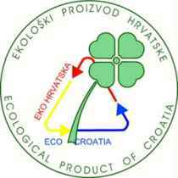
Thank you!

