Slide 1

Zagreb,
31st January 2017
Hi4CSR Learning Activity
Ecolabels:
Current Developments at EU level

Slide 2
Overview
Introduction
EU Ecolabel - Legal Framework
EU Ecolabel - Characteristics
EU Ecolabel - Statistics
What’s new?

Slide 3
1. Introduction
What exactly an ecolabel is?
  Voluntary environmental performance certificate awarded to products and services, that have to meet specific, identified criteria which reduce overall environmental impact
How many ecolabels are in circulation?
  Ecolabel Index, the largest global directory of ecolabels, currently tracking 465 ecolabels in 199 countries, and 25 industry sectors, 239 in Europe
Which labels to trust with so many products and services making green claims?
Notes:
Ecolabel Index, the global directory of ecolabels by Big Room

Slide 4

2. EU Ecolabel - Legal Framework
The environmental label of the EU
launched in 1992 by the European Commission as a Europe-wide voluntary environmental labelling scheme that consumers could trust
implemented by Regulation No 66/2010
part of the EU Action Plan on Sustainable Consumption and Production and Sustainable Industrial Policy (2008)
linked to other EU policies such as green public procurement (GPP), Ecodesign of energy-using products (2009) and EU Eco-Management and Audit Scheme - EMAS (2009)

Slide 5
3. EU Ecolabel - Characteristics
Based on the life-cycle approach
  has been designed to ensure that their main environmental impacts are reduced throughout the product’s life-cycle, from the extraction of raw materials, to production, packaging and transport, right through disposal
Assessed by independent experts
  that set, together with panels of stakeholders, the ecological criteria products and services must comply with to be awarded the EU Ecolabel
now has 38760 products and services comprised by 1998 licenses (September 2016)
Notes:
as of the September 2016 reporting period.

Slide 6
4. EU Ecolabel – Statistics
Drop in EU Ecolabel licences and products/service in March 2016, in line with the expiry of some product group criteria
Until September 2016, a significant amount of licences were reintegrated after reassessment against the new criteria → upswing in licences and products/services
During this reporting period, the largest number of EU Ecolabel licences was awarded in France (26%), Italy (18%), and Germany (12%)
Out of the total licences, the majority of products/services comprised within this total are from Italy (46%), France (10%), and Spain (9%)
Notes:
“indoor paints and varnishes”, “outdoor paints and varnishes”, “soaps, shampoos and hair conditioners”, which had a significant amount of awarded products

Slide 7
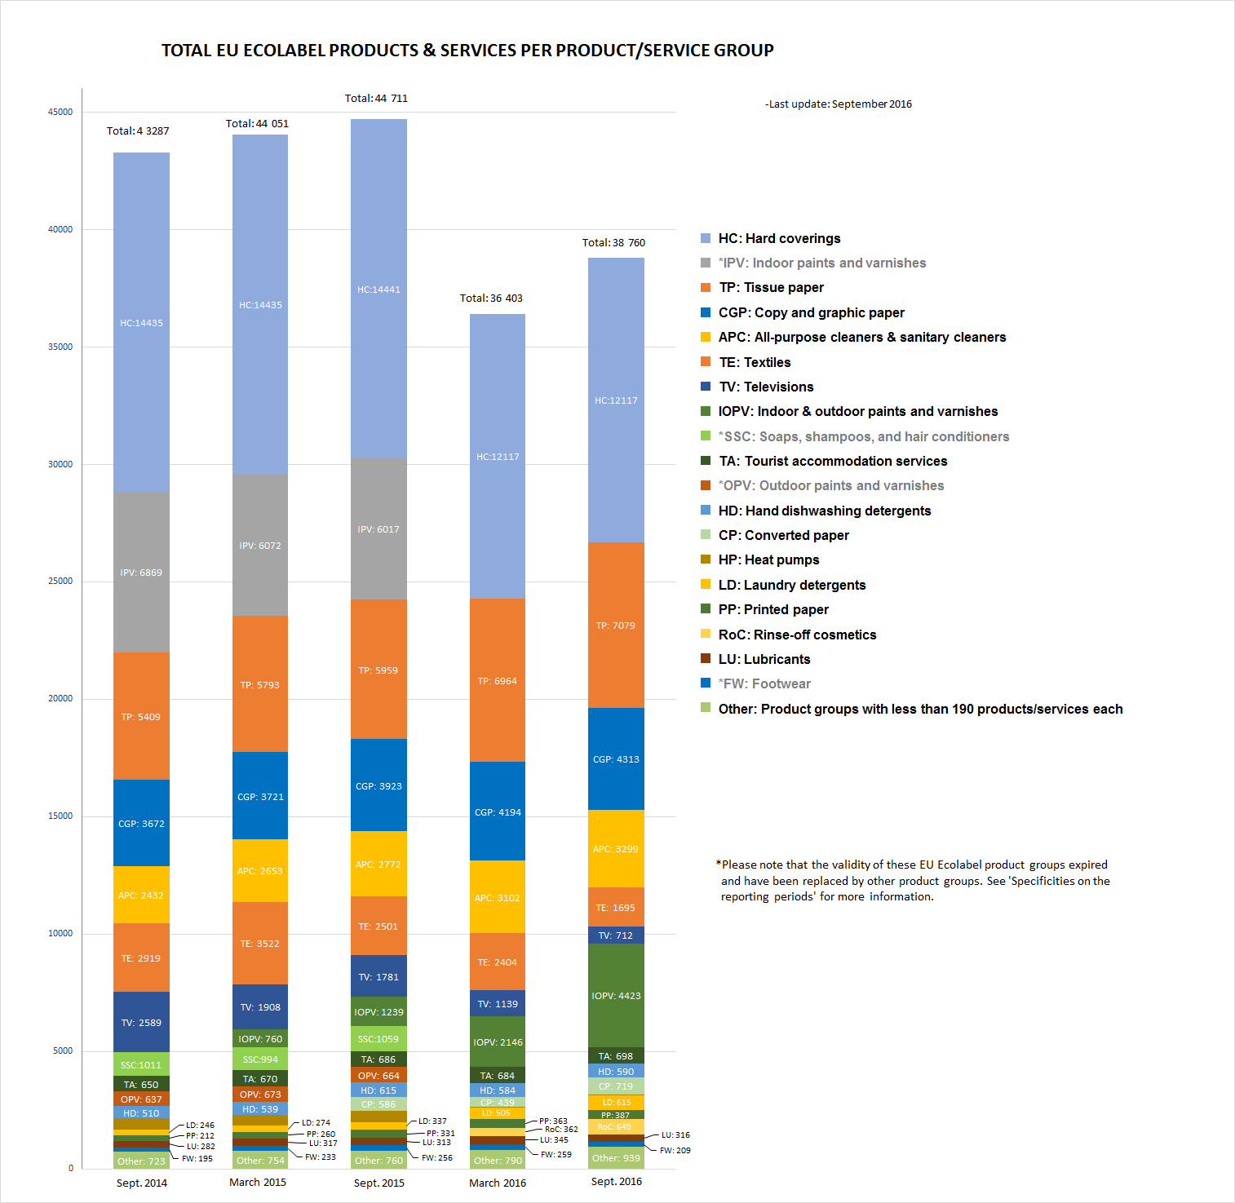
4. EU Ecolabel – Statistics

Slide 8
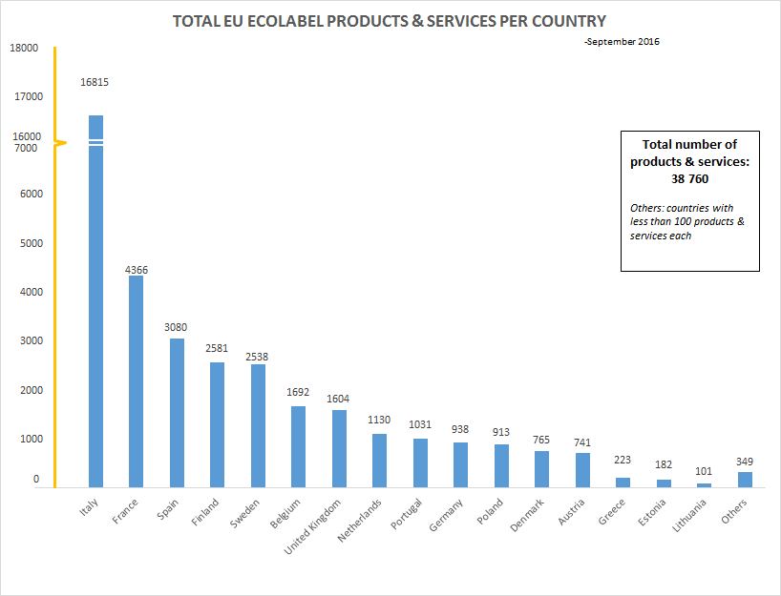
4. EU Ecolabel – Statistics

Slide 9
5. What’s new?
April – July 2014
  EC consultation to support the evaluation of the Implementation of the EU Ecolabel Regulation (EC) 66/2010
  “… the results of the consultation will be part of the evaluation of the Ecolabel regulation. The evaluation will also be based on interviews and other data. A workshop is planned for fall 2014 before preparing the final evaluation”
December 2014
  Fitness Check under the 2015 REFIT Actions of:
    Regulation (EC) No 1221/2009 of 25 November 2009 on the voluntary participation by organisations in a Community eco-management and audit scheme (EMAS)
    Regulation 66/2010 on the EU Ecolabel
  Results expected for 2015
Notes:
The purpose of the fitness check is to evaluate and assess the contribution to competitiveness, sustainable consumption and production. The Commissions Regulatory Fitness and Performance Programme (REFIT) aims to assess the effectiveness, efficiency, coherence, relevance and EU added value of specific parts of the EU acquis. The EU Ecolabel and EMAS Regulations have been selected to be part of this exercise. The results are expected by the end of 2016.

Slide 10
5. What’s new?
March 2016
  EU Ecolabel and EU Eco-Management and Audit Scheme (EMAS) REFIT still ongoing
  EU Ecolabel Work Plan for 2016-2018:
    EU Ecolabel implementation strategy (role of competent bodies, criteria, communication)
    Policy development (coherence implementation, harmonization with Circular Economy, Sustainable Consumption and Production, Green Public Procurement, Ecodesign Directive, energy labeling etc.)
    Cross–cutting issues tackled by new tasks forces are being established to tackle and develop common guidance applicable for all product groups
      Chemicals Task Force
      Strategic Task Force on EU Ecolabel uptake
      Energy Task Force
      Task Force on the promotion of EU Ecolabel Tourism Accommodation Services
Notes:
The Commissions Regulatory Fitness and Performance Programme (REFIT) aims to assess the effectiveness, efficiency, coherence, relevance and EU added value of specific parts of the EU acquis. The EU Ecolabel and EMAS Regulations have been selected to be part of this exercise. The results are expected by the end of 2016.
In order to harmonise the criteria development and implementation, tasks forces are being established to tackle cross–cutting issues and develop common guidance applicable for all product groups. After a consultation with the members of the EUEB and interested stakeholders, a number of cross cutting issues have been identified in June 2015 as of particular interest for the years 2016-2018. A call for interest has been issued to EUEB Members in June 2015 to participate to the corresponding task forces
Chemicals Task Force (work started in March 2016, initial options and proposals for discussion planned for November 2016 and final proposals for April 2017) • Strategic Task Force on EU Ecolabel uptake (work started in February 2016, first results planned for May 2016) The work of the Energy Task Force is planned to start in 2017, in order to match the timing of the Task Force's results with the timing of possible revision of the EU Ecolabel criteria for relevant product groups. In addition, a Task Force on the promotion of EU Ecolabel Tourism Accommodation Services will begin its work under the lead of AFNOR, France.

Slide 11
5. What’s new?
October - November 2016
  REFIT still ongoing
  Commission updated EU Ecolabel criteria for computers, furniture and footwear
  EC Work Programme 2017: Delivering a Europe that protects, empowers and defends (25.10.2016)
    No reference to EU Ecolabel!
  Concerns of members states and relevant organizations on the future of the EU Ecolabel !
    Series of open letters to EC from EEB, BEUC, EuroCommerce, ANEC, ECOS etc.
  EU Ecolabel Advisory Board meeting expected in November
Notes:
Commission faces backlash over Ecolabel uncertainty
Member states are considering action to support the voluntary EU Ecolabel scheme after leaked documents revealed that the European Commission may scrap it, ENDS has learned
ENDS Europe | Commission faces backlash over Ecolabel uncertainty Europe's environmental news and information service
EU Ecolabel could be scrapped, leaked doc shows
ENDS Europe (subscription)-02 Nov 2016
http://www.eeb.org/index.cfm/library/eeb-beuc-letter-on-ecolabel-future/
28 October 2016
Let’s reinforce not reduce Ecodesign and Ecolabel
Brussels, 15 November 2016
Open letter regarding EEB and BEUC concerns on the future of the EU Ecolabel Regulation and on the fate of specific product groups
19 December 2016
Letter to the European Commission President Juncker and First Vice-President Timmermans (CC Vice-President Katainen, Commissioner Vella)
http://www.eeb.org/index.cfm/library/concerns-on-the-potential-discontinuation-of-eu-ecolabel-product-groups-letter-to-the-ec-president-juncker/
http://www.beuc.eu/publications/beuc-x-2016-142_mgo_letter_to_the_european_commission_president_juncker_and_first_vice-president_timmermans-_eu_ecolabel.pdf

Slide 12
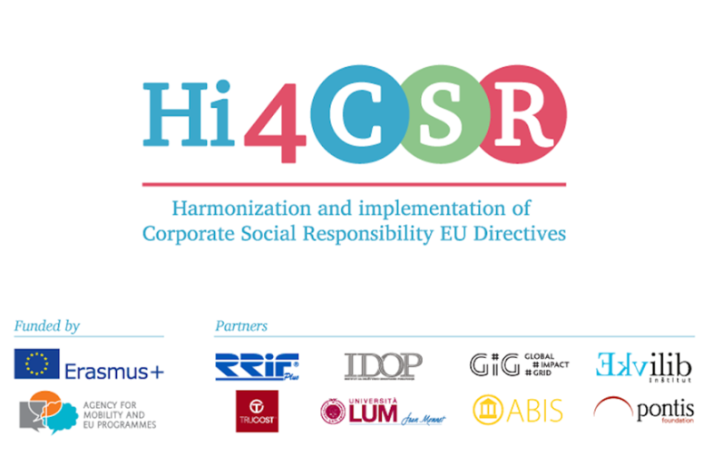
Thank you for your attention!
Karolina Sobczak
Projects Coordinator

