Slide 1
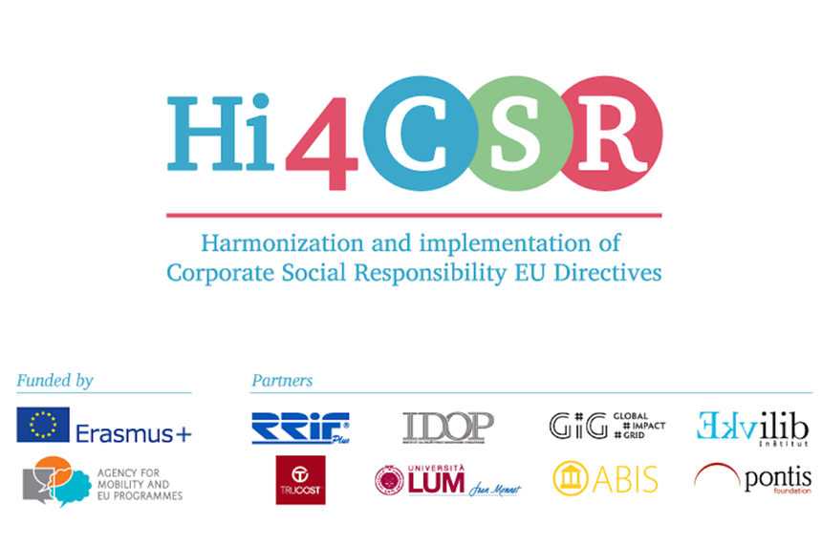
Recycling and waste reduction– LUM Jean Monnet University
LA Zagreb 03/02/2017

Slide 2
Initiative | Entry into force | Last update | Level of enforcement | Disclosure requirements
Ordinance of 26 June 1995 concerning safety requirements for street-vended food | Jun, 26, 1995 | Aug, 28, 1996 | Mandatory | No
Legislative Decree n. 30 of 2013: Implementation of Directive 2009/29/EC | Apr, 5, 2013 | Jul, 23, 2015 | Mandatory | Yes
Social Reporting GBS 2013 Standard - Principles and Standard for Sustainability Reporting | 2013 |  | Voluntary | Yes
Social Report In Public Administration | 2006 |  | Voluntary | Yes
Legislative Decree No. 121 on the protection of the environment through criminal law as well as on ship-source pollution | Aug, 16, 2011 |  | Mandatory | No
Legislative Decree No. 152 concerning the protection of waters against pollution | May, 11, 1999 | 2003 | Mandatory | Yes
Legislative Decree No. 182 on port reception facilities for ship-generated waste and cargo residues | Aug, 6, 2003 | 2009 | Mandatory | Yes
Legislative Decree No. 53 on ship safety, pollution prevention and living conditions and work on board for ships | May, 12, 2011 |  | Mandatory | Yes
Legislative Decree no. 22 of 1997 on waste, hazardous waste and packaging and packaging waste | 1997 | 2003 | Mandatory | Yes
Legislative Decree 152/2006 - Environmental Code | Apr, 14, 2006 | 2015 | Mandatory | Yes
Data courtesy of eRevalue

Slide 3
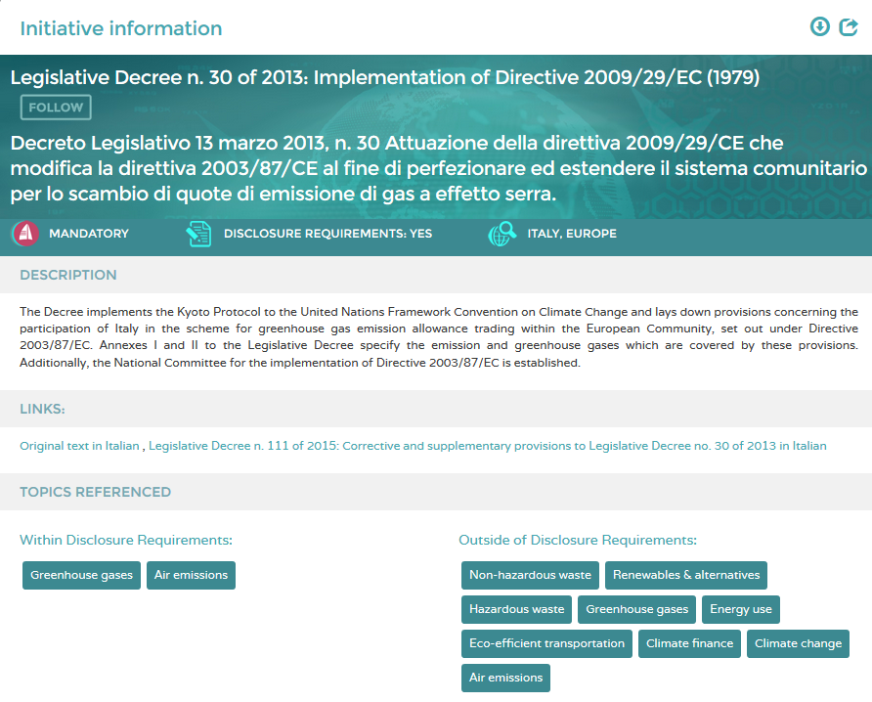
Data courtesy of eRevalue

Slide 4

Best practice: networking

Slide 5
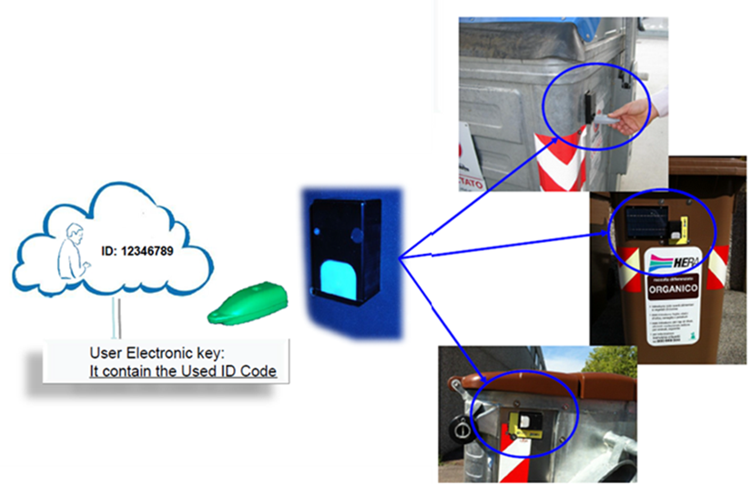
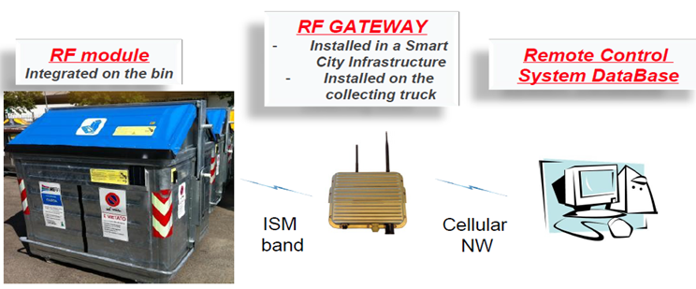

Slide 6
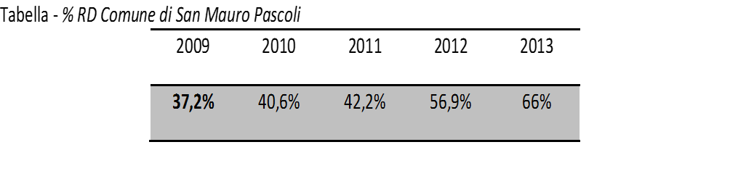
Impacts:
Data monitoring
Efficiency
Change of behavior
The project made recycling easier?
Score | #
1 | 18
2 | 13
3 | 17
4 | 22
5 | 30
Total sample | 100
Average score
3,71

