Slide 1
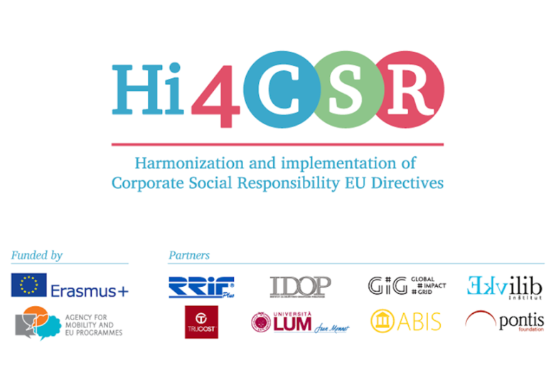
Stimulating the processing of used materials
Slovenia

Slide 2
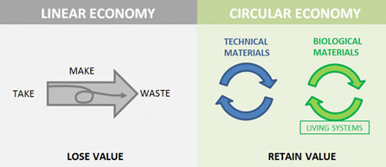
NEW PARADIGM: WASTE = RESOURCE

Slide 3
In october 2015, Slovenia adopted a framework program for transition to green economy
Saving the environment + economic growth = GREN GROWTH

Slide 4
program of waste management and waste prevention program
Adopted in June 2016 by Slovenian government
OBJECTIVE: To prevent or reduce the harmful effects of waste generation and waste management
an umbrella strategic document to introduce a new approach to the treatment of waste
in planning of policy and law-making it is necessary to take into account the five-step waste hierarchy: waste prevention, preparation for reuse, recycling, other processing operations, disposal of waste.

Slide 5
program of waste management and waste prevention program
Programme of waste management identifies 31 measures
Waste prevention programme identifies 8 long-term objectives and 34 actions, among others:
organization of a registry of environmental protection and record keeping;
information and awareness;
solving the problems of illegal waste dumping;
redefining the principle of extended producer responsibility
tightening of conditions of who can be waste collector

Slide 6
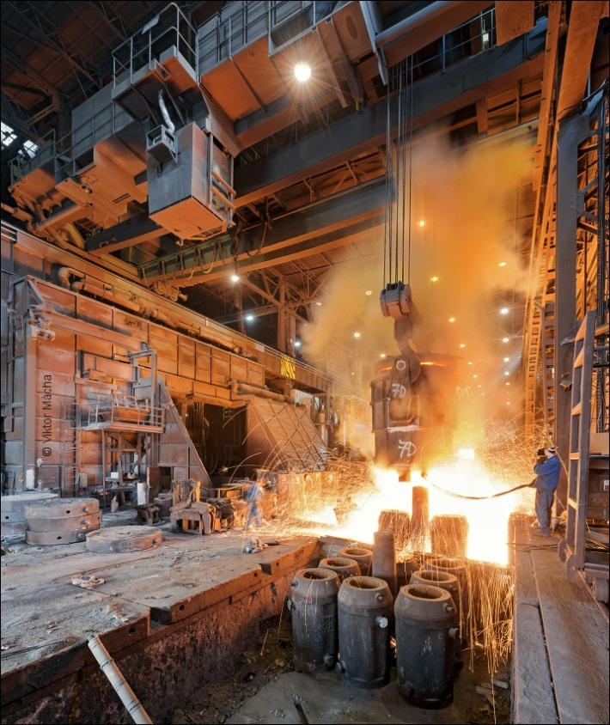
Petrol Energetika, Koroška region
Excess heat from steel factory Metal comes into the heating plant Petrol, which is then used for heating in municipality Ravne na Koroškem and sanitary water heating.

Slide 7

Valtex
Selected as highly commended entry on global competition as an example of good circular economy practice in the category of best governmental, regional or city project of circular economy
The material flow cycle, which has been established in Novo mesto and eight surrounding municipalities in 2015/2016, is the first such example of circular practice in the world
Citizens who seperate the waste actively provide raw material - milk and juice cartons→ from which the toilet paper and paper hand towels are then produced in regular industrial process→ towels and toilet paper are then returned and consumed in municipal infrastructure of Novo mesto
Citizens participate actively in the circular economy of Novo mesto and surrounding municipalities

Slide 8
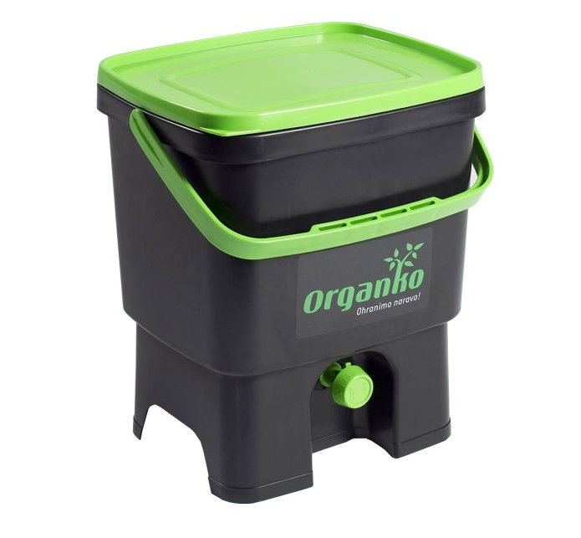
Plastika skaza
ORGANKO is a mini composter made of waste packaging
Croatian municipality Osijek bought 3000 ORGANKOS
By the end of August 2016 Osijek reduced the amount of bio-waste by 1200 tons

Slide 9

Wcycle, municipality Maribor
The aim of the project is to establish a circular economic model by connecting three companies under public ownership: SNAGA as a collector and processor of waste, NIGRAD (utility services) and ENERGETIKA (energy services).
SNAGA: after processing the waste, part of it goes into reuse
NIGRAD: takes construction waste and processes it into building materials
ENERGETIKA takes part of the waste for incineration and use it to generate energy

Slide 10
Center reuse - When waste products get new life
http://www.cpu-reuse.com/
Center reuse Ljubljana works in partnership with public enterprises
Anyone can submit products that are no longer needed and are still well preserved, such as furniture, computer equipment, books, equipment for home and leisure, bicycles, sporting goods, clothing, toys - in short, everything that is well preserved , functional and useful.
CPU products will be prepared for re-use and placed for sale at a symbolic price in the Green Store, where you will also find attractive and unique products from different materials. By purchasing the CPU Ljubljana you save money, conserve natural resources and support local jobs.

