Slide 1
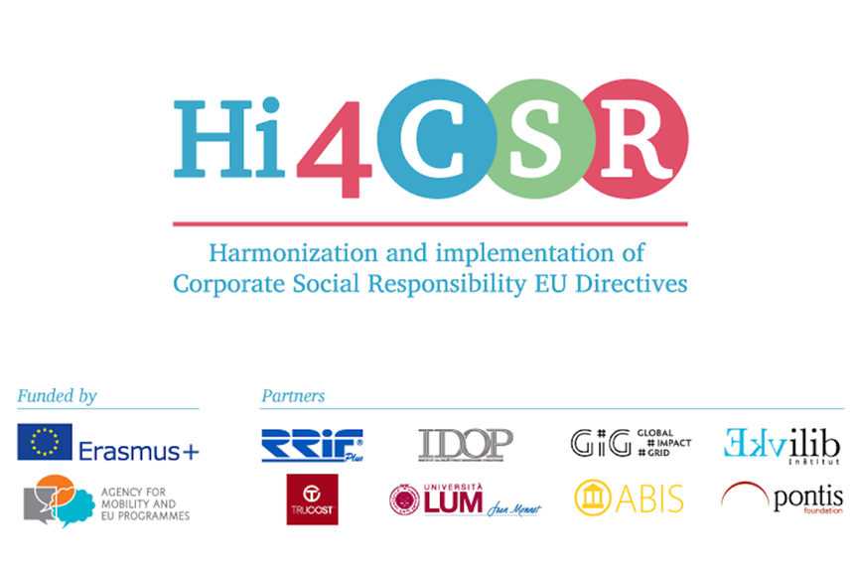
Circular Economy
Stimulating the processing of used materials
SLOVAKIA
Tatiana Čaplová / Pontis Foundation
tatiana.caplova@pontisfoundation.sk
FEBRUARY 3 / 2017 / Zagreb

Slide 2



CONTENT
Introduction
Waste Policy & Legislation of EU
Slovak Legislation in the Area of Waste Managment
Circular economy
Good practices (not only) from Slovakia

Slide 3


INTRODUCTION
Summary of the overall situation
In Europe, we currently use 16 tonnes of material per person per year, of which 6 tonnes become waste. //European Commission
In 2014, total waste production in the EU amounted to 2 144 million tons (75,5 million tons of hazardous waste).
In 2014, packaging waste by waste operations and waste flow amounted to 82 milion tons – 65 % was recycled.
Recycling rate of municipal waste in EU28 was 45 % in 2015.
In 2014, total waste production in the Slovakia amounted to 7,12 million tons (202 711 tons of hazardous waste).
Approximately 67 percent of waste ends up in landfills, with 11 percent incinerated. Recycling and composting together account for only 5 percent of waste in Slovakia. //Slovak Spectator, 2016.
Recycling rate of municipal waste in Slovakia was 14,9 % in 2015.
In 2014, packaging waste by waste operations and waste flow amounted to 463 613 tons – 65 % was recycled.
Source: Eurostat
Source: https://spectator.sme.sk/c/20124437/slovakia-pursues-a-circulation-economy.html,

Slide 4
EU LEGISLATION
New Waste Policy & Legislation of EU
The European Commission adopted an ambitious Circular Economy Package, which includes revised legislative proposals on waste to stimulate Europe's transition towards a circular economy.
Key elements of the revised waste proposal include:
A common EU target for recycling 65% of municipal waste by 2030;
A common EU target for recycling 75% of packaging waste by 2030;
A binding landfill target to reduce landfill to maximum of 10% of municipal waste by 2030;
A ban on landfilling of separately collected waste;
Promotion of economic instruments to discourage landfilling ;
Concrete measures to promote re-use and stimulate industrial symbiosis –turning one industry's by-product into another industry's raw material;
Economic incentives for producers to put greener products on the market and support recovery and recycling schemes (eg for packaging, batteries, electric and electronic equipment, vehicles).
Source: European Commission. http://ec.europa.eu/environment/waste/target_review.htm

Slide 5
SLOVAK LEGISLATION
Slovak legislation
NEW
Act No. 79/2015 Coll. on waste and amendments to certain acts (!!!)
Selected regulations governing the field of waste in Slovakia
Complete wording of Act No. 223/2001 Col. on Waste and Amendment and Supplement to Some Act
Amendment Act No. 343/2012 Coll. amending Act No. 223/2001 Coll. on Waste (complete current wording)
Decree of the Slovak Ministry of Environment No. 310/2013 Coll. on Implementing Certain Provisions of the Act on Waste
Decree of the Slovak Ministry of Environment No. 284/2001 Coll. witch estabilised Calatogue of waste
...
Regulations governing the field of packaging and packaging waste in the European Union
European Parliament and Council Directive 94/62/EC on packaging and packaging waste; consolidated version, including all amendments and supplements
European Parliament and Council Directive 2008/98/EC on Waste and repealing certain Directives
Source: NATUR-PACK. http://www.naturpack.sk/en/legislation/

Slide 6
SLOVAK LEGISLATION
Act No. 79/2015 Coll. on waste and amendments to certain acts
New Slovak waste management legislation
After a lengthy legislative process, a new Slovak waste act (“Act“) has been approved. The Act, which came into effect on 1 January 2016, completely replaced the previous waste management and packaging legislative regime.
The new legislation affects all levels of waste management, and thus changes brought by the Act should be considered from the viewpoint of players in the waste management sector, such as producers of certain goods, municipalities, and entrepreneurs active in the waste management industry.
New regulation on municipal waste
Currently, more than 70 % of waste collected in Slovakia ends in landfills. In order to change this portion in favor of recycling or other treatment of waste, the Act imposes obligations on the producers, entrepreneurs, and on municipalities regarding the separation and recycling of waste and with respect to treatment of illegal landfills. The Act also regulates in greater detail the relationship between producers (or their collective organisation) and municipalities.
Source: Hekelová, S.; Lučivjanský, M. http://roadmap2016.schoenherr.eu/no-time-to-waste-new-waste-legislation-in-slovakia/

Slide 7
SLOVAK LEGISLATION
Act No. 79/2015 Coll. on waste and amendments to certain acts
Producer responsibility
Under previous waste management legislation, extended producer responsibility was applicable to enumerated types of waste, with specific rules for each type. Under the Act, this responsibility will be imposed in similar ways upon producers (including importers) of electrical appliances, batteries and accumulators, packaging, cars, tyres, and other non-packaging products (such as paper, cardboard, or glass). The Act also creates obligations to distributors of some of these products as well.
Obligations include various duties related mainly to the responsibility to treat waste resulting from a product placed on the Slovak market. Producers can fulfil these obligations:
(i) individually – in such cases producers would be obliged to create their own systems of handling of the relevant waste stream. In particular, they would be required to obtain authorisation for fulfilling their obligations directly from the Ministry of Environment; or
(ii) collectively – by fulfilling producer obligations collectively, through a producers’ organisation. The organisation would have to apply for authorisation from the Ministry of Environment.
Source: Hekelová, S.; Lučivjanský, M. http://roadmap2016.schoenherr.eu/no-time-to-waste-new-waste-legislation-in-slovakia/

Slide 8
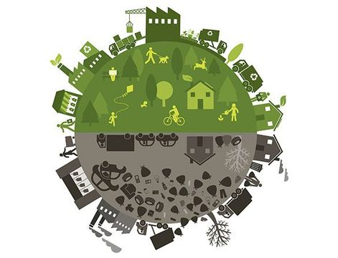
CIRCULAR ECONOMY

Slide 9

CIRCULAR ECONOMY
Why should companies be interested in circular economy ?
Circular economy represents a new alternative to a traditional linear economy based on “take-make-consume-dispose” patterns. The re-circulation of materials in economy helps keep resources in the production process as long as possible and use them to the maximum of their value.
The Cradle to Cradle principle motivates companies not only to manufacture less harmful products but also products which improve the environment around us. Although businesses often take the linear direction, there are a large number of companies which are trying to renew, recycle and reuse existing materials or waste in production.
According to the European Commission’s information, better product eco-design, prevention of waste creation, or reuse of materials in production can save European companies up to €600 billion. Increasing the efficiency of the use of resources by 30 % could help countries increase their GDP by 1 % by 2030 and create two million new jobs.

Slide 10
CIRCULAR ECONOMY
BLF Recommendations in the field of Circular Economy
1.Treat waste as raw material
Did you know that users discard up to 80 % of products after just six months of use ? The main aim that the model of circular economy seeks to achieve is to make the use of all products more efficient and to extend their life cycles.
Good practice: U.S. Steel Košice:
The textbook example of permanent material used in circular economy is steel. Worldsteel Association estimates that about 75 percent of produced steel is still in use. It is due to the natural properties of steel, mainly the possibility of an infinite number of recycling cycles without quality loss together with simple and economical separation of steel from waste using its magnetic properties. Every steel producer is also a center for steel recycling because steel scrap is a natural part of the process of new steel production.

Slide 11
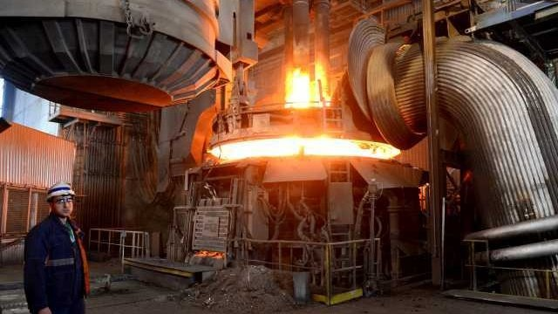
CIRCULAR ECONOMY
BLF Recommendations in the field of Circular Economy
1.Treat waste as raw material
because steel scrap is a natural part of the process of new steel production.

Slide 12
CIRCULAR ECONOMY
BLF Recommendations in the field of Circular Economy
2. Use energy from renewable resources
“Re-Thinking Progress” reveals a new model of economy based on products which are “made to be made again” while using energy from renewable sources. Renewable sources contribute to achieving energetic self-sufficiency, reducing dependence on natural gas supplies and fossil fuels...
Good practice: Kaufland
Kaufland (Bratislava, retail chain) uses recuperation technology for heating and cooling instead of conventional heating units. Industrial cooling technology includes integrated heat exchangers and heat pumps that convert waste heat into usable energy, which fully covers the needs of heat for heating the building in winter and refrigeration demand for cooling the building in summer.

Slide 13
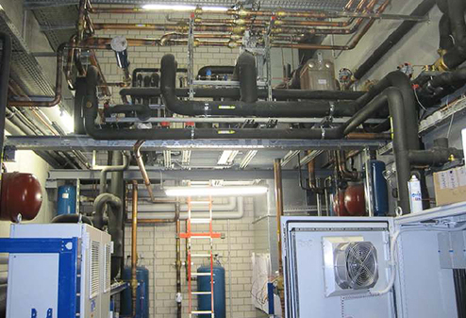
CIRCULAR ECONOMY
BLF Recommendations in the field of Circular Economy
2. Use energy from renewable resources
because steel scrap is a natural part of the process of new steel production.

Slide 14
CIRCULAR ECONOMY
BLF Recommendations in the field of Circular Economy
3. Design products so that harmless materials can be recycled in production
The aim should be to design products which will not pose any risk and whose presence (in buildings, offices, households, etc.) will not do any harm to health. It does not suffice to dispose of unhealthy products because their subsequent recycling will result in the production of further toxic products.
Good practice: Fairphone
Fairphone produces ethical and easily repairable smartphones which are made from ethically sourced and recycled mineral resources and materials. The engineers who developed Fairphone did not think only of the materials, but also of the phone’s entire life cycle with a view to minimizing its impact on the
planet and the humanity. The production of the new smartphone does not require minerals from conflict countries, the device is fully recyclable, and the rights of the workers who produce it are not violated.

Slide 15
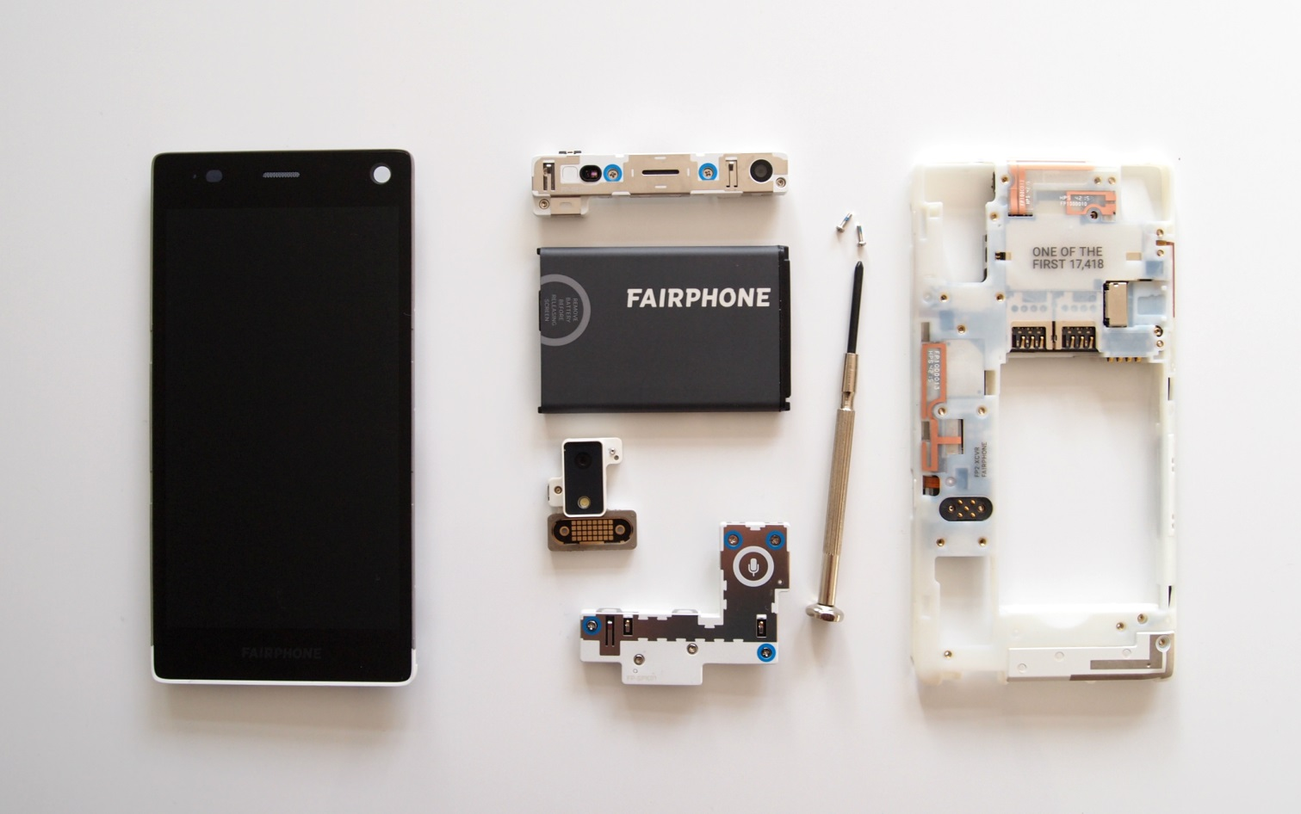
CIRCULAR ECONOMY
BLF Recommendations in the field of Circular Economy
3. Design products so that harmless materials can be recycled in production
because steel scrap is a natural part of the process of new steel production.

Slide 16
CIRCULAR ECONOMY
BLF Recommendations in the field of Circular Economy
4. Design products as material banks
We should regard all products as material banks, which means we should put the materials aside for some time, and when the product dies, the collected materials should be sent for reuse. It is important to note that this can only be done if the products (buildings, boats, etc.) have been designed for such a purpose. The concept of “Materials Passports” makes it clear where in the product which
materials can be found.
Good practice: Herman Miller
It was one of the first companies to have started designing their products using the “Materials Passport” method. It came up with an idea of chairs dismantlable into individual materials within 15 minutes. The materials can be subsequently recycled and used for the production of new parts

Slide 17

CIRCULAR ECONOMY
BLF Recommendations in the field of Circular Economy
Material passports - Maersk
because steel scrap is a natural part of the process of new steel production.
https://www.youtube.com/watch?v=Axs4MT8QCcg

Slide 18
CIRCULAR ECONOMY
BLF Recommendations in the field of Circular Economy
5. A product should be of benefit both to people and the
environment
The question of the protection of consumers have been brought to the fore. The European Union more vehemently appeals for the elimination of toxic chemicals from the production and supports investments into production processes which do
not pollute the environment.
Good practice: Akzonobel
There are a lot of examples based on the principle of circular economy abroad. For example, the AkzoNobel company has made paint which cleanses the air. It is a product which is not detrimental to health and the environment. It contains bacteria which transform formaldehyde and thus improve the air indoors.
.

Slide 19

GOOD PRACTICES FROM SLOVAKIA
Institute of Circular Economy in Slovakia (INCIEN)
network of professionals who help raise awareness and understanding of the principles of circular economy in Slovakia
the members of INCIEN are involved in the international platform SOLVED. This means that whatever your project is – they can involve the whole team of international experts from around the world who are able to provide innovative solutions to address the challenges of the project.
WHAT THEY DO? They provide a platform to support education in the field of circular economy contacts to further inspire individuals and companies, they offer consulting to initiating specific instruments to promote circular economy in each region...
Source: http://www.incien.sk/kto-sme/

Slide 20
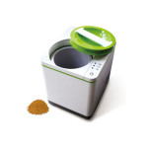
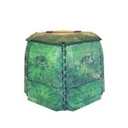
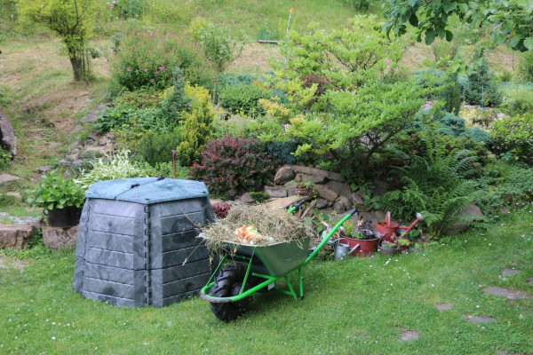
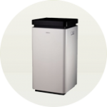
GOOD PRACTICES FROM SLOVAKIA
JRK Waste Management in Slovakia
„Our mission is to reduce the amount of general mixed waste, to prevent its occurrence and to increase the level of waste sorting. We place an emphasis on the prevention of biodegradable waste disposal.“
They provide kitchen composters and other solutions for apartmets, containers for waste separtions, intelligent solutions and etc.
Source: http://www.forlesswaste.com/products/

Slide 21
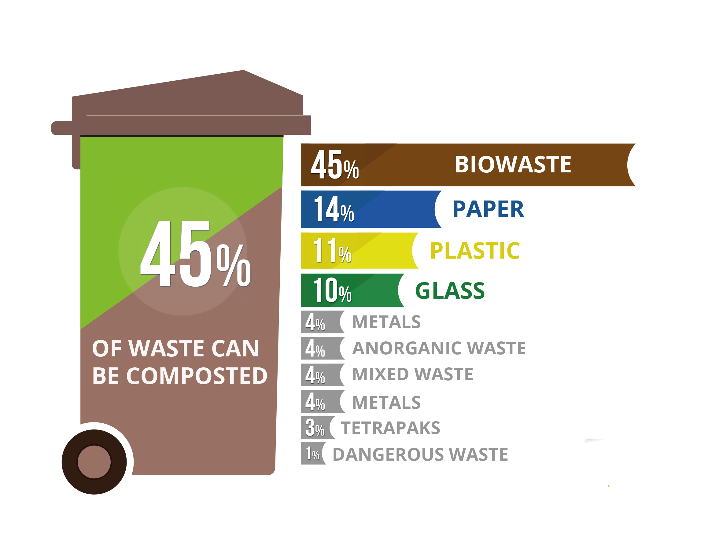
DID YOU KNOW?
JRK Waste Management in Slovakia
Did you know..?
Source: http://www.forlesswaste.com/products/

Slide 22



Q & A
ANY QUESTIONS OR COMMENTS?

Slide 23

THANK YOU
....for your attention.
Tatiana Čaplová
Program Coordinator
Pontis Foundation / Business Leaders Forum
tatiana.caplova@pontisfoundation.sk
Made from 100 % recycled material found on WWW. Thank you to the people who made it. ☺

