Slide 1
Zagreb,
1st February 2017
Hi4CSR Learning Activity
Employment of disabled persons:
Current developments at EU level

Slide 2
Overview
The Context
Legislative Framework
The Equality Employment Directive
UN Convention on the Rights of Persons with Disabilities
The EU Implementation Framework
European Disability Strategy 2010-2020
Recent developments

Slide 3
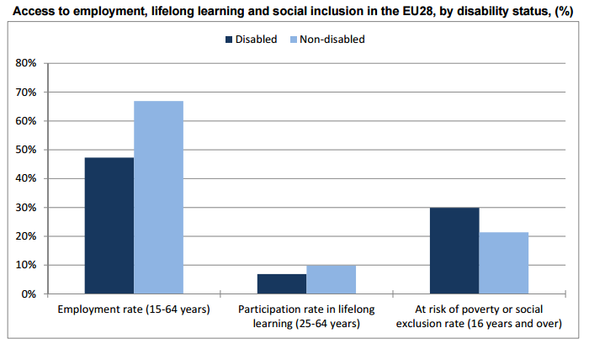
1. The Context
Eurostat, 2011
Notes:
Employment of disabled people — Statistical analysis of the 2011 Labour Force Survey ad hoc module
Around 44 million people aged 15-64 in the EU28 have reported a disability, often preventing them from taking part fully in society and the economy. Whether in the labour market, in the education system or for social inclusion indicators, the situation of disabled persons in the EU28 is less favourable than that of nondisabled people. Persons with disabilities had a more limited access to the labour market in the EU28 in 2011: while the employment rate2 of people aged 15 to 64 without disability was 66.9%, this rate was much lower (47.3%) for those with disabilities. The pattern was the same for access to education and lifelong learning in the EU28: the participation rate in education and training2 of non-disabled people aged 25-64 was 9.8% in 2011, compared with 6.9% for those with disabilities. The gap existing between non-disabled and disabled persons was also noticeable for social inclusion: while the at-risk of poverty or social exclusion rate2 was just over 20% for non-disabled people aged 16 and over (21.4%) in the EU28 in 2013, this share stood at almost 30% for disabled persons (29.9%).
Around 44 million people aged 15-64 in the EU28 have reported a disability in 2011
One in six people in the European Union has a disability that ranges from mild to severe, leaving around 80 million people who are often prevented from taking part fully in society. • The rate of poverty for people with disabilities is 70% higher than average people, mainly due to limited access to employment. • Over a third of people aged over 75 have disabilities that restrict them to some extent, and over 20% are considerably restricted.
Unemployment rate for persons with disabilities in the EU is much higher than that of nondisabled

Slide 4
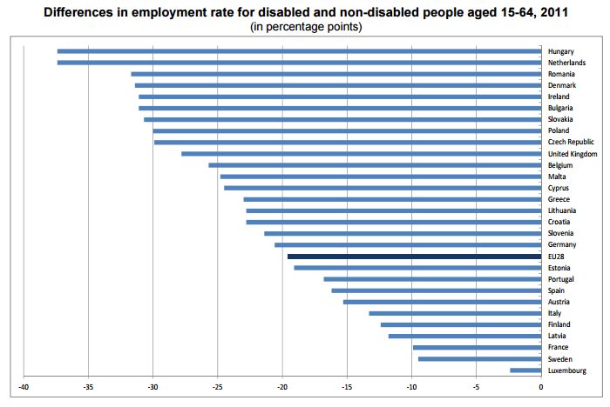
1. The Context
Eurostat, 2011
Notes:
Employment of disabled people — Statistical analysis of the 2011 Labour Force Survey ad hoc module
Widest gaps in the employment rates of disabled and non-disabled people in Hungary and the Netherlands In 2011 across Member States, the largest differences between the proportion of disabled people and that of non-disabled people aged 15-64 being in employment were recorded in Hungary and the Netherlands (both -37.4 percentage points). At the opposite end of the scale, gaps of less than 10 percentage points were registered in Luxembourg (-2.4 pp), Sweden (-9.5 pp) and France (-9.9 pp). At EU28 level, the difference between the employment rate of disabled people (47.3%) and of non-disabled people (66.9%) was -19.6 pp in 2011.

Slide 5
1. The Context
Around 80 million people in the EU are affected by a disability
Around 44 million people aged 15-64 in the EU28 reported a disability in 2011
Due to the ageing of the population, the figure is expected to increase to 120 million by 2020
Unemployment rate for persons with disabilities in the EU is much higher than that of nondisabled
EASPD and EDF claim that the employment rates of persons with disabilities as close to 20%
It is assumed by the International Labour Organisation that the rates have been disproportionately affected since the onset of the crisis
Notes:
EASPD REPORT ON THE UN CONCLUDING OBSERVATIONS ON THE EU REPORT ON THE IMPLEMENTATION OF THE CRPD (January 2016)
European Association of Service providers for Persons with Disabilities
European Disability Forum

Slide 6
2. Legislative Framework
Employment Equality Directive (Directive 2000/78/EC)
framework for equal treatment in employment and occupation
prohibits discrimination on the grounds of religion or belief, disability, age, or sexual orientation as regards employment and occupation
provides that employers shall take appropriate measures where needed to enable a person with a disability to have access to, participate in, or advance in employment, or to undergo training unless such measures would impose a disproportionate burden on the employer
UN Convention on the Rights of Persons with Disabilities (2006)
first international legally binding instrument setting minimum standards for rights for people with disabilities
the European Union is the first regional organization to ratify a human rights treaty
all EU countries have signed it (Finland, Ireland and the Netherlands still to ratify it)
23 EU countries have also signed its Optional Protocol (21 have ratified it)

Slide 7
2. Legislative Framework
EU implementation framework
dedicated to the promotion, protection, and monitoring of the Convention
composed of: The European Parliament, The European Ombudsman, The European Commission, The EU Agency for Fundamental Rights (FRA) and The European Disability Forum (EDF)
complements national monitoring mechanisms in EU Member States e.g. national equality bodies, Ombudspersons, National Human Rights Institutions, monitoring committees with the participation of representatives of organisations concerned with the rights of persons with disabilities
Cooperates with a number of monitoring networks at EU level
Notes:
The EU Implementation Framework promotes, protects and monitors the implementation of the CRPD in matters of EU competence, including EU legislation and policy (2013)
Cooperates with a number of monitoring networks at EU level:
The Working Group on the UNCRPD of the European Network of National Human Rights Institutions
Equinet, the European Network of Equality Bodies
The European Network of Ombudsmen

Slide 8
2. Legislative Framework
European Disability Strategy 2010-2020
Its objectives are pursued by actions in eight priority areas:
“To raise significantly the share of persons with disabilities working in the open labour market”
…that represent one-sixth of the EU's overall working-age population
Accessibility
Participation
Equality
Employment
Education and training
Social Protection
Health
External Action
Notes:
The core elements of the UN Convention are reflected in the European Disability Strategy 2010-2020 (2010)
The Disability Strategy is accompanied by an 'Initial Plan of activities for 2010- 2015',33 which is a sort of roadmap with respect to each of the priority areas, and a timetable. Progress on the implementation of the action plan is monitored by the Commission's Inter-service group on Disability and the Disability High Level Group (DHLG). The Disability Strategy was due for review by the end of 2013 and in the course of 2016, to take account of the progress made. However, the intended mid-term review of the roadmap has been delayed,
Meanwhile, on 23 December 2015, the Commission launched a public consultation on its mid-term review of the European Disability Strategy 2010- 2020, open for contributions until 18 March 2016.
http://www.europarl.europa.eu/RegData/etudes/IDAN/2016/536347/EPRS_IDA(2016)536347_EN.pdf

Slide 9
2. Legislative Framework
European Disability Strategy 2010-2020 – Employment
Need to recognise the right of people with disabilities to have the opportunity to earn a living via a job in an open, inclusive and accessible labour market through
fully exploiting the Europe 2020 Strategy and its Agenda for new skills and job
developing models of good practice on quality accommodation and jobs
informing Public Employment Services on measures to carry out at national level
At the MS level by
raising awareness
identifying and promoting effective support structures
publishing a compendium of good practice from Active Labour Markets Policies
making use of the European Social Fund
Notes:
The Disability Strategy is accompanied by an 'Initial Plan of activities for 2010- 2015',33 which is a sort of roadmap with respect to each of the priority areas, and a timetable. Progress on the implementation of the action plan is monitored by the Commission's Inter-service group on Disability and the Disability High Level Group (DHLG). The Disability Strategy was due for review by the end of 2013 and in the course of 2016, to take account of the progress made. However, the intended mid-term review of the roadmap has been delayed,
Meanwhile, on 23 December 2015, the Commission launched a public consultation on its mid-term review of the European Disability Strategy 2010- 2020, open for contributions until 18 March 2016.
http://www.europarl.europa.eu/RegData/etudes/IDAN/2016/536347/EPRS_IDA(2016)536347_EN.pdf

Slide 10
3. Recent developments
Concluding observations of the UN CRPD Committee to the EU
36 recommendations, including to
“…take effective action to measure the employment of persons with disabilities and to increase their employment rate in the open labour market, including by providing training for member States on reasonable accommodation and accessibility in the context of employment”
as it expressed concerns
“…about the high unemployment rates for persons with disabilities, especially women with disabilities and persons with intellectual and/or psychosocial disabilities…”
Progress report on the Implementation of the European Disability Strategy 2010-2020 under way
Public Consultation on the review of the European Disability Strategy 2010-2020 (December 2015 – March 2016)

Slide 11
3. Recent developments
Proposal for a European Accessibility Act, to make products and services more accessible to the disabled persons
Adoption of the Web Accessibility Directive: new digital services and products offer new opportunities for people with disabilities to take part in society and in the labour market
Proposal for the ratification of the Marrakesh Treaty, to make published works accessible to blind and visually impaired people
Opportunities coming from the European Pillar of Social Rights proclaimed in the 2015 State of the Union address, under the “Equal opportunities and access to the labour market” part
public consultation throughout 2016
Social Summit for Fair Jobs and Growth co-hosted by EC and Sweden in Gothenburg on 17 November 2017

Slide 12
Despite the action taken at EU level, lack of equal opportunities in the labour market remains the most important challenge for persons with disabilities. Efforts should be enhanced to ensure focus on abilities instead of disabilities.
European Commission “Annual Growth Survey 2017”
(November 2016)
Notes:
(Global Reporting Initiative, UN Global Compact, International Integrated Reporting Council and CDP)

Slide 13
Thank you for your attention!
Karolina Sobczak
Projects Coordinator

