Slide 1

Non-Financial reporting: implementation and best practices
Tatiana Čaplová / Pontis Foundation
tatiana.caplova@pontisfoundation.sk
JANUARY 30 / 2017/ Zagreb

Slide 2



CONTENT
What is Non-Financial Reporting?
Value of Non-Financial Reporting
Global Trends in Sustainability/CSR Reporting
EU Legislation on Non-Finacial Reporting
Slovak Legislation on Non-Financial Reporting
Best Practices from Slovakia
Role of BLF in Non-Financial Reporting

Slide 3



WHAT IS NON-FINANCIAL REPORTING
Non-finacial reporting can be considered as synonymous with other terms: sustainability reporting, triple bottom line reporting, corporate social responsibility (CSR) reporting, corporate citizenship reporting and more.
A sustainability report is a report published by a company or organization about the economic, environmental and social impacts caused by its everyday activities.
Sustainability reporting can help organizations to measure, understand and communicate their economic, environmental, social and governance performance, and then set goals, and manage change more effectively. A sustainability report is the key platform for communicating sustainability performance and impacts – whether positive or negative.
Source: GRI

Slide 4
VALUE OF NON-FINANCIAL REPORTING
8 reasons NOT to report
We do not have the data.
It costs too much!
It´s just PR
What good will it do us?
We don´t want to show off!
Nobody asked us to report
No one reads reports!
Who has the time?
Source: Elaine Cohen presentation, CEE CSR Summit 2016

Slide 5
VALUE OF NON-FINANCIAL REPORTING
The 1 main reason to report ...and many more
Better Risk Management
Improved processes and systems
Reducing compliance cost
BUILDING TRUST
Brand reputation
Transaprency with stakeholders
Progressing vision & strategy
Competitive advantage
Increased consumer loyalty

Slide 6
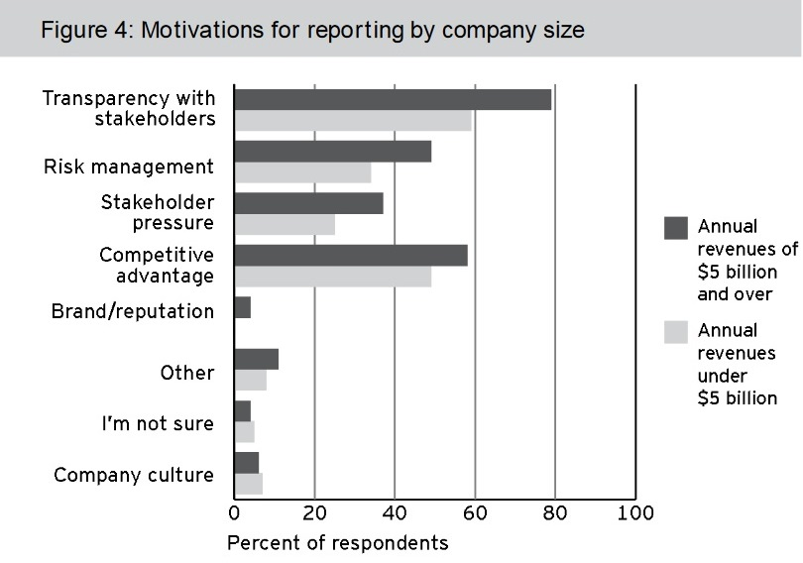
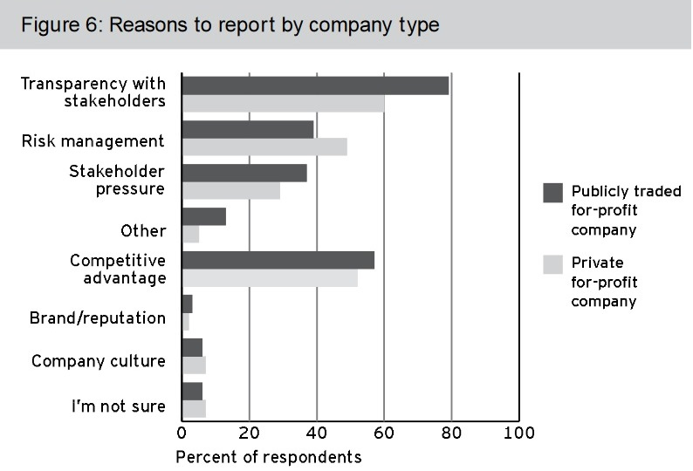
VALUE OF NON-FINANCIAL REPORTING
IT´S JUST PART OF BUSINESS: reasons to report
Source: Source: Boston College Center for Corporate Citizenship and EY 2013 survey

Slide 7
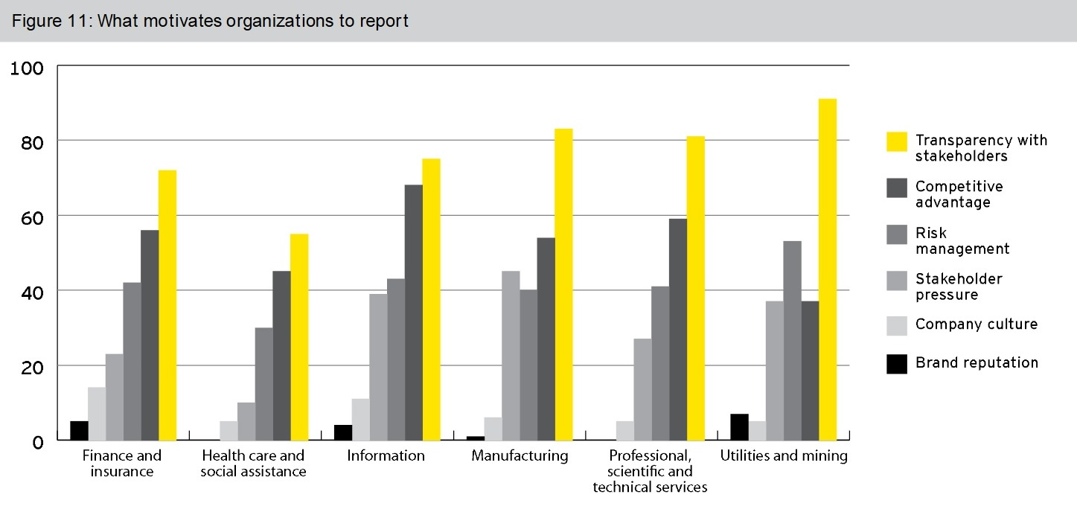
VALUE OF NON-FINANCIAL REPORTING
IT´S JUST PART OF BUSINESS: reasons to report
Source: Source: Boston College Center for Corporate Citizenship and EY 2013 survey

Slide 8
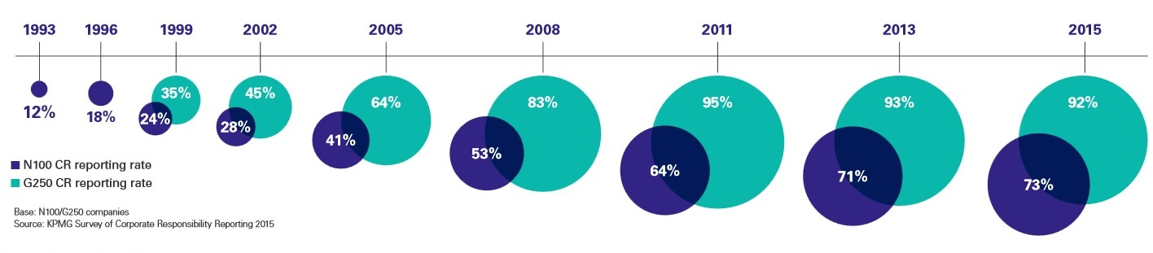
GLOBAL TRENDS IN NON-FINACIAL REPORTING
So WHO is doing it?
92 %
2015
64 %
2005

Slide 9
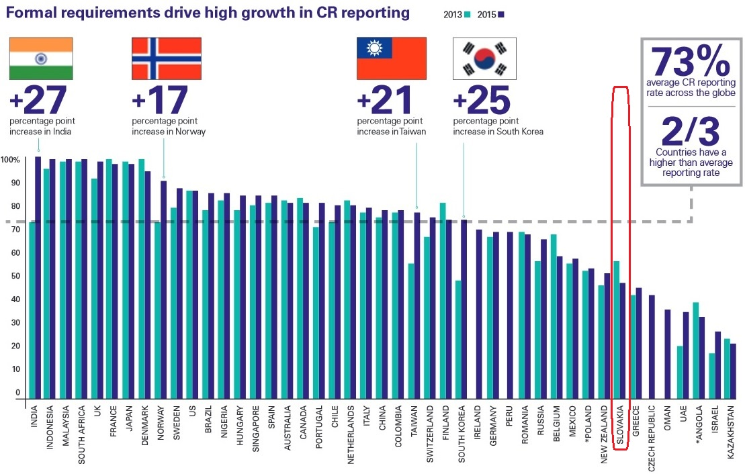
GLOBAL TRENDS IN NON-FINACIAL REPORTING
HIGH GROWTH in CSR reporting
Slovakia
45 %
Source: KPMG Survey of Corporate Responsibility Reporting 2015

Slide 10
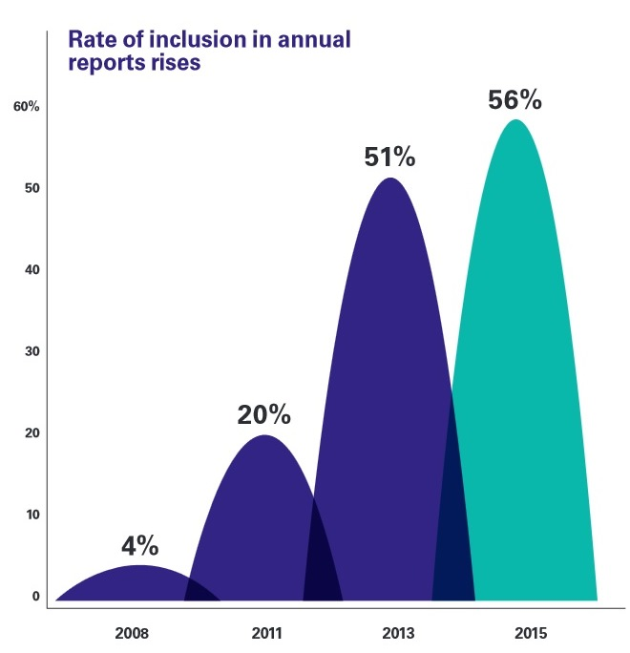
GLOBAL TRENDS IN NON-FINACIAL REPORTING
Non-financial data becomes a STANDARD FEATURE in ANNUAL REPORTS
Source: KPMG Survey of Corporate Responsibility Reporting 2015

Slide 11
EU LEGISLATION ON NON-FINANCIAL REPORTING
European Commision STRATEGY ON CSR
The Commission promotes CSR in the EU and encourages enterprises to adhere to international guidelines and principles. The EU’s policy is built on an agenda for action to support this approach. It includes:
Enhancing the visibility of CSR and disseminating good practices
Improving and tracking levels of trust in business
Improving self and co-regulation processes
Enhancing market rewards for CSR
Improving company disclosure of social and environmental information (!!!)
Further integrating CSR into education, training, and research
Emphasising the importance of national and sub-national CSR policies
Better aligning European and global approaches to CSR.
To evaluate the CSR strategy, the Commission launched a Public Consultation on CSR 2011-2014: achievements, shortcomings, and future challenges in 2014.
Source: European Commision http://ec.europa.eu/growth/industry/corporate-social-responsibility/

Slide 12
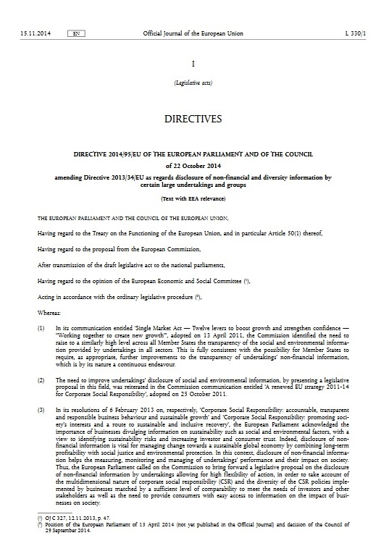
EU LEGISLATION ON NON-FINANCIAL REPORTING
BASIC EU ACTS on Non-Finacial Reporting
Directive 2013/34/EU of the European Parliament and of the Council of 26 June 2013 on the annual financial statements, consolidated financial statements and related reports of certain types of undertakings, amending Directive 2006/43/EC of the European Parliament and of the Council and repealing Council Directives 78/660/EEC and 83/349/EEC (Directive 2013/34/EU) as amended by Directive 2014/95/EU of the European Parliament and of the Council of 22 October 2014 amending Directive 2013/34/EU as regards disclosure of non-financial and diversity information by certain large undertakings and groups (Directive 2014/95/EU)
Source: European Commision http://ec.europa.eu/finance/company-reporting/non-financial_reporting/index_en.htm#related-information-csr

Slide 13
EU LEGISLATION ON NON-FINANCIAL REPORTING
What does it mean in practice?
This means that by the 6th of December of this year, the Directive will be effective in all EU member states and certain companies will need to report according to its requirements for the upcoming Fiscal Year, starting on January 1st 2017. As a result, the first company reports under the Directive are expected to be published in 2018, covering financial year 2017-2018.
Who will be required to disclose?
Companies with an average number of employees greater than 500, a balance sheet total of 20 million Euros or a net total of 40 million Euros, and that are listed on a EU regulated exchange market.
Companies with an average number of employees greater than 500, a balance sheet total of 20 million Euros or a net total of 40 million Euros, that are not exchange listed on a EU regulated exchange market, but are defined by Member States as public-interest entities, (including credit institutions and insurance undertakings)
Source : http://enablon.com/blog/2016/03/03/answering-10-common-questions-on-the-eu-sustainability-reporting-directive

Slide 14

EU LEGISLATION ON NON-FINANCIAL REPORTING
What aspects will my company have to disclose information on?
Companies are required to disclose policies, outcomes and risks related to at least:
Environmental matters
Social and employee aspects
Respect for human rights
Anticorruption and bribery issues
Diversity in their board of directors
Source : http://enablon.com/blog/2016/03/03/answering-10-common-questions-on-the-eu-sustainability-reporting-directive

Slide 15

EU LEGISLATION ON NON-FINANCIAL REPORTING
What if our company has several subsidiaries?
If the annual report published by the parent corporation covers the subsidiaries and that report meets the requirements of the Directive, then only one report will be necessary.
What if our company already reports?
If the company already reports and discloses relevant information according to well-known international, national and European guidelines (for instance, the UN Global Compact, GRI, the OECD Guidelines for Multinational Enterprises, ISO 26000, or certain ILO Declarations of Principles), then the company is already likely to comply with the Directive.
Source : http://enablon.com/blog/2016/03/03/answering-10-common-questions-on-the-eu-sustainability-reporting-directive

Slide 16

EU LEGISLATION ON NON-FINANCIAL REPORTING
What is expected in 2018?
More than 6,000 companies in Europe will have to report annually on their sustainability performance according to the requirements of the EU Directive on Non-Financial Information Disclosure.

Slide 17
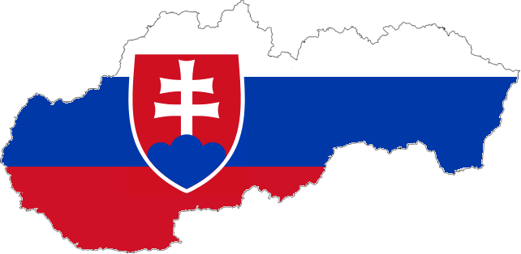
SLOVAK LEGISLATION
SLOVAKIA:
Why has there been the need to enact CSR reporting?
In 2015, the National Council of the Slovak Republic passed an amendment to the Act on Accounting N° 431/2002
The Act is in accordance with the Directive 2014/95/EU of European Parliament and of the European Council of 22 October 2014
This part of the Act came into force on 1 January 2017, the first reports must be published in 2018
Firms are bound to disclose information about their CSR activities and diversity policies

Slide 18

SLOVAK LEGISLATION
SLOVAKIA:
Who is Concerned by the Act to Report on CSR?
Firms of public interest with an average number of employees exceeding 500 are committed to report on their non-financial information.
This obligation concerns some banks, insurance companies, health insurance companies, management companies or even pension fund management companies. This obligation also concerns those companies which have emitted securities that have been accepted for on the regulated market of any EU member state.

Slide 19

SLOVAK LEGISLATION
SLOVAKIA:
Who is Concerned by the Act to Report on CSR?
A public interest entity is understood to be any accounting entity which meets at least two of this conditions for a period of at least two consecutive accounting periods:
          the total assets value exceeds 170,000,000 euros
          the net turnover exceeds 170,000,000 euros
          the average number of employees exceeds 2,000

Slide 20

SLOVAK LEGISLATION
SLOVAKIA:
Who is Concerned by the Act to Report on Their Diversity Policy?
Firms that has emitted their securities that have been accepted for trade in the regulated market of any of the EU Member States and meet at least two of the following conditions:
          the total assets value exceed 20 million euros
          the net turnover exceeds 40 million euros or
          the number of employees exceeds 250

Slide 21

SLOVAK LEGISLATION
SLOVAKIA:
Who is Concerned by the Act to Report on Their Diversity Policy?
... the Annual Reports of such companies must also include a description of the diversity policies that they apply in their administrative, management and supervisory bodies, especially in regard to age, sex, education and professional experience of the members of these bodies, the way they are executed and the results achieved in the reported period.

Slide 22
SLOVAK LEGISLATION
SLOVAKIA:
What does it Mean in Practice?
Public interest entities with more than 500 employees – obligation to report on CSR
Companies registered on the Stock Exchange with more than 250 employees – obligation to report on their diversity policies
Companies can have their reports prepared for the whole group
If the parent company located outside Slovakia includes information about its subsidiary located in Slovakia, the local subsidiary does not need to make a separate report
Firms are obliged to include such information in their annual reports
There has been no report methodology prescribed for the concerned companies

Slide 23
SLOVAK LEGISLATION
SLOVAKIA: Current State of Implementation of Directive
Responsible organization: Business Leaders Forum
Number of companies affected: 60
Transposition status: already transposed – as part of an amendment to the act No. 431/2002 Coll on Accounting
Which ministry is in charge: Ministry of Finance
Definition of public interest entities: the public interest entity is defined as an entity that has issued equities/securities and those are admitter to trading on a regulated market of any Member State of The EU – a bank, a branch of a foreign bank, the Export-Import Bank of Slovak Republic, the insurance company, brach of a foreign insurance company, reinsurance company, healtch insurance, asset maangement company etc. etc.
Verification by assurance required? No, while audit is required
Local accompanying measures? Slovakia doen not have any other approach to reporting besides this law. The law doesn´t say anything about the preferred method of reporting.
...
Source: http://bit.ly/2bz3A1B

Slide 24
SLOVAK LEGISLATION
CROATIA: Current State of Implementation of Directive / GRI
Responsible organization: Croatian BCSD
Number of companies affected: 300
Transposition status: Lack of transparency from the government. BCSD organises training for companies. Companies show strong interest.
Which ministry is in charge: Most likely Ministry of Finance
Definition of public interest entities: most likely all large companies
Local accompanying measures? Support through seminars organized by BCSD
Comments: Ministry of finance will start on this subject in the second part of the year, it will not be a separate Law, but rather an addition to the existing Accounting Law
Source: http://bit.ly/2bz3A1B

Slide 25

BEST PRACTICES FROM SLOVAKIA
Heineken Slovensko
“In a report that we prepare every year, you will be able to read about our measures towards better results in the areas of water resource protection, reduction of CO2 emissions, use of local raw materials, responsible consumption of our products, protection of health and safety of our employees and support for the communities in which we live and work. All of us at HEINEKEN Slovensko believe in the philosophy of permanently sustainable business. We value experience and, with a common effort, we will continue to look for opportunities for a stable growth of our company while respecting our colleagues, partners and the surrounding environment.”
Odin Goedhart
Managing Director

Slide 26

BEST PRACTICES FROM SLOVAKIA
VUB Bank
The economic results for the previous twelve months have been traditionally reviewed in the Annual Financial Report. An integral part of this report is the Report on Responsible Business, which shows our effort to contribute to sustainable development and improving the quality of life for people. We consider ‘success’ a synonym for the responsibility that we feel towards Slovakia.”
Alexander Resch
Chairman of the Board of Directors and General Manager of
Všeobecná úverová banka, a.s.

Slide 27

BEST PRACTICES FROM SLOVAKIA
Slovak Telekom

Slide 28

ROLE OF BLF
SLOVAKIA:
What we do as Business Leaders Forum?
Training on how to report CSR to concerned employees
Training on how to apply the GRI methodology
Stakeholder dialogue – identifying topics for your report
Finding reporting strategies to suit your firm
Preparation of a report
GRI G4 Directives application assessment

Slide 29

Q & A
ANY QUESTIONS ? ☺

Slide 30
Q & A
Useful resources:
CSR Reporting Blog by Elaine Cohen. Available here: http://csr-reporting.blogspot.sk/
Directive on Non-Financial Reporting – National transpositions by each Member State: http://eur-lex.europa.eu/legal-content/HR/NIM/?uri=CELEX%3A32014L0095&qid=1482168215685
GRI: NFR Directive information compilation. Available here: https://globalreporting.sharepoint.com/GIDA/_layouts/15/WopiFrame.aspx?guestaccesstoken=0uzZnStMzdM1CP0F8TbiYJZTn890wlIa%2bBLppZQ7veY%3d&docid=1584acd39f2dc4e31ae0e69491bdc577e&action=view
Feedback statement on the public consultation on the non-binding guidelines for reporting on non-financial information – it´s uploaded in Dropbox (Presentation 60 min)
Feedback statement on the public consultation on the non-binding guidelines for reporting on non-financial information by companies having taken place from 15 January to 15 April 2016). Available here: http://ec.europa.eu/finance/consultations/2016/non-financial-reporting-guidelines/docs/summary-of-responses_en.pdf
European Commission: Non-Financial Reporting. Available here: http://ec.europa.eu/finance/company-reporting/non-financial_reporting/index_en.htm

Slide 31

Q & A
....for your attention.
Tatiana Čaplová
Program Coordinator
Pontis Foundation / Business Leaders Forum
tatiana.caplova@pontisfoundation.sk

