Slide 1
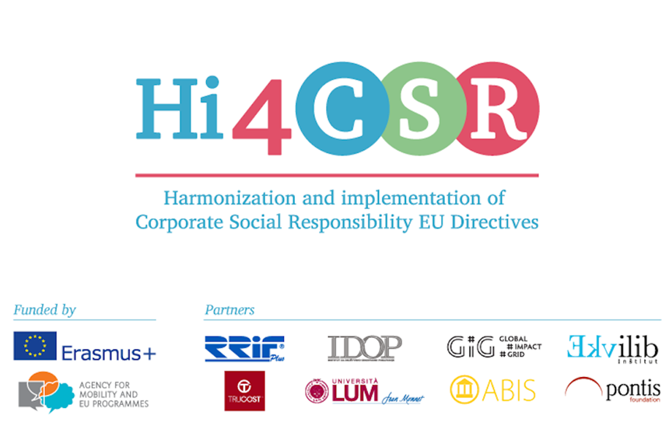
Ecolabels: information or confusion? SLOVAKIA
Tatiana Čaplová / Pontis Foundation
tatiana.caplova@pontisfoundation.sk
JANUARY 31 / 2017 / Zagreb

Slide 2
CONTENT
Introduction
Systems and schemes of environmental labelling
Eco-labeling in Slovakia
Perception of environmental product labelling by Slovak & Czech consumers
Conclusion

Slide 3
INTRODUCTION
What is Eco-labeling?
Environmental product labeling is a voluntary tool in the protection of the environment. Environmentally friendly products meet strict environmental criteria and are considerate not only to the environment but to the consumer's health as well. They have a lesser negative impact on the environment.
The label 'Environmentally friendly product' is given to the products for a limited period of time. The requirements and conditions according to the respective statute are revised in the view of the newest information regarding environmental protection and the modernisation of production technologies. This enables the national programme to increase or tighten the environmental requirement for the products.
Source: Bosák, M.; Tarča, A.; Krajňák S.: Eco-labeling in Slovak Republic according to the norm ISO 14020. Available here http://bit.ly/2bz3A1B

Slide 4
INTRODUCTION
Development of Eco-labeling
Germany in 1978: The label “Blue angel“ was given to the first product. The success of the German eco-labeling programme led to the foundation of other eco-labeling programmes
Country | Name of label | Effective from
Germany | Blue Angel | 1978
Canada | Environmental choice | 1988
Scandinavian countries | Nordic Swan | 1989
Japan | Eco Mark | 1989
USA | Green Seal | 1989
Austria | Österreichisches Umweltzeichen | 1991
France | NF-environment | 1991
EU | EU-Ecolabel | 1992
Czech republic | Ekologicky šetrný výrobek | 1993
Slovak republic | Environmentálne vhodný produkt | 1997
Source: Bosák, M.; Tarča, A.; Krajňák S.: Eco-labeling in Slovak Republic according to the norm ISO 14020. Available here http://bit.ly/2bz3A1B

Slide 5
SYSTEMS OF ECO-LABELING
Systems and schemes of environmental labeling
Labeling products with an environmental label is organised by the state in most countries, usually the head governmental office for the environment. After paying the appropriate fee to this office the label is obtained via proof documentation that the product fulfils the specific environmental criteria. This way the state funds the system and guarantees its correct functioning - the state is the guarantee of the appropriateness of the process.
Currently more systems and schemes of environmental labeling exist on the market and according to the norm ISO 14020 they can be divided into:
Types normalised within the norms ISO 14020,
type I (according to ISO 14024: 1999),
type II (according to ISO 14021: 2016),
type III (according to ISO 14025: 2006),
B. Types normalised outside the norms ISO 14020.
Source: Bosák, M.; Tarča, A.; Krajňák S.: Eco-labeling in Slovak Republic according to the norm ISO 14020. Available here http://bit.ly/2bz3A1B

Slide 6
ECO-LABELING IN SLOVAKIA
Environmental labeling in Slovakia
The awarding of the national environmental label “Environmentally friendly product“ through a national scheme has been performed since under the control of the Slovak Republic. The conditions and procedures in awarding and usage of this national label - as well as the environmental label of the EU -are set in the Act No. 217/2007 of the book of law which were amended with its validity on the 1st of June, 2007 by No. 469/2002 on the environmental labeling of products conforming to the Act No. 587/2004 of the book of law.

Slide 7
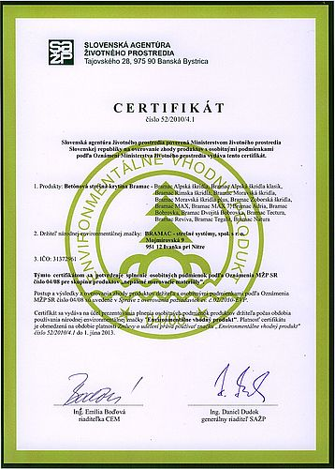
ECO-LABELING IN SLOVAKIA
Environmental labeling in Slovakia
Slovak companies that have the right to use the national mark "Environmentally Friendly Product:
Festap, Bratislava (steel enamel baths and shower pans)
Bramac - roof systems, Ivanka pri Nitra (tiles)
Považská cementáreň, Ladce (Cement)
Happy End, Pezinok (universal and hydrophobic sorption materials)
Compag SK, Bratislava (gabion modular construction)
Johan Enviro, Bratislava (universal and hydrophobic sorption materials)
Maccaferri Central Europe, Brezová pod Bradlom (gabions, Reno mattresses, Terramesh systems)

Slide 8
ECO-LABELING IN SLOVAKIA
Environmental labeling in Slovakia – EU ecolabel
Since the Slovak Republic joined the EU in 2004 applicants can also obtain the European environmental label „EU ecolabel“ (formerly “European flower“). Awarding of this European environmental label follows the regulation of the European parliament No. 66/2010 on the EU ecolabel.
.
Source: Bosák, M.; Tarča, A.; Krajňák S.: Eco-labeling in Slovak Republic according to the norm ISO 14020. Available here http://bit.ly/2bz3A1B

Slide 9
ECO-LABELING IN SLOVAKIA
Environmental labeling in Slovakia – EU ecolabel
Among the products that cannot obtain this environmental label are:
Drinks, food,
human and veterinary medicine, medical supplies,
products containing chemical substances or mixtures qualifying for toxic or dangerous for the environment, are carcinogen, mutagen or reproductively toxic according to the European parliament regulation No. 1272/2008 and products containing a substance according to article 57 of the European parliament regulation No. 1907/2006 (REACH),
products manufactured by processes most likely expressively harmful for mankind or the environment,
products without an important share on the domestic market and in sales
.
Source: Bosák, M.; Tarča, A.; Krajňák S.: Eco-labeling in Slovak Republic according to the norm ISO 14020. Available here http://bit.ly/2bz3A1B

Slide 10
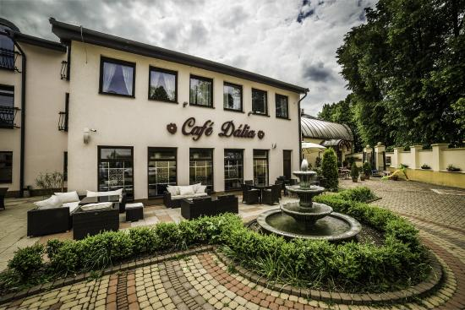
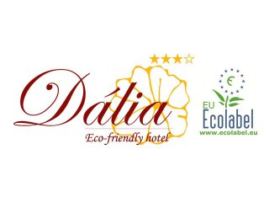
ECO-LABELING IN SLOVAKIA
Environmental labeling in Slovakia – EU ecolabel
EXAMPLE: Eco friendly hotel Dália
.
Hotel Dália in Košice is one of the first ecological hotels in Slovakia.
The hotel used energy efficient light bulbs and 100% recycled office paper, the summer months provide heating vodysolárne panels, disposable packaging of bathroom cosmetics have been replaced by organic cosmetics certified by the European Eco label. Offer a breakfast menu has been expanded by a healthy organic foods. The hotel are distributed bins for sorting waste, so that the guests could actively involved in the separation.

Slide 11
ECO-LABELING IN SLOVAKIA
Environmental labeling in Slovakia – EU ecolabel
In 2015 the right to use the label “EU ecolabel“ was awarded to 131 products, out of which two were services, in Slovakia. There are more than 36.400 products within the EU.
.
Source: Bosák, M.; Tarča, A.; Krajňák S.: Eco-labeling in Slovak Republic according to the norm ISO 14020. Available here http://bit.ly/2bz3A1B

Slide 12
ECO-LABELING IN SLOVAKIA
Organic farming label
The main objective of the European logo is to make organic products easier to be identified by the consumers. Furthermore it gives a visual identity to the organic farming sector and thus contributes to ensure overall coherence and a proper functioning of the internal market in this field..
EU
SLOVAKIA

Slide 13
ECO-LABELING IN SLOVAKIA
Examples of ecolabels used in Slovakia
EKOenergy
EKOenergy is a label for electricity, managed by the European EKOenergy network, a network of more than 30 environmental NGOs from over 20 European countries. The EKOenergy label is the only electricity label which has resulted from a pan-European consultation process, which works on the whole European market and which is recognized by stakeholders in all European countries. The first EKOenergy criteria have been approved in February 2013.
Source: http://www.ecolabelindex.com/ecolabels/?st=country,sk

Slide 14
ECO-LABELING IN SLOVAKIA
Examples of ecolabels used in Slovakia
EPEAT
EPEAT is a global rating system for greener electronics. Using EPEAT (“Electronic Product Environmental Assessment Tool”), purchasers in 43 countries can evaluate, compare and select electronics based on environmental attributes. EPEAT currently includes categories for PCs and Displays, Televisions, and Imaging Equipment (printers, copiers, scanners, multifunction devices, fax machines and mailing machines). Categories for Servers and Mobile Phones are in development.
Source: http://www.ecolabelindex.com/ecolabels/?st=country,sk

Slide 15
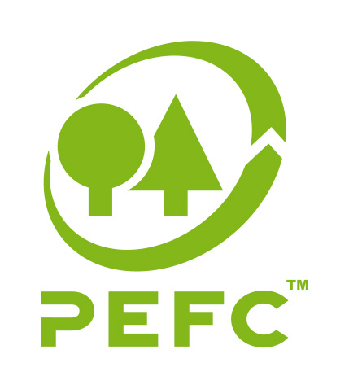
ECO-LABELING IN SLOVAKIA
Examples of ecolabels used in Slovakia
PEFC
The Programme for the Endorsement of Forest Certification (PEFC) is an international non-profit, non-governmental organization dedicated to promoting Sustainable Forest Management (SFM) through independent third-party certification. It works throughout the entire forest supply chain to promote good practice in the forest and to ensure that timber and non-timber forest products are produced with respect for ecological, social and ethical standards.
Source: http://www.ecolabelindex.com/ecolabels/?st=country,sk

Slide 16
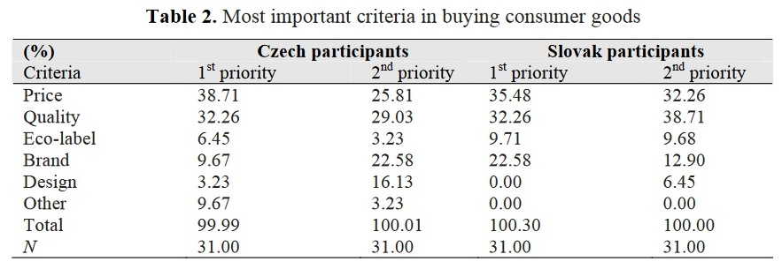
PERCEPTION OF ECO-LABELING IN SR/CR
Perception of environmental product labelling by Slovak & Czech consumers
Dočekalová, M.; Straková, J.: THE INFLUENCE OF ECO-LABELLING ON CONSUMER BEHAVIOUR IN THE CZECH REPUBLIC AND SLOVAKIA
Although an eco-label does not affect the consumer’s behaviour, there are 32.26% of Czech participants and 22.58% of Slovak participants who notice whether the product is eco-labelled.

Slide 17
SLOVAK COMPANIES
„OWN ECO-LABELS“ OF SLOVAK COMPANIES
Kaufland Slovakia – K-Bio

Slide 18
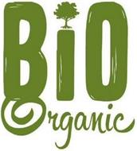
SLOVAK COMPANIES
„OWN ECO-LABELS“ OF SLOVAK COMPANIES
Lidl Slovakia – UTZ; Bio Organic

Slide 19
SLOVAK COMPANIES
„OWN ECO-LABELS“ OF SLOVAK COMPANIES
Tesco Slovakia – PERFECTLY IMPERFECT

Slide 20
CONCLUSION
TO SUM UP:
It is under some criticism that in the Slovak Republic there is little influence from the presence of this label on products to sway the buyer. Also criticised is the length and financially expensive certification and the fact that the label is only valid for three years deters many producers. An important bonus for businesses seems to be the label's influence on the acceptance by business partners and markets abroad.

Slide 21
Q & A
ANY QUESTIONS ?

Slide 22
THANK YOU
....for your attention.
Tatiana Čaplová
Program Coordinator
Pontis Foundation / Business Leaders Forum
tatiana.caplova@pontisfoundation.sk
Made from 100 % recycled material found on WWW. Thank you to the people who made it. ☺

