Slide 1
Food Law and Food Hygiene– LUM Jean Monnet University
LA Zagreb 02/02/2017

Slide 2
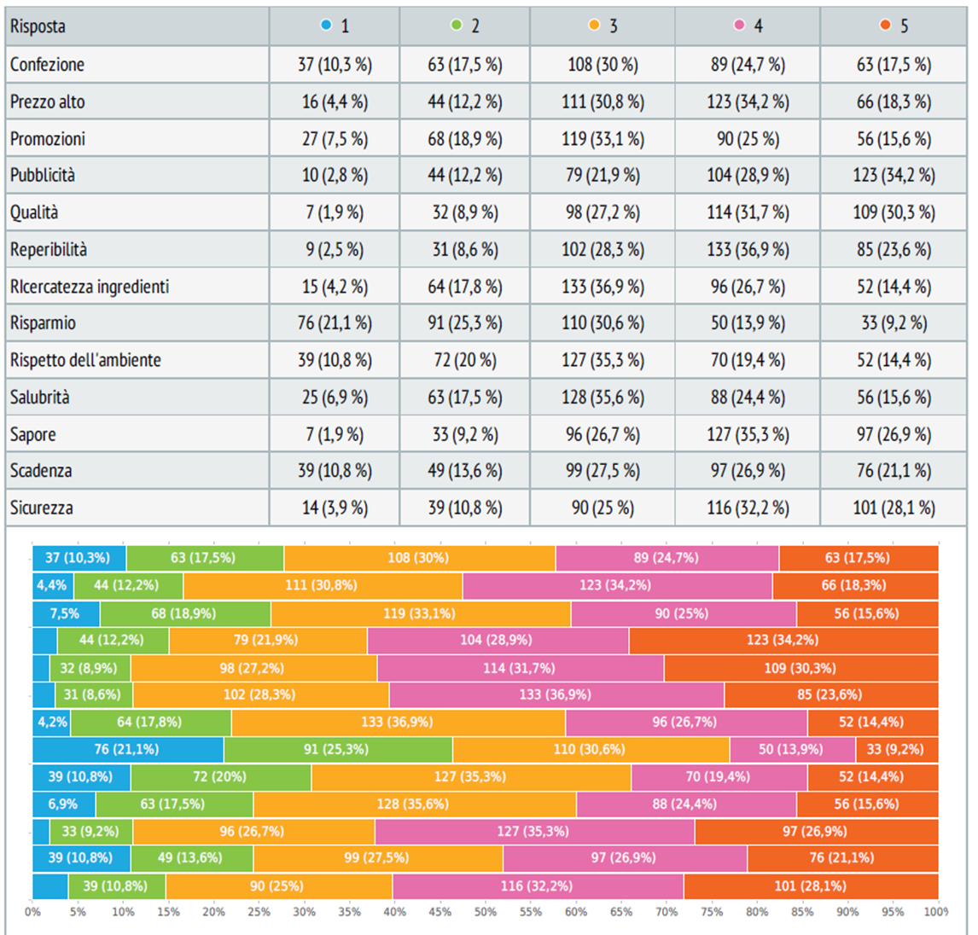
Scores associated to food «brands»

Slide 3
Scores associated to food «brands» with ecolabel

Slide 4
Scores associated to food «private labels»

Slide 5
Scores associated to food «private labels» with ecolabel

