Slide 1
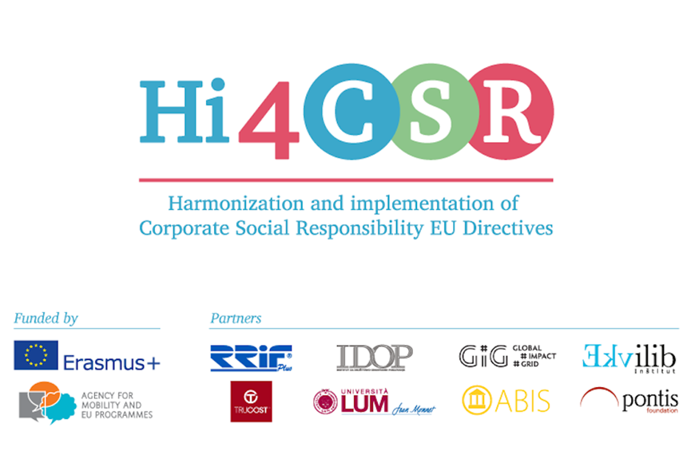
Let´s talk about food: Food Law & Food Hygiene Legislation SLOVAKIA
Tatiana Čaplová / Pontis Foundation
tatiana.caplova@pontisfoundation.sk
FEBRUARY 2 / 2017 / Zagreb

Slide 2
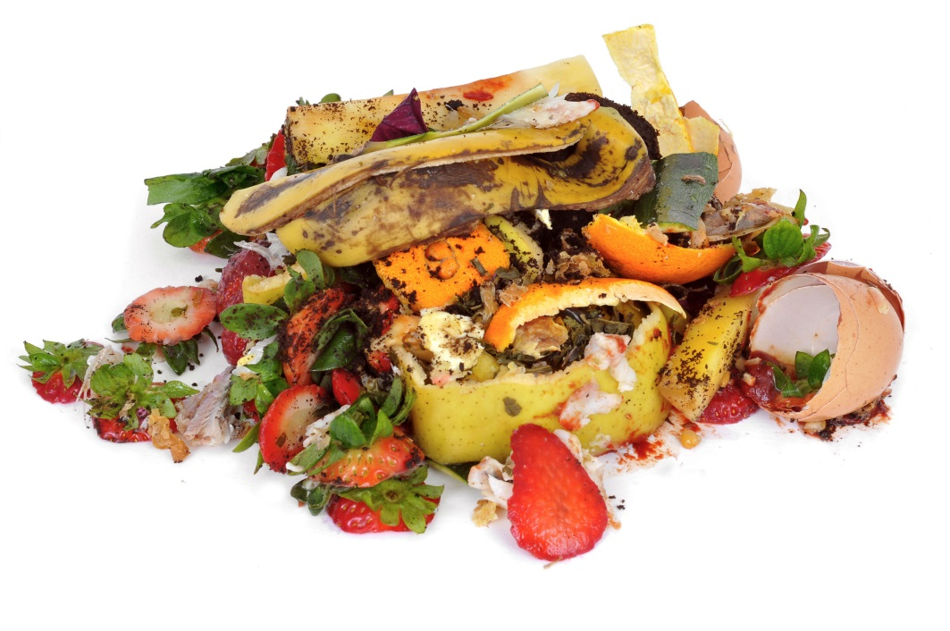
CONTENT
Introduction
Four Food Waste Facts
Slovak Legislation on Food Safety & Hygiene
What is special about Slovak food law?
What´s new?
Good practices from Slovakia

Slide 3
INTRODUCTION
Summary of the overall situation
Around 88 million tonnes of food are wasted annually in the EU, with associated costs estimated at 143 billion euros.
The Food and Agriculture Organization of the United Nations estimates that, each year, one-third of all food produced for human consumption in the world (around 1.3 billion tons) is lost or wasted. This includes 45% of all fruit and vegetables, 35% of fish and seafood, 30% of cereals, 20% of dairy products and 20% of meat.
Around 240 thousands tons of food is wasted annually in Slovakia (it´s about 45 kilos of food per capita).
Tetra Pak company found out in a research conducted in 2015 that 57% of all Slovakian households throw food away once a month at least, while 9% of them do this daily.
Slovak households get rid of mostly cooked food (61%), but also bread and bakery (48%), fruits and vegetables (47%), dairy products and cheese (19%).
Source: Fusion, 2016. Available here: http://bit.ly/2e1ktEs
World Economic Forum, 2015. http://bit.ly/2jRxFgs
Source:hnonline.sk, 2016. Available here: http://bit.ly/2fOU79G
openiazoch.sk, 2015. Available here: http://bit.ly/2kRisJW

Slide 4
INTRODUCTION
The key reasons of Food Waste (in general):
losses from harvesting and storing crops,
transportation not respecting safety standards,
defects of packing,
ineffective supply management,
wrong shopping and food consumption habits of customers
According to Tetrapak survey (2015), 99 % of people in Slovakia are trying to reduce their amount of food waste. This is mainly about consumer shopping behavior. Slovaks tend to buy only what they can really benefit from (80%) and they are also investing more in perishable foods (36%).
Source:openiazoch.sk, 2015. Available here: http://bit.ly/2kRisJW

Slide 5
INTRODUCTION
Date marking – always a problem in Slovakia
Slovaks understand the concept of „best before” dates even less than European average (47 %). Only 38 % of them know that food can be consumed after this date, but it may no longer be at its best quality.
Only 44 % of Slovaks know that the food will be safe to eat up to this „use by” date, but should not be eaten past this date. (European average is 40 %).
According to Eurobarometer survey, better shopping and meal planning will help Slovak people to waste less food at home (47 %). Another steps forwards in this problem could be: using up leftovers instead of throwing them away (33 %), using the freezer to preserve food longer (27 %) and availability of smaller portion sizes in shops (27 %).
Source:FLASH EUROBAROMETER: Food waste and date marking 2015. Avilable here: http://bit.ly/2ks3mhp

Slide 6
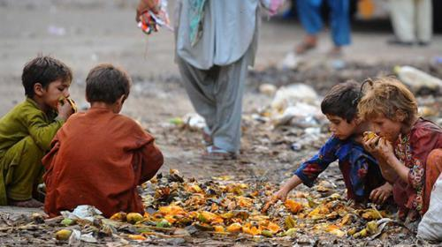
FOOD WASTE FACTS
FOUR Food Waste Facts
All the world’s nearly one billion hungry people could be fed on less than a quarter of the food that is wasted in the US, UK and Europe.
Source: http://feedbackglobal.org/food-waste-scandal/

Slide 7
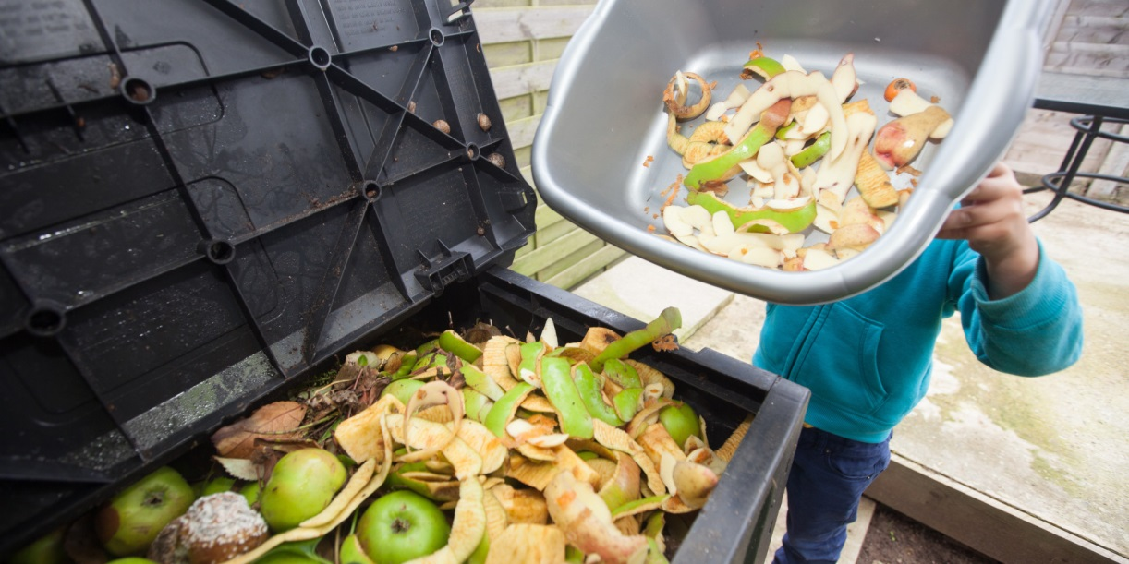
FOOD WASTE FACTS
FOUR Food Waste Facts
Most of this wastage occurs in the developed world; per capita food waste by consumers (not including the production process) in Europe and North America is around 95-115kg per year, compared to just 6-11kg in sub-Saharan Africa and South/South-East Asia.
Source: https://www.weforum.org/agenda/2015/08/which-countries-waste-the-most-food/

Slide 8
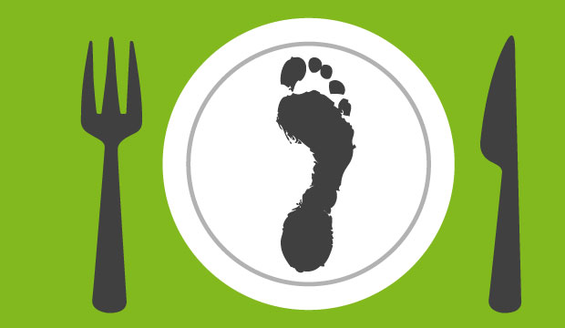
FOOD WASTE FACTS
FOUR Food Waste Facts
Food loss and waste also has a significant impact on the environment. The carbon footprint of wasted food is estimated at 3.3 gigatonnes. In fact, if food waste were a country, it would rank behind only the US and China for greenhouse gas emissions.
Source: https://www.weforum.org/agenda/2015/08/which-countries-waste-the-most-food/

Slide 9
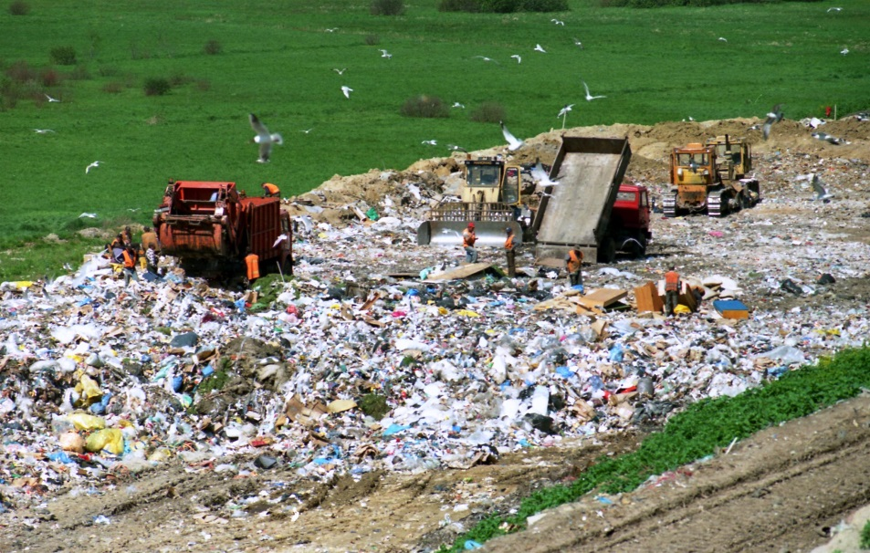
FOOD WASTE FACTS
FOUR Food Waste Facts
The production of wasted food also uses around 1.4 billion hectares of land – 28% of the world’s agricultural area. A huge amount of surface or groundwater – known as “blue water” – is also lost; about 250km3, more than 38 times the blue-water footprint of US households
Source: https://www.weforum.org/agenda/2015/08/which-countries-waste-the-most-food/

Slide 10
SLOVAK LEGISLATION
Slovak Legislation on Food Safety & Hygiene
Basic Legislation
Act of the National Council of the Slovak Republic No. 152/1995 Coll. on Foodstuffs as amended
Act of the National Council of the Slovak Republic No. 39/2007 on Veterinary Care as amended
....
Food Hygiene
Regulation of the Government of the Slovak Republic No. 352/2009 Coll. laying down the hygienic requirements on the direct sale and supply of small amounts of primary agricultural production of animal origin, poultry and rabbit meat and wild game and meat there of
Commission Regulation (EC) No 2073/2005 of 15 November 2005 on microbiological criteria for foodstuffs*
....
Food inspection
Act of the National Council of the Slovak Republic No. 128/2002 Coll. on state supervision of inner market relating consumer ́s protection and on amendments of certain acts
....
ALL THE SLOVAK LEGISLATION ON FOOD YOU CAN FIND HERE:
http://www.haccp-org.eu/food_safety/pics_pdf/Slovak_legislation.pdf
http://www.svps.sk/legislativa/default.asp

Slide 11
SLOVAK LEGISLATION
Food Code of the Slovak Republic
...is an implementing rule relating to Act on Foodstuffs, based from decrees of the Ministry of Agriculture of the Slovak Republic and the Ministry of Health of the Slovak Republic
...regulates health safety of food, hygiene rules, quality and contents of food, ingredients, technological production processes, packaging of food products, in categories as well as all food products. It also regulates the range and the ways of food products labelling, storage, transportation, manipulation and circulation, sampling and inquiry standards. These obligations concern each legal subject that produces, manipulates or markets food products.
Source: Food Legislation in Slovak Republic. http://www.haccp-org.eu/food_safety/pics_pdf/Slovak_legislation.pdf /

Slide 12
SLOVAK LEGISLATION
What is special about Slovak food law
A regulation on the labelling of foodstuffs claiming Slovak origin
For example, foodstuffs can be labelled with the marketing tool “Made in Slovakia” only if all production phases took place in Slovakia. In addition, foodstuffs made in Slovakia may be considered “Slovak foodstuffs” if at least 75% of the ingredients used in its production come from Slovakia.
Source: http://roadmap2015.schoenherr.eu/slovakia-beware-non-compliance-food-law/

Slide 13
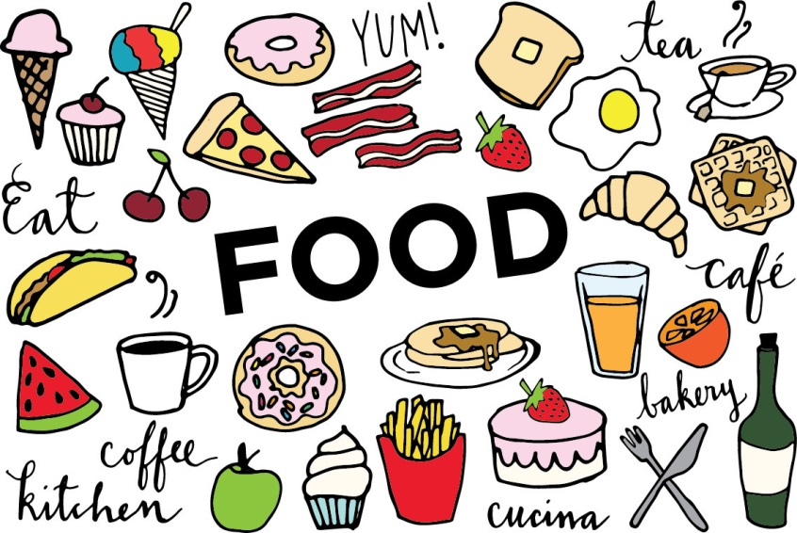
CONTEXT
What is special about Slovak food law
An obligation of retail undertakings
An obligation of retail undertakings with turnover from retail sale of foodstuffs of at least EUR 10 mln in the last calendar year to report biannually to the authority the share of its turnover formed by the sale of Slovak foodstuffs. The undertaking must also publish the data on its website and in its stores
Source: http://roadmap2015.schoenherr.eu/slovakia-beware-non-compliance-food-law/

Slide 14
SLOVAK LEGISLATION
What is special about Slovak food law
The Act on unfair terms in commercial relations, the subject matter of which is foodstuffs
. The idea behind this is claimed to be to help suppliers resist the pressure of retail chains with a stronger bargaining position in contractual relations. The act enumerates not only provisions that may not be omitted in such agreements, but also prohibited clauses, including: (i) making the sale of supplier’s foodstuffs conditional on the production of foodstuffs under the reseller’s own trademark (except if the reseller helps develop the foodstuffs); (ii) an obligation of the supplier to reimburse profit or margin of the retail chain operator that is lower than expected; and (iii) promotional activities of the retail chain operator without adequate consideration in favour of the supplier.
Source: http://roadmap2015.schoenherr.eu/slovakia-beware-non-compliance-food-law/

Slide 15
SLOVAK LEGISLATION
Tightening supervision in Slovakia
Recent amendments have also affected sanction mechanisms. The amounts of allowable fines have been doubled; a new inspection body (the “food cobra squad”) has been established; and new competences of the supervisory authorities have been added.
The number of inspections has risen over 2014, exceeding 35,700 by the end of August. So far, the highest fine reached EUR 50,000. The sanctioned non-compliance included goods missing labelling in the state language and date of consumption, missing laboratory tests of drinking water, laboratory identification of an ingredient not mentioned in the ingredients’ list and storage of incompatible goods..
Source: http://roadmap2015.schoenherr.eu/slovakia-beware-non-compliance-food-law/

Slide 16
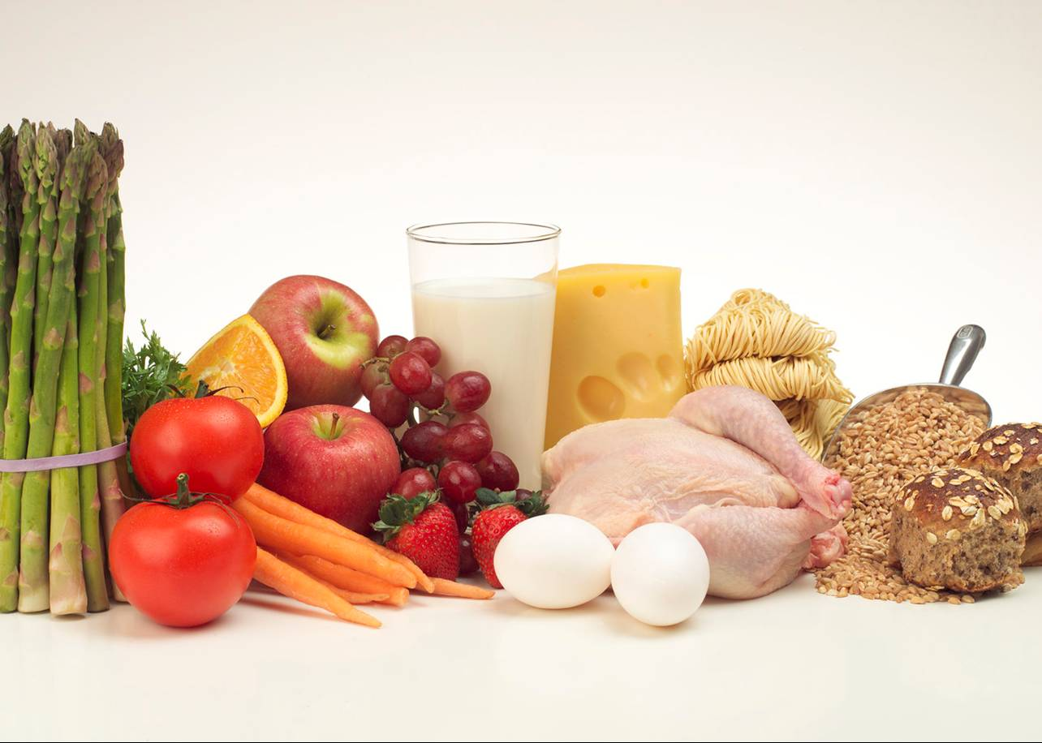
NEWS
What´s new?
Slovakia cut VAT from 20% to 10% on food products
The Slovak government decided to reduce the value-added tax (VAT) on a number of food products (fresh bread, butter, freshwater fish, meat and milk) from the rate of 20% to 10 %. The reduction became effective on January 1, 2016.
Source: https://www.weforum.org/agenda/2015/08/which-countries-waste-the-most-food/

Slide 17
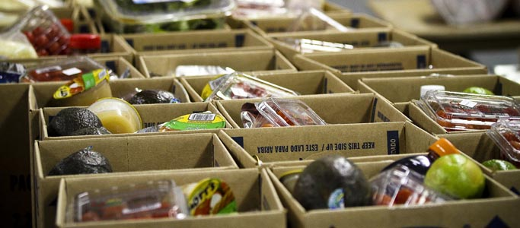
NEWS
What´s new?
Giving away food after its best-before date
According to the Food Amendment Act of 29 November 2016 adopted by the National Council of the Slovak Republic, foodstuff after best-before dates can be given to charity.
In 2015, only grocery retail chains of the Slovak Alliance of Modern Commerce (SAMO) - Billa, Kaufland, Lidl, Metro and Tesco - had to dispose of nearly 15.000 tons of food of 12,5 million euro value. The leftovers include namely non-perishable goods such as flour, pasta, sweets or health safety beverages.
The aim of this amendment is to contribute to reducing of food waste.
Source: https://www.weforum.org/agenda/2015/08/which-countries-waste-the-most-food/

Slide 18
NEWS
Free of charge supply of food to the Slovak Food Bank –no obligation to pay VAT to the state budget
According to the guideline issued by the Slovak Financial Directorate, a VAT payeris not obliged to pay VAT when donating food to the Slovak Food Bank, provided they meet certain conditions. The conditions are that the VAT payer must have claimed input VAT during the purchase of the donated items and the statutory threshold of EUR 17 for one donated item without VAT is not exceeded.
The first Food Banks, which were created to stop food going to waste, emerged in the United States in 1967. After 20 years the Canadian and the US model crossed the ocean and also started in Europe. The Slovak Food Bank with its headquarters in Košice is helping the needy all over Slovakia. The bank collects food that retail chains and food producers are unable to sell, but which is still of merchantable quality. This food is distributed to charitable organizations.
Source:http://www.pbs.sk/onas.php

Slide 19
GOOD PRACTICES FROM SLOVAKIA
Kaufland Slovakia
Charity food collection 2016
Partner: Slovak Red Cross
3-years history of this collection
From more than 26 tons of food collected, Kaufland Slovakia has prepared 1,523 food packages to help lone citizen or families in need.
Kaufland donated to the collection another 10 tons of food = 600 more food packages for people in need.
Facts:
Food was received from 11,612 donors
On average 4 pieces of food were donated by 1 person
This food collection helped 2,123 beneficiaries in need
Each of them received circa 28 pieces of food in a package
Kaufland Slovakia donated food worth of more than 400 000 EUR in 2014 to people in need.
Source: http://instoreslovakia.sk/2016/11/kaufland-36-ton-darovanych-potravin-ludi-nudzi/

Slide 20
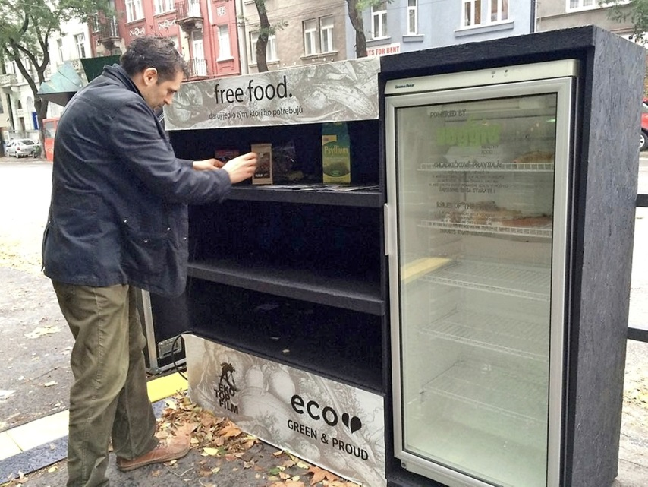
GOOD PRACTICES FROM SLOVAKIA
Slovak project – Free Food
Food Waste is a civic organization that tries to fight a food waste in Slovakia
They organized a joint cooking, screening of documentary about dumpster diving, they collected food for hostel Sv. Vincent de Paul ...
They are currently working on project Public Fridges (refrigerators) and they are developing an application on food sharing.
In public fridges people can insert the food that has not been consumed by themselves and anyone can take it. It is one of the ways how to alert the public about the danger of food waste.

Slide 21
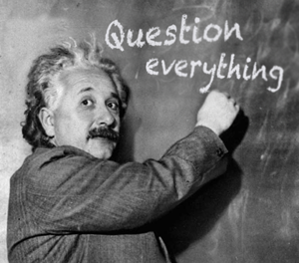
Q & A
ANY QUESTIONS OR COMMENTS?

Slide 22
THANK YOU
....for your attention.
Tatiana Čaplová
Program Coordinator
Pontis Foundation / Business Leaders Forum
tatiana.caplova@pontisfoundation.sk
Made from 100 % recycled material found on WWW. Thank you to the people who made it. ☺

