Slide 1
Diversity and CSR– LUM Jean Monnet University
LA Zagreb 01/02/2017

Slide 2
Initiative | Introduction | Entry into force | Degree of binding | Issuer | Disclosure requirements
Social Report In Public Administration |  | 2006 | Voluntary | Government of Italy | Yes
Law No. 15/2009 "Optimisation of productivity of public work and efficiency and transparency of the public administration |  | 2009 | Mandatory | Government of Italy | Yes
Memorandum of Understanding Between the Ministry of Economy and Finance and the Association of Banking Foundations and Savings Banks (ACRI) |  | Apr, 22, 2015 | Conditionally Mandatory | Government of Italy | Yes
Legislative Decree no. 254 - Implementation of Directive 2014/95/EU | Dec, 30, 2016 | Jan, 25, 2017 | Mandatory | Government of Italy | Yes
Directors’ report on financial statements, 2009 |  | Mar, 11, 2009 | Voluntary | Italian Accounting Association | Yes
Data courtesy of eRevalue

Slide 3
Data courtesy of eRevalue

Slide 4
Data courtesy of eRevalue

Slide 5
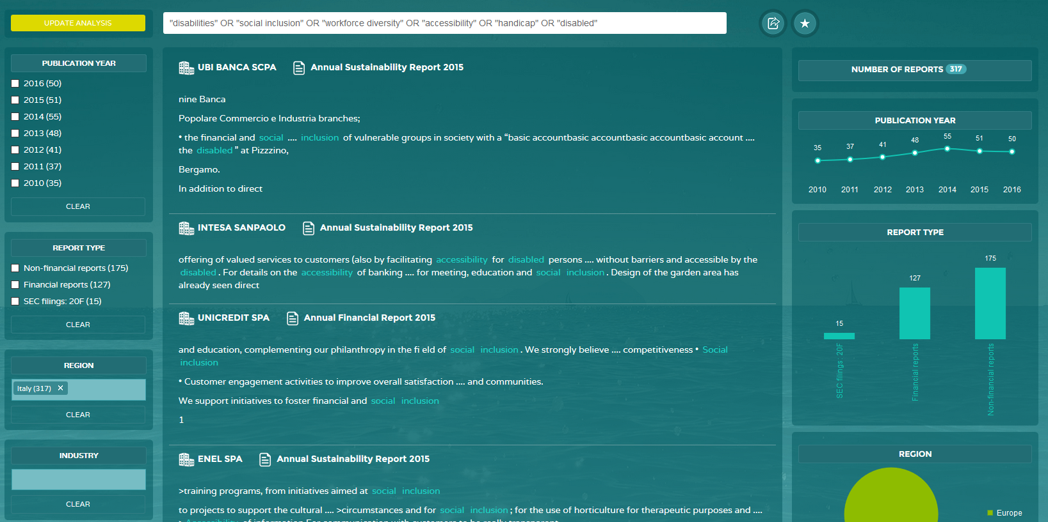
Data courtesy of eRevalue

Slide 6
The legislative decree 81/2015 – Jobs Act, introduces a mandatory requirement to employ people with disabilities with different quotas according to the size of the company
15-35 employees: 1
36-50 employees: 2
> 50 employees: 7% of the total employees

